Slide 1


Workplace drug & alcohol Policy Workshop
Jo McGuire, CPCT
jo@jomcguire.org

Slide 2


today’s goals
value of policy
understand Nevada law
review best practices
earmarks of a good policy
policy content

Slide 3

disclaimer. not a lawyer
All information provided by Jo McGuire, Inc. and its principles/agents and employees, whether verbal or written; is not intended to provide legal advice.
Although we go to great lengths to make sure our information is accurate and useful and our interpretation of it is appropriate to your particular situation, we recommend that you contact your attorney with your legal questions and concerns.
Reliance upon information provided by Jo McGuire Inc., its principals/agents or employees for legal advice is unfounded.

Slide 4

pre-work
some things to know first

Slide 5
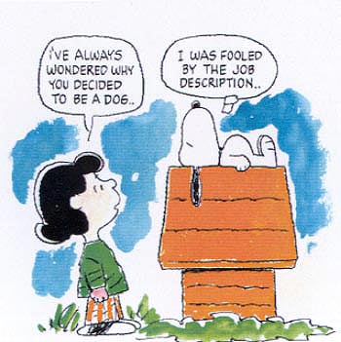
position descriptions
define who is safety sensitive and who is not
EEOC – must be able to show that the employee’s inability or impaired ability to perform job-related tasks could result in a direct threat
*articulate why each position description should/may not operate under-the-influence of drugs/alcohol

Slide 6

things to consider
DO NOT implement a drug/alcohol testing program without a policy in place that has been communicated to your workforce
avoid “case-by-case” scenarios as a policy catch-all
under-the-influence vs. impaired
use certified collections professionals
use the correct testing products
perform the right type of drug test
use an MRO

Slide 7
best practices
good to know

Slide 8

a word about D.O.T.
U.S. Department of Transportation C.F.R. 49 Part 40
if you have D.O.T. and non-D.O.T. employees
you must have TWO separate workplace
drug & alcohol policies. One specifically
for D.O.T. employees and one
specifically for non-D.O.T. employees
www.odapc.gov

Slide 9
a word about D.O.T.
U.S. Department of Transportation C.F.R. 49 Part 40
best practice
federal mandates
only rule of law in the U.S. pertaining to the full body of workplace drug & alcohol testing
repeatedly upheld in courts of law
a very good model for your policy
www.odapc.gov

Slide 10

what’s the big deal about a policy?
your policy is your company’s rule of practice
provides clarity of expectations
outlines consequences for violations
creates accountability
addresses issues pertaining to liability

Slide 11

what’s the big deal about a policy?
Garcia v. Tractor Supply Company
Roe v. TeleTech Customer Care Management
Emerald Steel Fabricators, Inc. v. Bureau of Labor and Industries
Barrett v. Robert Half Corp
Ross v. Raging Wire Telecomm, Inc.
Casias v. Wal-Mart Stores, Inc.
Coats v. Dish Network
http://www.naag.org/publications/nagtri-journal/volume-1-number-2/the-effects-of-marijuana-legalization-on-employment-law.php

Slide 12

winds of change
Callaghan v. Darlington Fabrics Corp, RI Superior Court, 2017
Barbuto v. Advantage Sales & Marketing MA Supreme Judicial Court, 2017
Noffsinger v. SSC Niantic Operating Company, CT U.S. District Court, 2018
Terry v. United Parcel Service Incorporated, AZ U.S. District Court, 2019
Wild v. Carriage Funeral Holding, Inc, NJ Superior Court, 2019
New Jersey Compassionate Use MMJ Act
Arkansas Medical Cannabis ACT
OK Unity Bill
NYC Job Applicant Testing Barred unless safety-sensitive
Deitchler D, McKenna E. Insight. Littler. [Online] January 11, 2019. [Cited: August 28, 2019.] littler.com/publication-press/publication/connecticut-continues-extend-protections-employees-under-state-medical.

Slide 13

what’s the big deal about a policy?
Safe & Drug Free Workplace
Workers Compensation
State laws
Reasonable Cause Situations
Liability Issues

Slide 14
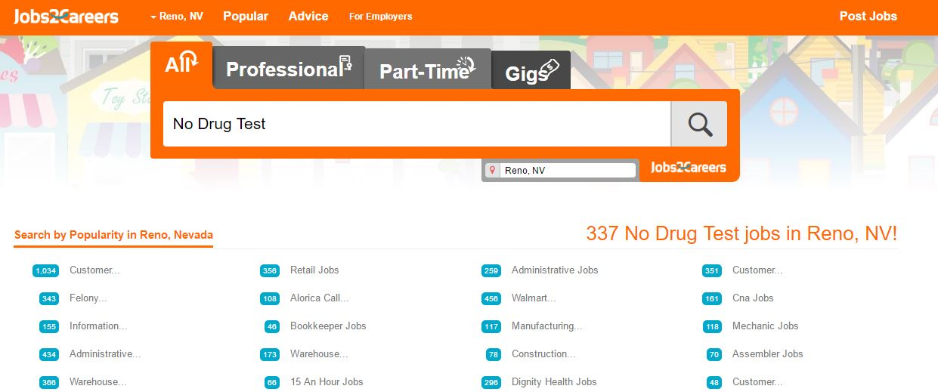
what’s the big deal about a policy?
people in the community know whether or not your company is “drug-friendly”

Slide 15

flexibility. change it up
think of your policy as a “living/breathing” document
review annually
change it when necessary
sometimes trends don’t last – but sometimes they become ingrained
common sense decisions don’t necessarily require policy changes

Slide 16
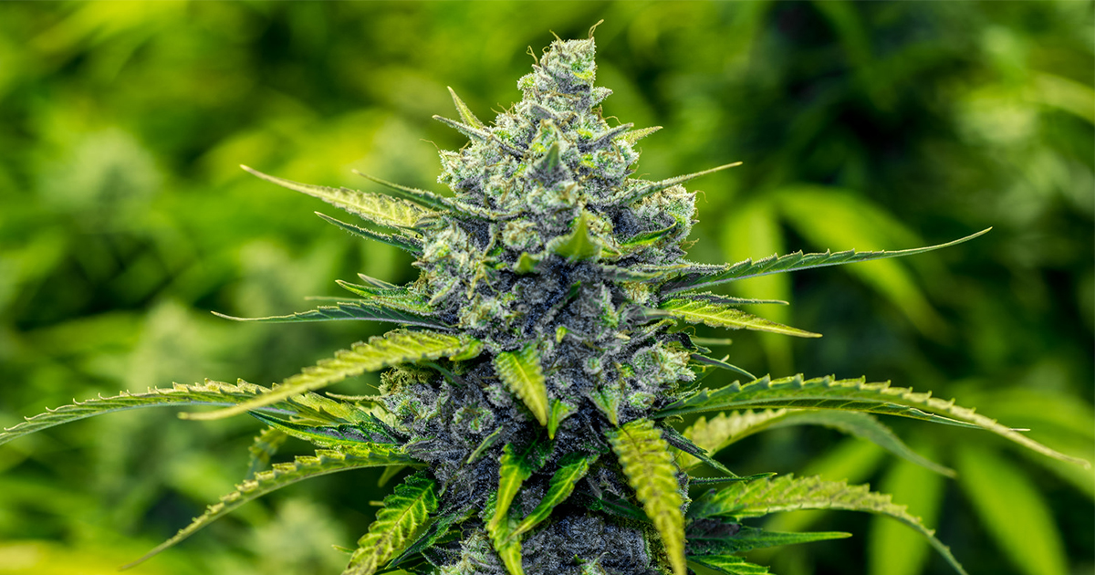
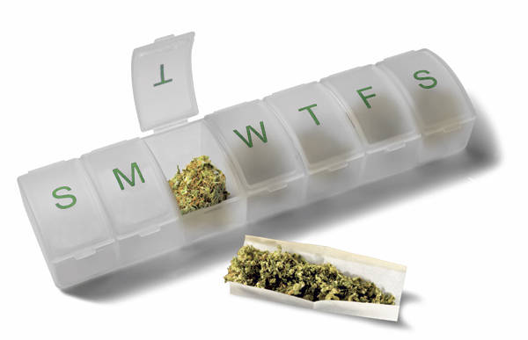
medical marijuana accommodation
if you choose to make allowances in your policy:
be very specific
be consistent
safety sensitive does not qualify
keep detailed documentation of accommodations

Slide 17
state laws

Slide 18

illinois law
Illinois does not encourage OR prohibit testing
Employers have the right to a drug-free workplace
It is not illegal for employers to require testing for those who have been or are in a drug rehab program
There *IS* a discrimination law
Prescribed medication = ADA protections
Singling out protected groups (age, race, gender, etc.)
Protect privacy
https://www.nolo.com/legal-encyclopedia/illinois-drug-testing-laws.html
https://www.loriecker.com/employee-rights/drug-testing-workplace
https://www.goldmanandehrlich.com/drug-testing-look-like-illinois/

Slide 19
illinois law
A potential employee can be drug tested providing they have been given a conditional job offer based upon the drug testing results.
Any employer that receives funding from the federal government must require drug test of all potential employees.
Employers desiring to receive the funding to promote their drug-free work environment must comply with specific rules that include posting or publishing a notification of their policy for a drug-free work environment.
Employer’s receiving funding must set up an awareness program delineating the harmful effects of drugs.
https://www.nolo.com/legal-encyclopedia/illinois-drug-testing-laws.html
https://www.loriecker.com/employee-rights/drug-testing-workplace
https://www.goldmanandehrlich.com/drug-testing-look-like-illinois/

Slide 20
illinois law
Employers must provide a written policy of drug-free regulations to each employee and post a copy of the regulations where all employees will have access to it.
Employers must provide a written statement of the penalties imposed for failure to pass a drug test.
Employees testing positive for drugs or alcohol must be given the opportunity for rehabilitation, counseling, and treatment.
Potential employees who fail the drug tests will have their job offer withdrawn.
https://www.nolo.com/legal-encyclopedia/illinois-drug-testing-laws.html
https://www.loriecker.com/employee-rights/drug-testing-workplace
https://www.goldmanandehrlich.com/drug-testing-look-like-illinois/

Slide 21
ADA law
DOES NOT:
require any employer to accommodate/allow the medical use of marijuana in the workplace
require an employer to modify the job or working conditions of a person who engages in the medical use of marijuana that are based upon the reasonable business purposes of the employer
BUT the employer must *attempt to make reasonable accommodations for the medical needs of an employee who engages in the medical use of marijuana if the employee holds a valid registry identification card, provided that such reasonable accommodation would not:
pose a threat of harm or danger to persons or property or impose an undue hardship on the employer
prohibit the employee from fulfilling any and all of his or her job responsibilities.
*must “attempt” to meet the needs

Slide 22
ADA law
does NOT require an employer to:
provide health care to pay for medical marijuana
allow the use of medical marijuana at work
modify the job or working conditions of a person who uses medical marijuana
IF the modification
creates a threat of harm to persons or property
creates an undue hardship for employer
prohibits the employee from completing any assigned duties & responsibilities

Slide 23

medical marijuana accommodation
some examples of “reasonable accommodations” by EEOC:
allow the employee to work from home
make existing facilities readily accessible by individuals with disabilities
job restructuring to p/t or modified work schedules; reassignment to a vacant position
acquisition or modification of equipment or devices
appropriate adjustment or modification of examinations, training materials or policies,
provide qualified readers or interpreters

Slide 24
illinois law
Against the law in IL to possess, manufacture or sell substances or methods that help people cheat on drug tests. This includes synthetic urine, adulterants, or devices intended to help people smuggle these things in.
Illegal to substitute or adulterate your specimen.
For the purposes of this Section, ‘drug or alcohol screening test’ includes, but is not limited to, urine testing, hair follicle testing, perspiration testing, saliva testing, blood testing, fingernail testing, and eye drug testing.
A violation of this Section is a Class 4 felony for which the court shall impose a minimum fine of $1,000.
Public Act 093-0691
https://www.inoutlabs.com/drug-test-test-cheating-felony/

Slide 25
earmarks of a good policy
making sure there is value in it

Slide 26


your workplace drug & alcohol policy
create culture
clarity
complete
consistent
communicate it

Slide 27

your workplace drug & alcohol policy
create culture
set the tone you desire for your company environment
what are your company values?

Slide 28

your workplace drug & alcohol policy
clarity
what are violations?
what are consequences?
do NOT be vague

Slide 29

your workplace drug & alcohol policy
complete
avoid gaps
leave yourself opportunities

Slide 30

your workplace drug & alcohol policy
consistent
commit to the policy
follow-through. every. single. time.

Slide 31
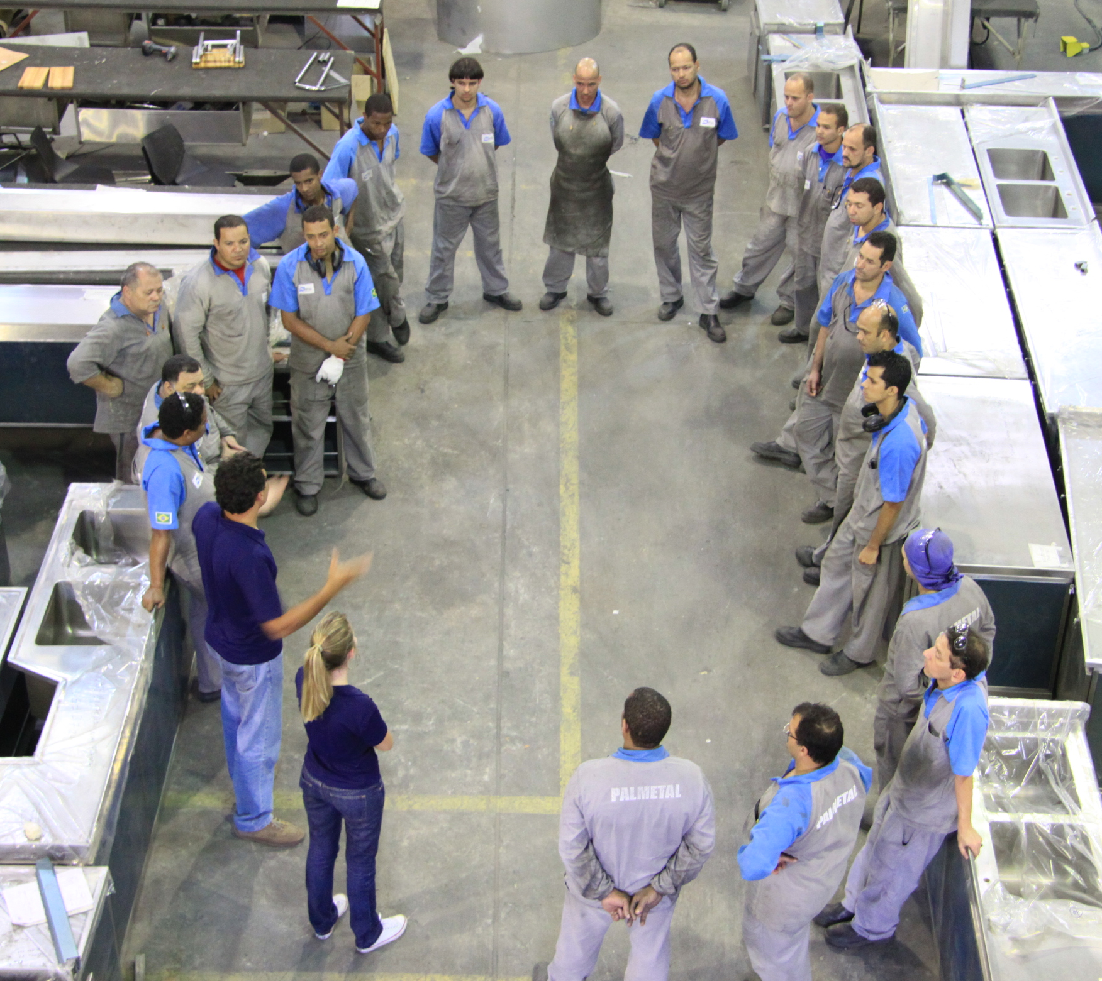
your workplace drug & alcohol policy
communicate
plan for communication company-wide
review, repeat, reiterate, remind

Slide 32
policy content
putting it all together

Slide 33

questions to answer
what is your purpose – or – the mission statement for your D&A policy?
how will you make your employees aware of your policy?
what are the boundaries & expectations?
to whom does your policy pertain?
when, why & how will you test for substances?
which substances will be subject to testing?
what are the consequences for policy violations?
what resources will you provide for those who violate the policy?

Slide 34

purpose/mission statement
explicitly describe your agency's mission; how will substance use impact the accomplishment of that mission?
review the adverse impact substance use has/could have on your agency
think about personnel records, security clearance revocations, EAP records, Merit Systems Protection Board actions, and other relevant items to glean examples regarding past public health, safety or security risks
large numbers are neither necessary nor essential. The preamble focuses on the magnitude of risk for even one employee

Slide 35
purpose/mission statement
[Company Name] is committed to protecting the safety, health, and well-being of its employees and all people who come into contact with its workplace(s) and property, and/or use its products and services. Recognizing that drug and alcohol abuse pose a direct and significant threat to this goal, [Company Name] is committed to ensuring a substance-free working environment for all of its employees.

Slide 36
purpose/mission statement
[Company Name] has a vital interest in maintaining a safe and efficient environment for its employees, clients and customers. Employees who are under the influence of drugs or alcohol on the job pose serious safety risks not only for the user but also to co-workers and others. The possession, use or unauthorized sale of an illegal drug or alcohol may also pose unacceptable risks for safe and efficient operations. Accordingly, it is the right, obligation and intent of the Company to maintain a safe and healthy environment for all of its employees and guests and to protect Company property, equipment and operations.
The Company has adopted a drug-free workplace policy to ensure that our business is functioning safely, efficiently and cost-effectively. In doing so, the Company will comply with all federal and state drug-free workplace requirements.

Slide 37

employee awareness
new employee interviews
handbook sign-off sheet
orientation
job performance reviews
company-wide meetings
safety meetings
team meetings
reminders whenever pertinent

Slide 38

who qualifies?
to whom does your policy apply?
is anyone exempt?
f/t and p/t
contractors & sub-contractors
seasonal employees
vendors
applicants

Slide 39
who qualifies?
This policy applies to all job applicants, full-time and part-time employees and contract employees of the Company when they are on Company business or on Company premises, including but not limited to all properties, facilities, land, platforms, buildings, structures, fixtures, installations, automobiles, trucks and other vehicles whether owned, leased or used by the Company or for Company purposes.
This policy also covers the use of drugs or alcohol while off Company premises if the employee is "under the influence," as defined in this policy, when representing the Company. All Company property will be subject to search at the discretion of the Company.
Additionally, regardless of the event or situation employees are always responsible for their actions and behavior at Company-related events or activities.

Slide 40
who qualifies?
Applicants
All applicants are covered by this policy insomuch as the Company has extended a conditional offer of employment and a pre-employment drug test is required.
Applicants are not entitled to Company-paid retests or any other services that may be made available to employees in this policy unless stipulated by applicable state or federal law.

Slide 41

boundaries/expectations
what is acceptable behavior and what is not
drugs (illicit, prescription, synthetic)
alcohol
paraphernalia
under-the-influence
unsafe behaviors

Slide 42
boundaries/expectations
The Company employees are prohibited from:
Being under the influence of drugs as defined in this policy (i.e., a confirmed positive drug test and/or demonstrating the signs and symptoms of being under the influence of drugs);
Being under the influence of alcohol as defined in this policy (i.e., a BAC of 0.02 or higher as demonstrated by an alcohol test and/or demonstrating the signs and symptoms of being under the influence of alcohol). (See the Alcohol Use Exceptions section of this policy.);
Testing positive for drugs or alcohol;
Failing to notify a supervisor or manager if the employee believes that he or she is under the influence of drugs or alcohol;

Slide 43
boundaries/expectations
Bringing illegal drugs, alcohol, controlled substances or drug paraphernalia to work and/or storing such items on Company property;
Possessing, using, manufacturing, distributing or attempting to distribute, sell or dispense drugs or controlled substances off Company property that may adversely affect the Company, the worker’s job performance, or place at risk the safety or wellbeing of the worker or others.
Abusing prescription drugs, which includes exceeding the recommended prescribed dosage or using others’ prescribed medications;
Switching, tampering with or adulterating any specimen or sample collected under the Company’s policy for the purpose of testing for drugs or alcohol;

Slide 44
boundaries/expectations
Disclosing information related to a drug or alcohol test result, and/or substance abuse treatment referrals, except as required by this policy;
Refusing to cooperate with the terms and conditions of this policy. Failure to cooperate includes, but is not limited to:
Refusal to be tested
Failure to provide an adequate sample without a valid medical excuse
Refusal to sign required paperwork (including, but not limited to, consent forms, acknowledgement forms, and chain of custody forms)
Failure to show up at an assigned collection site to provide a specimen
Failure to be reasonably available to be tested once the employee has been notified

Slide 45
boundaries/expectations
Alcohol-Use
Alcohol use will not be tolerated at the workplace, but may be permitted at the discretion of management when employees are representing the Company during professional functions. However, alcohol consumption by employees will not be permitted on Company property. The Company expects employees to exercise good judgment at all times when representing the Company. At no time are employees permitted to be under the influence of alcohol or to operate a motor vehicle while under the influence of alcohol.
Alcohol-Use Circumstances | Company Policy
Will on-duty alcohol use be permitted? | No
Who can/must authorize on-duty alcohol use? | [Name of Supervisor]
Will drinking be permitted at Company-sponsored events? | Yes, At the discretion of management
Will drinking be permitted at professional functions/meetings? | Yes, At the discretion of management
Will drinking be permitted while traveling and/or entertaining on behalf of the Company? | Yes, At the discretion of management
Will the company pay for transportation expenses for an employee who is unable to drive? | Yes
Are employees permitted to consume alcohol and operate a company vehicle? | No

Slide 46
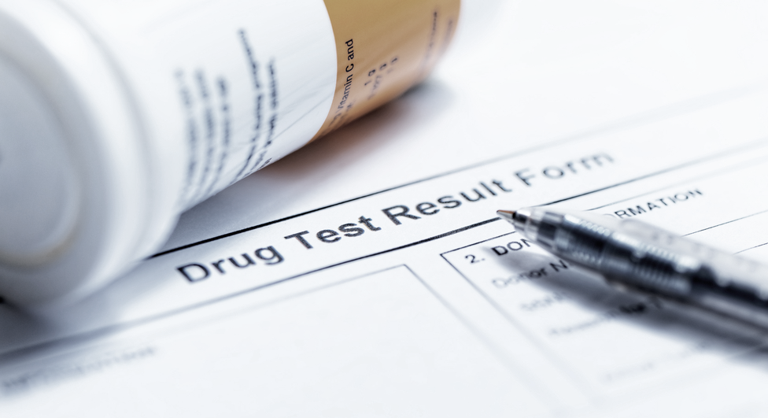
why will you test?
drug testing is a vital piece of a viable policy
it is the tool that enforces the words on the page
consider any union agreements/obligations

Slide 47
why will you test?
pre-employment – upon conditional offer of employment
random – must be scientifically selected
post-accident – define what constitutes an accident
reasonable suspicion/cause – define conditions and who can determine
return-to-duty – following a failed drug screen, if allowed to return to work
follow-up – series of random drug tests TBD by the SAP

Slide 48
why will you test?
Pre-Employment Drug Testing
All applicants for employment with the Company, including applicants for safety-sensitive positions, will be required to submit to a drug test once a conditional offer of employment has been extended and accepted. All offers of employment are contingent on a negative test result. Applicants will be required to sign an acknowledgement and consent form.
A positive drug test, failure or refusal to participate in a drug test, failure to sign the acknowledgement and consent form, or any effort to tamper with a sample or to alter a test result will disqualify an applicant from employment. Candidates that fail the pre-employment drug test may not re-apply or be considered for employment for one year.
Applicants previously employed by the Company, regardless of the length of time they were away, will be subject to a pre-employment drug test as outlined above.

Slide 49
why will you test?
Random Drug Testing
The Company reserves the right to conduct random testing. When random testing is conducted all employees may be subject to random, unannounced drug testing.
Employees subject to random testing will have an equal probability of being neutrally selected for such testing. The Company does not have the right to waive the selection of any employee who has been randomly chosen.
Random tests will be unannounced and performed at reasonable intervals throughout the year. The selection of employees for random drug and alcohol testing will be made by a scientifically valid method, such as a random number table or a computer-based random number generator that is matched with employee identification numbers (i.e., Social Security numbers, payroll identification numbers, or other comparable identifying numbers).

Slide 50
why will you test?
Random Drug Testing (cont)
Random testing will be conducted at a frequency rate of 50 percent, meaning that the Company will conduct random testing of 50 percent of the total number of employees in a given year. The names of individuals who are randomly selected for testing will be returned to the eligibility list for future selection during the same year.
Whenever an employee is selected for a random test, he or she will be notified of the selection and instructed to report to a collection site within 15 minutes (plus travel time). If the individual is performing a safety-sensitive function, other than driving a commercial motor vehicle, at the time of notification, the employee must cease performing the safety-sensitive function and proceed to the testing site as soon as possible.

Slide 51
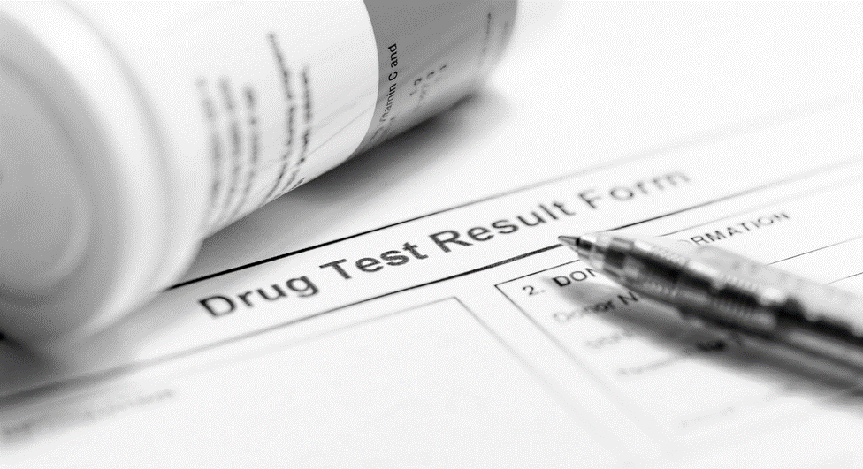
when will you test?
how often will you run a random pool?
annually, bi-annually, quarterly, monthly
who will make the frequency determination?
who will run the random pool? (TPA, HR Manager)
avoid predictability of timing

Slide 52
why will you test?
Post-Accident Drug & Alcohol Testing
All employees who are believed to have caused an accident during work time or while on Company business or on Company property, regardless if an injury occurs or not, will be subject to a drug and/or alcohol test.
Accidents that include any of the following will result in a drug and/or alcohol test:
A fatality
Any injury that requires medical attention away from the scene of the accident
An injury that results in lost work time
Damage to Company in the amount of $_____
A post-accident drug test must take place within 24 hours of the time of the accident. A post-accident alcohol test must take place within 8 hours of the time of the accident. Any employee who fails to report a work-related accident is in violation of this policy and is subject to disciplinary action up to and including termination.

Slide 53
why will you test?
Reasonable Suspicion Drug and Alcohol Testing
Employees will be required to submit to a drug and/or alcohol test when a trained supervisor or manager has a rational basis, whether from direct observation or from the reports of others, to believe that an employee has violated this policy or is under the influence of legal or illegal drugs or alcohol that has an impact on the individual or the work environment. Reasonable suspicion will be documented and not based on rumor, speculation, or unsubstantiated information. Referrals will be made according to the procedures set forth by the Company.
Behavior that could prompt reasonable suspicion of drug or alcohol use in violation of the Company’s policy includes, but is not limited to, the following:
Direct observation of reckless or risky behavior, that may indicate an individual is impaired by or under the influence of intoxicants or illegal drugs;
Direct observation of speech, odor or appearance that may indicate an individual is impaired by or under the influence of intoxicants or illegal drugs;

Slide 54
why will you test?
Reasonable Suspicion Drug and Alcohol Testing (cont)
Reports or information that an individual was seen taking, selling, dispensing, or using illegal drugs, or telling other employees of being involved in such activities
Evidence of an attempt to alter a drug or alcohol test sample or result; and/or
Patterns of abnormal/erratic conduct such as, but not limited to, increased absenteeism, excessive tardiness, or lack of expected or required work performance.
Reasonable suspicion does not mean that the Company must be correct in its belief, only that it has some rational basis for believing the employee is somehow involved in the use, sale, or possession of drugs and/or alcohol.
If the individual is to be sent home after providing a sample, the Company will make arrangements to get them home. For liability reasons it is not acceptable for a Company representative to drive the employee home.
Under no circumstances is the individual allowed to drive home if he or she may be under the influence.
If the individual insists on driving home, the Company is obligated to notify local police.

Slide 55
when will you test?
who will determine reasonable suspicion?
does a supervisor need to verify?
does a second party need to witness?
what training is required for supervisors?
what documentation is required?

Slide 56
why will you test?
Return-to-Duty and Follow-up Drug & Alcohol Testing
Any employee who has been removed from work to enter drug or alcohol treatment must submit to and provide a negative drug test result prior to returning to his/her job duties. Employee must provide a release statement indicating that the individual has completed a treatment program.
Employees who successfully complete substance abuse treatment may be eligible for reinstatement and, if re-instated, will be subject to follow-up unannounced testing. Employees will be subject to follow-up drug or alcohol testing (or both depending on what substance or substances they were being treated for) according to the recommendations of their medical provider or at the discretion of the Company.

Slide 57

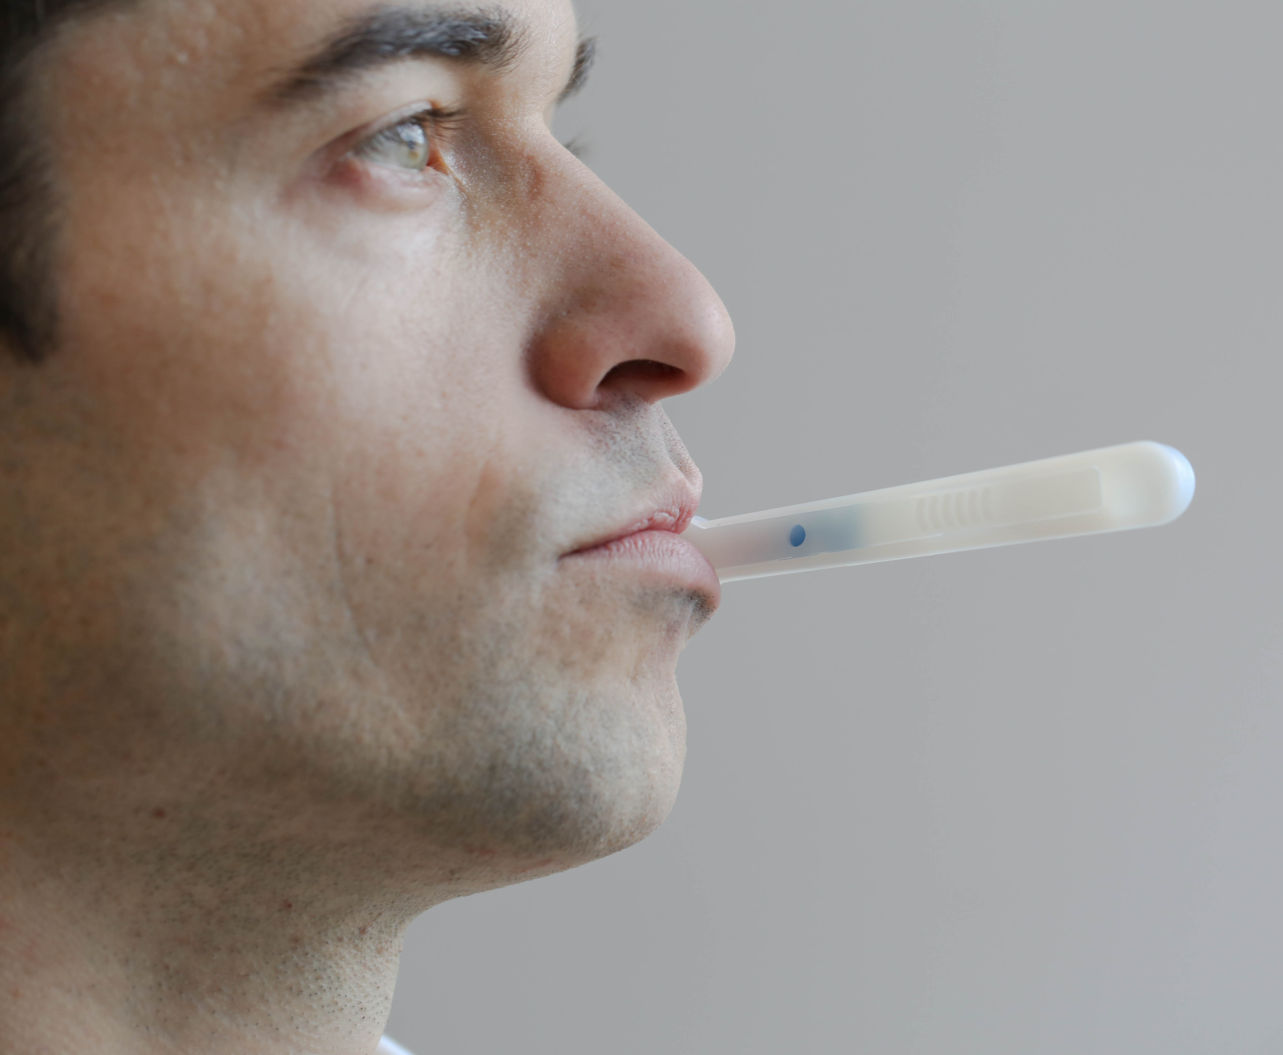
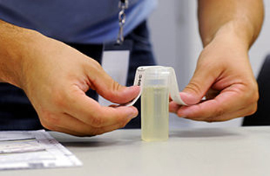
how will you test?
what type of test meets your needs?
Urinalysis
hair
oral fluid/saliva
instant test
lab-based test
lab confirmation only
what panel of drugs?
certified collections professionals

Slide 58
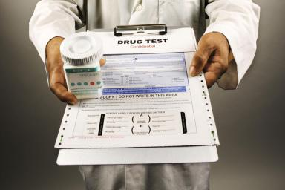
how will you test?
All sample collection and testing for drugs and alcohol will be performed according to the following conditions:
Collection—The collection of samples shall be performed under reasonable and sanitary conditions.
Chain-of Custody—Sample collections will be documented and these documentation procedures will include both of the following:
(a) Labeling of samples in order to reasonably preclude the possibility of misidentification of the person tested in relation to the test result provided.
(b) An opportunity for the person to be tested to provide any information that may be considered relevant to the test, including identification of currently or recently used prescription or nonprescription drugs or other relevant medical information.

Slide 59

testing procedures
Integrity of the Process—Sample collection, storage and transportation to the place of testing shall be performed in a manner reasonably designed to preclude the possibility of sample contamination, adulteration or misidentification.
Certified Laboratory—Sample testing will comply with scientifically accepted analytical methods and procedures. When drug testing is conducted at a laboratory, the lab will be approved or certified by the U.S. Department of HHS, the College of American Pathologists or the DHS
Instant-Result Testing—When drug testing is conducted using instant-results, point-of-collection devices, the device used will be cleared by the U.S.F.D.A. with laboratory confirmation.
Confirmation Testing—Drug testing will include confirmation of any positive drug test results for employees. Confirmation of positive drug test results for employees will be by use of a different chemical process than was used in the initial drug screen. The second or confirmatory drug test will be gas chromatography-mass spectrometry (GC/MS) or another comparably reliable analytical method.

Slide 60
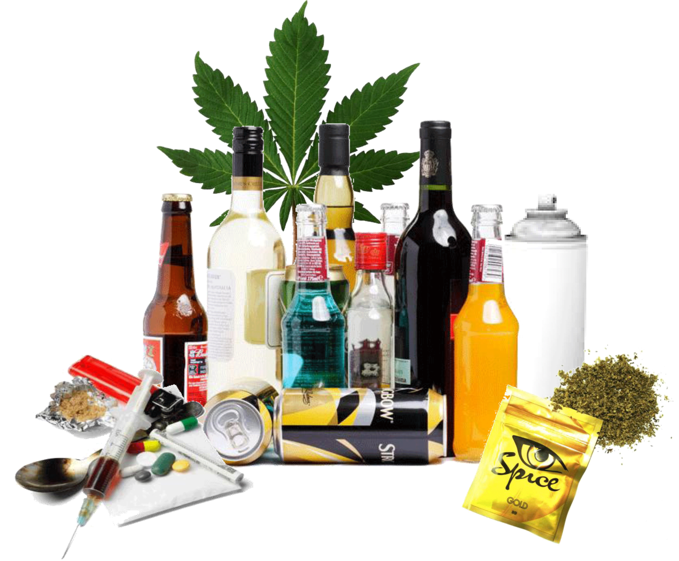
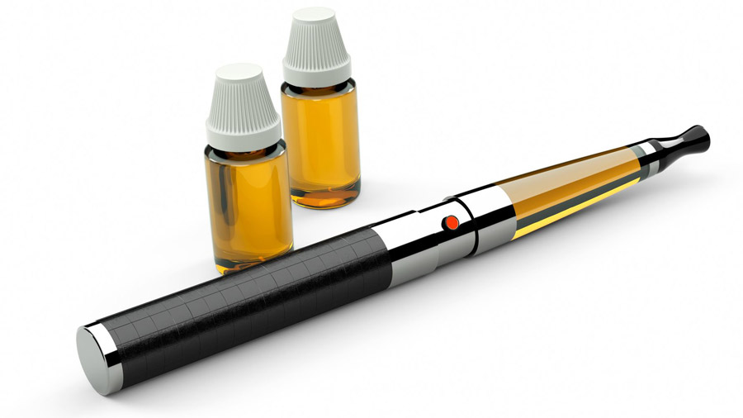
substances to be tested
The Company will test individuals for drugs utilizing urine and oral fluid testing technologies, both in a laboratory and with instant-result, point-of-collection devices. The Company reserves the right to utilize other testing technologies in accordance with applicable laws and when circumstances require an alternative. The Company will test for the following drugs:
Amphetamines, Methamphetamine, Cannabinoid (marijuana), Cocaine, Opiates, Opioids, Barbiturates
Benzodiazepine, Methadone, Phencyclidine (PCP) , MDMA, or any other altering substances, non-medical use of prescription drugs or prescription medications not used by pharmacist’s instructions
An individual who tests positive for any of the substances cited above will be subject to adverse employment action. (See the Consequences section of this policy for more information.)
Q: will you test for nicotine? will you allow e-cigarettes/vape devices?

Slide 61

substances to be tested
Marijuana Federally Illegal Medical Review Officers will not verify a drug test as negative based upon information that a physician recommended that the employee use “medical marijuana.”
Marijuana remains a drug listed in Schedule I of the Controlled Substances Act.
It remains unacceptable for any safety‐sensitive employee subject to drug testing under the Company’s drug testing regulations to use marijuana.
The federal language alone does not protect you … there must be specific parameters & consequences listed pertaining to this language.

Slide 62

substances to be tested
Alcohol
The Company will test individuals for alcohol utilizing breath testing technologies. The Company reserves the right to utilize other testing technologies in accordance with applicable laws and when circumstances require an alternative. A blood alcohol content (BAC) level up to 0.019 will result in an employee being removed from performing safety-sensitive functions until the individual tests 0.00 BAC. A BAC of 0.02 or higher will be considered a positive result. (See the Consequences section of this policy for more information.)

Slide 63
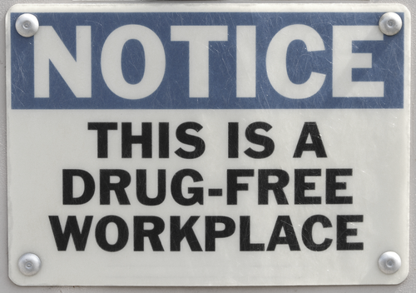
violations/consequences
what are the consequences of violating the policy?
what are the procedures for determining whether an employee has violated the policy?
what are the procedures for appealing a determination that an employee may have violated he policy?
2nd chances? zero tolerance? suspensions?

Slide 64

violations/consequences
Employees who violate any of the conditions of this policy will be subject to adverse employment action up to and including termination at the Company's sole discretion. Employees should understand that certain policy violations such as the use of alcohol (including possession of an open container) unless otherwise approved or any illegal drug activities (including the possession, sale, or use of illegal drugs) on Company premises or on Company time may result in immediate termination. Individuals who refuse to cooperate with the Company’s policy in any way will be subject to immediate termination.
Individuals who test positive for illicit drugs, including marijuana, will be terminated. Individuals who test positive for marijuana and possess a valid medical marijuana card will not be terminated but may be removed from performing certain safety sensitive tasks at the discretion of management. All individuals using medical marijuana, or any other prescription drugs that can cause impairment as stated on the label, may not be under the influence while at work.

Slide 65
violations/consequences
Applicant Positives—Job applicants who test positive will not be hired.
First-time Positives—Individuals who test positive for drugs in violation of this policy will be terminated.
Refusal to Cooperate— Refusal by an employee or prospective employee to provide a sample will result in termination of employment for the employee and the rescinding of a conditional job offer to an applicant.
Tampering and/or Adulteration—Individuals attempting to alter a drug/alcohol test result or test sample by means of tampering with, adulterating, switching, or dilution will be treated as a positive test result.
Suspensions—Employees involved in a post-accident or reasonable suspicion drug/alcohol test will be removed from their positions and suspended until the Company receives the test results. Negative results will be reinstated & paid for time missed during the suspension.
Verified Positive Results – Individual will be subject to adverse employment action up to and including termination.

Slide 66

EAP/SAP
what resources will you provide for those who violate the policy?
explain how to get help
include information on any existing employee assistance program(s)
describe the benefits offered by any existing health insurance plan
identify local resources that may be available
supply a list of treatment providers, substance abuse professionals, AA meetings, NA meetings, any local resources that may be helpful

Slide 67
EAP/SAP
The Company does not maintain an Employee Assistance Program (EAP) but will provide a list of resources. Employees are responsible for all costs associated with substance abuse counseling, treatment or rehabilitation.
Employees will not be discharged, disciplined or discriminated against for voluntarily seeking treatment for a drug/alcohol related problem if that individual has not previously tested positive for drugs or alcohol in violation of the Company’s policy, entered an employee assistance program for substance abuse-related issues, or entered an alcohol and drug rehabilitation program.

Slide 68

ADA considerations
In accordance with the Americans with Disabilities Act, the Company does not discriminate against any qualified individuals with a disability who are not currently using illegal drugs and who have either successfully completed rehabilitation or who may be currently participating in a supervised rehabilitation program and are no longer using illegal drugs. Nothing contained in this policy shall be construed to, or be applied in such a way that its application will, result in discrimination against any individual with a disability or handicap as those terms are defined by the Americans with Disabilities Act.
A current disability of any kind, however, does not entitle an employee and/or job applicant to violate any provisions of this policy.
**MRO – may provide a Fit For Duty exam in cases of behavior that could affect safety

Slide 69

other items
confidentiality
reservation of rights
definitions of terms
acknowledgement/consent
reasonable cause checklist

Slide 70


Slide 71
Workplace drug & alcohol Policy Workshop
Jo McGuire, C-DERT, CPCT
jo@jomcguire.org

