Slide 1


Slide 2
Participant Information
2018
Public School Building IYS Participation by School Level
Middle Schools (8th Grade) |  | High Schools (10th and/or 12th Grade)
N Schools Participating | N Schools Eligible | N Schools Participating | N Schools Eligible
27 | 54 | 16 | 27
Percent Participated: 50% |  | Percent Participated:59%

Slide 3
2018 IYS Past 30 Day Use

Slide 4
Perceived Risk with Use - 2018 IYS

Slide 5
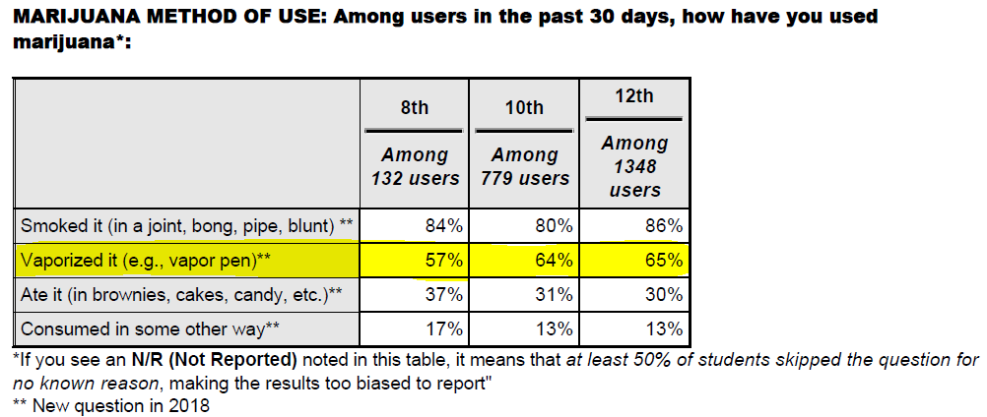

Slide 6

PLT Resource for Schools/Community
Assist with data analysis and presentations
Recommend best practice prevention strategies to implement in schools/communities (code of conduct policies, social norming campaigns, local ordinances, prevention policies)
Coalition of partners who offer direct services (school presentations, parent presentations, substance use and mental health services)

