Slide 1

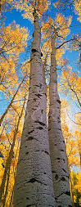
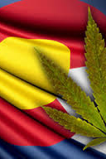

How Will Recreational Marijuana & Vaping Look in Your Community?

Slide 2
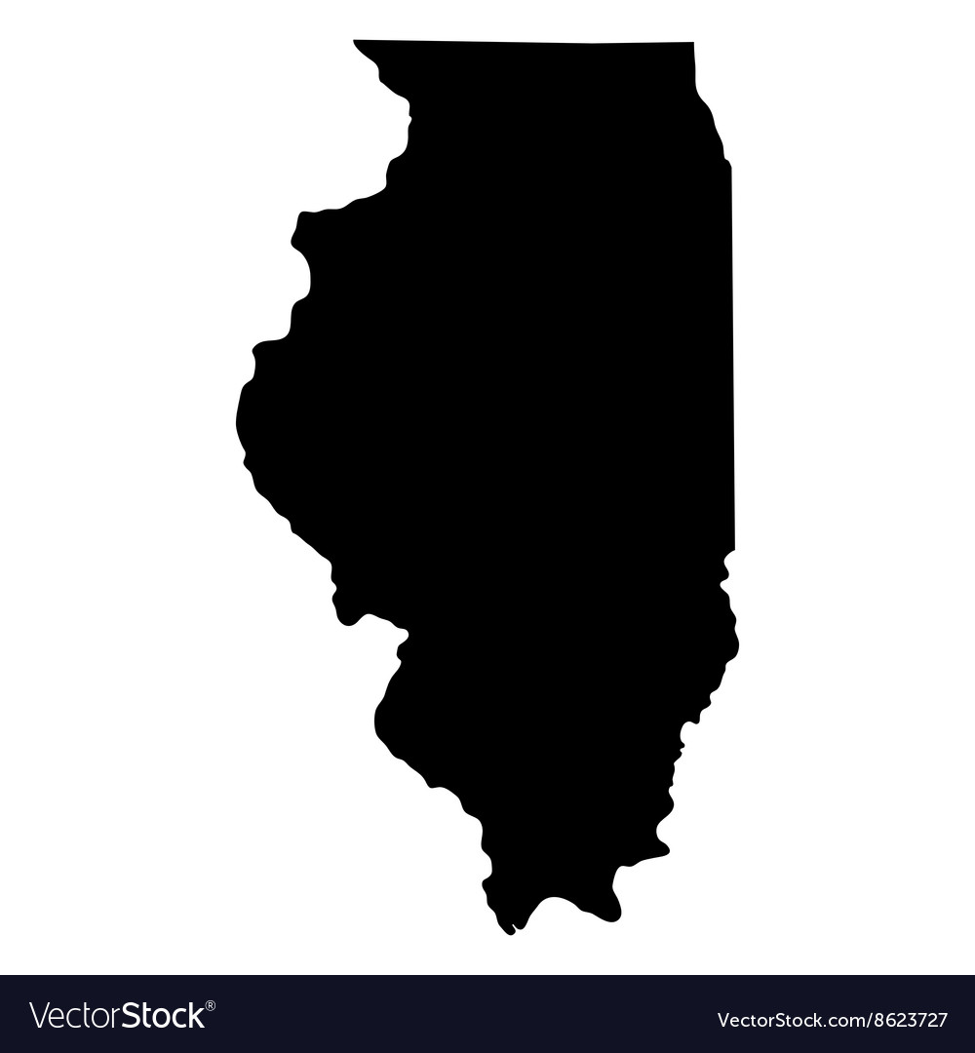


ILLINOIS Specifics
Summary
Types of businesses allowed
Levels of Local Control
Opt-out: prohibit any cannabis related business within your municipality
Opt-in: Determine how many and what kind of cannabis related businesses you will allow / will you allow lounges / onsite consumption?
Moratorium: Opt-out and re-address in a year to see what lessons may be learned from other communities

Slide 3

THINGS TO CONSIDER
TRACK THE COSTS
Keep Public Health & Safety as top priorities
Educational curricula, campaigns and programs
Protecting vulnerable age groups/populations
Compliance enforcement with LE
How to manage home grow violations
Parameters for open-marketing to youth
LIMIT OUTLET DENISITY
Zoning that respects all community members
Prohibit lounges/on-site consumption
Safe Driving education, enforcement & PSA campaign
Emergency services preparedness
Assistance in education for safe and drug free workplaces

Slide 4
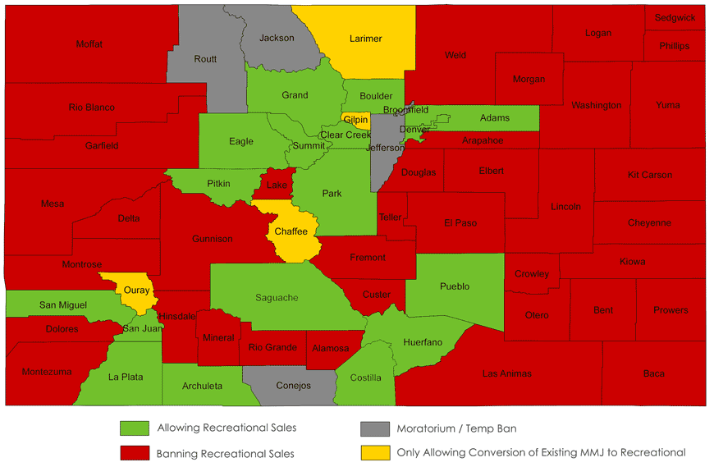
Opting-Out in Colorado
64 Counties Total
42 Opted-out immediately
38 Continue the opt-out currently
4 Reversed after moratorium ended (1-4 years)
13 Counties are “all-in” with all functions/operations
13 Others allow pieces but not all (labs, growing, manufacturing but not retail)

Slide 5

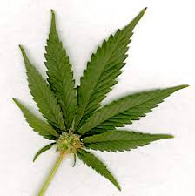

Commercialization
1,004
208
392

Slide 6
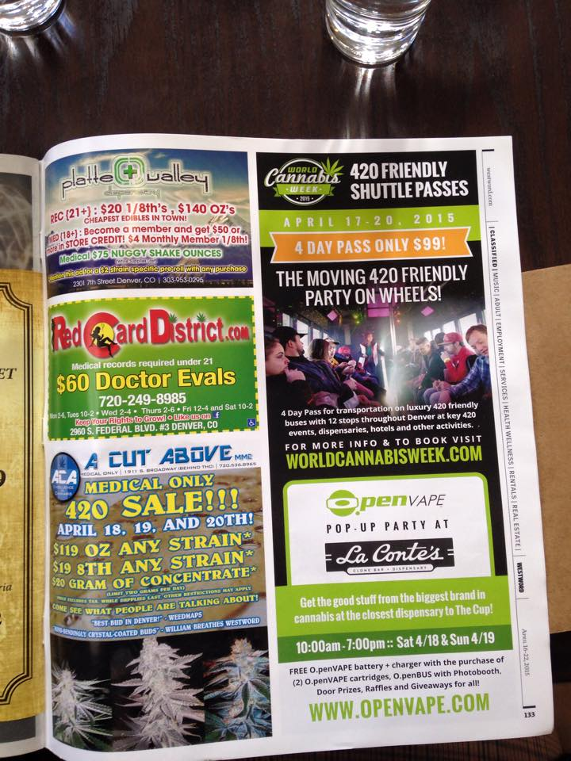
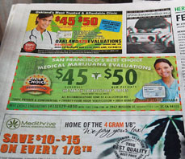

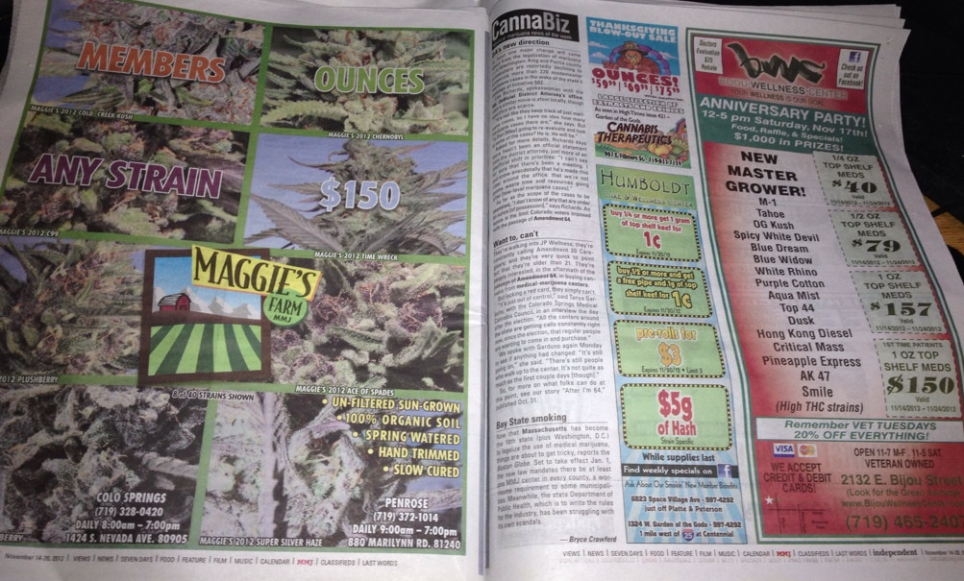

Slide 7
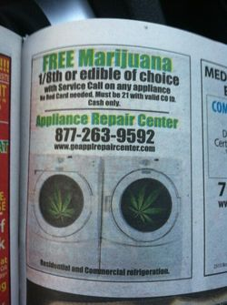

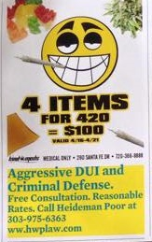


Slide 8
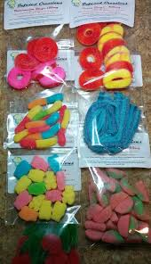
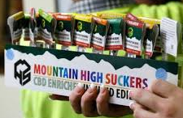
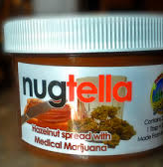
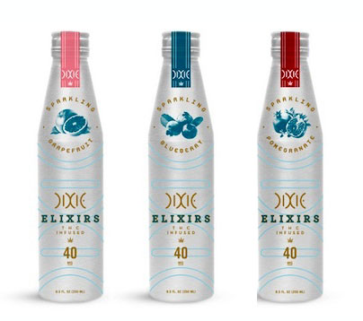
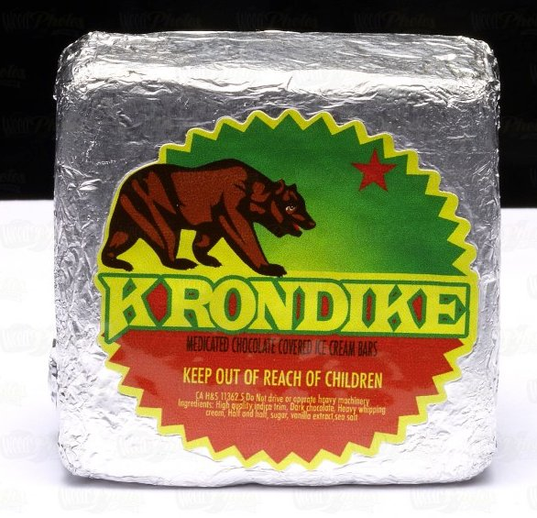

Slide 9




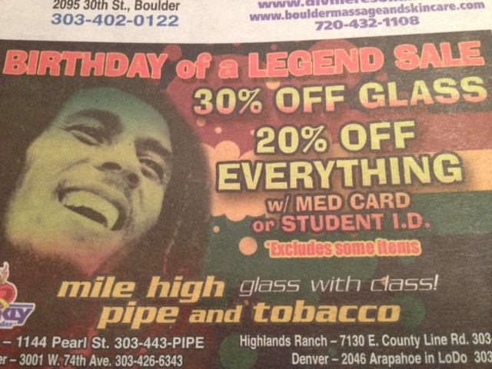

Slide 10
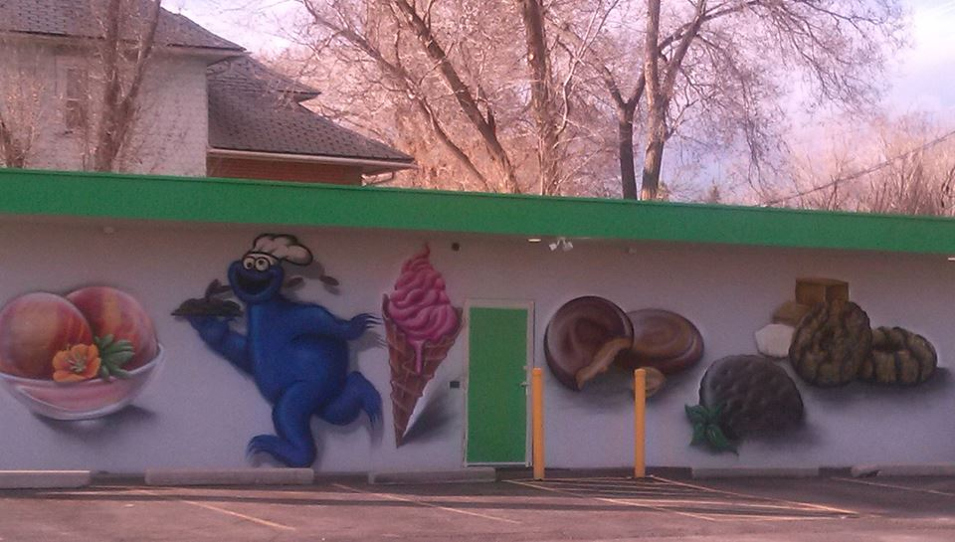
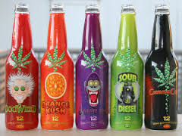



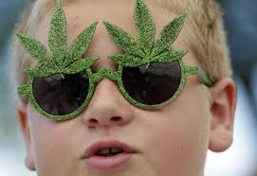
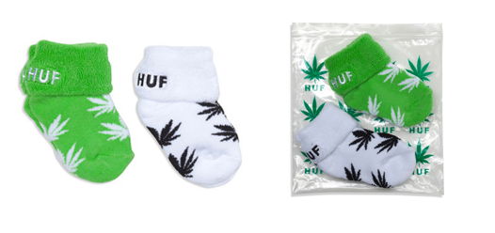

Slide 11
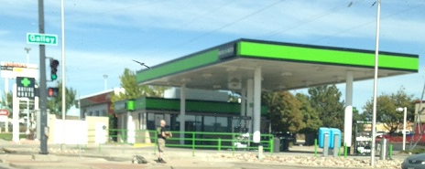
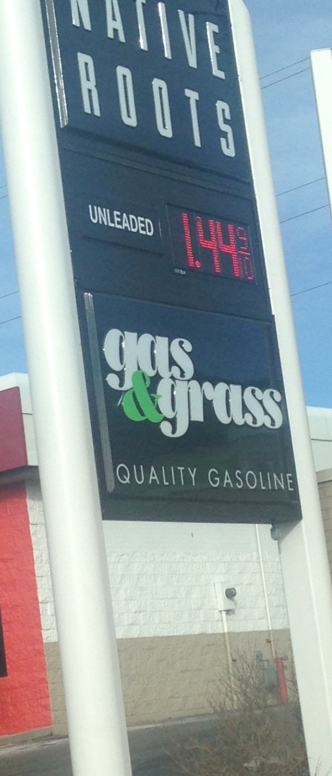
“Gas & Grass” Station

Slide 12
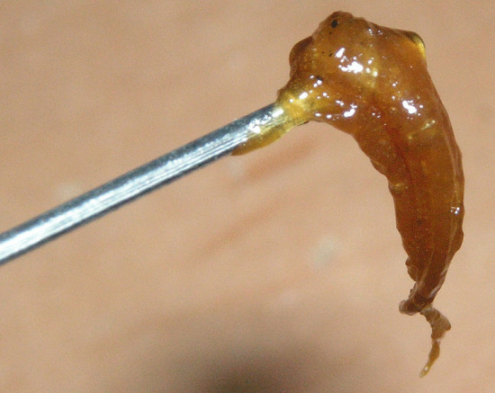
Ice
Wax
BHO
Dabs
Shatter
Concentrates

Slide 13
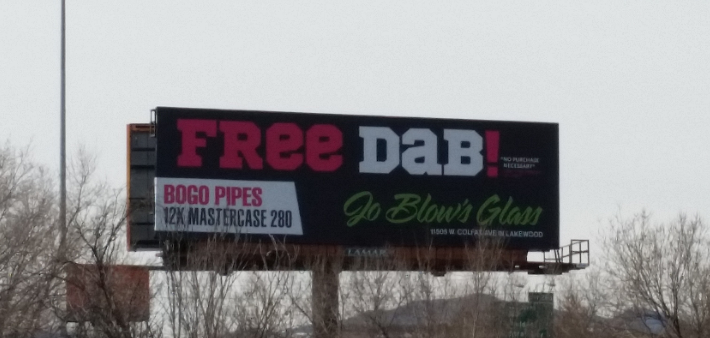

Slide 14
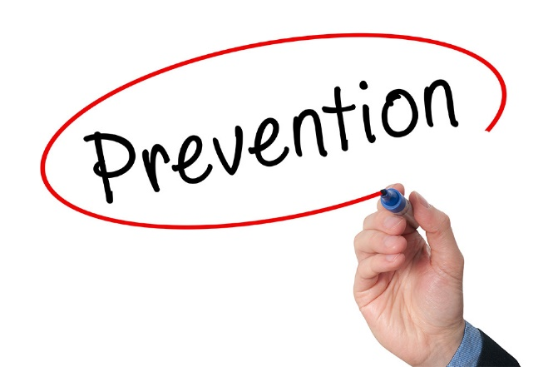
Suggestions
To avoid over-saturation
Limit quantity of licenses
Zoning is critical (avoid residential, school zones, etc.)
Create reasonable buffer zones that are enforced
Limit hours of operation permanently

Slide 15
Suggestions
EDUCATE, EDUCATE, EDUCATE drivers
Non-contestable DUID Standard
Support DRE criteria and data: it is tried and true
Standards/judgements should be based on science, not supposition
No impairment test
Impairment device(s) may be forthcoming but without a standard of measurement, will not solve the problem

Slide 16
Use Rates

Slide 19
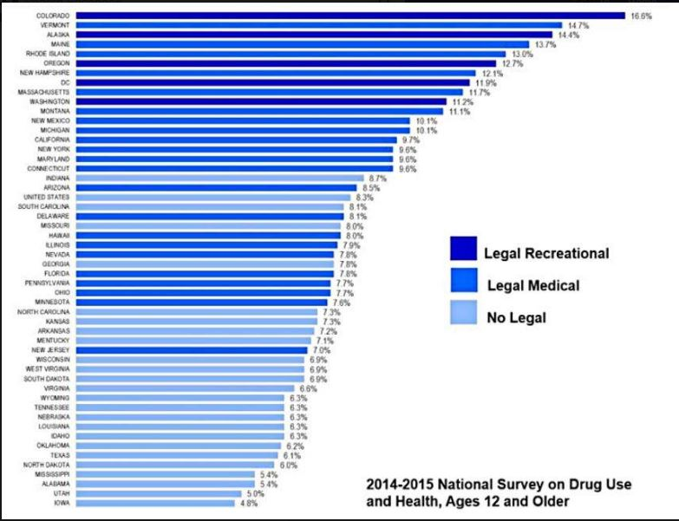
“Colorado now leads the country in past-month youth marijuana use, after legalizing marijuana in 2012. The state claims this dubious distinction after being in third place in the 2012-2013 report, and in fourth place in the 2011-2012 study.” - SAM

Slide 20
2018 National Survey on Drug Use and Health
45,000 more teens are regularly using marijuana
MJ users are more likely to abuse opioids than non-users
Marijuana Use Disorder is increasing
On average 8,400 Americans aged 12↑ tried MJ for the 1st time each day of 2018 (100/day increase over previous study)
First time users are typically between 12-25 yoa
Approx 4.4M people aged 12↑ had a MJ Use Disorder in the past year
U.S. NSDUH 2018 Survey Results: SAMHSA

Slide 21
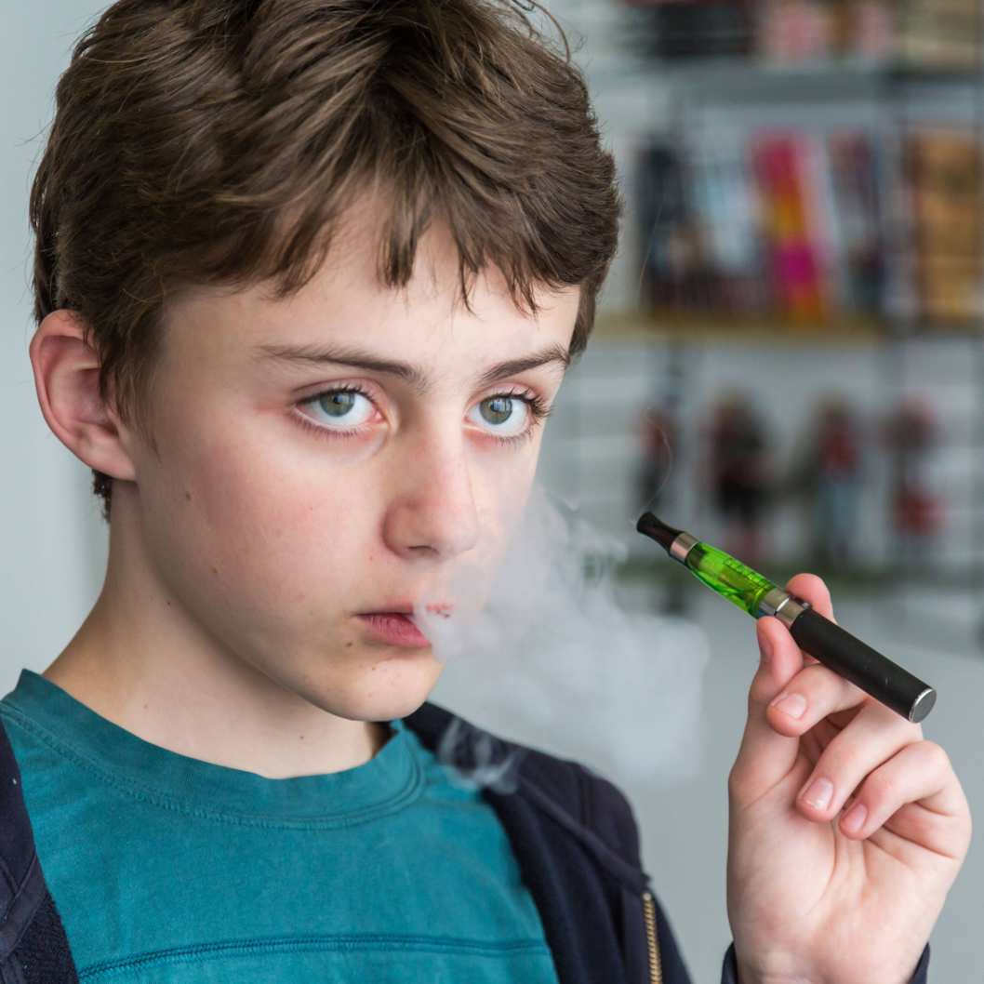
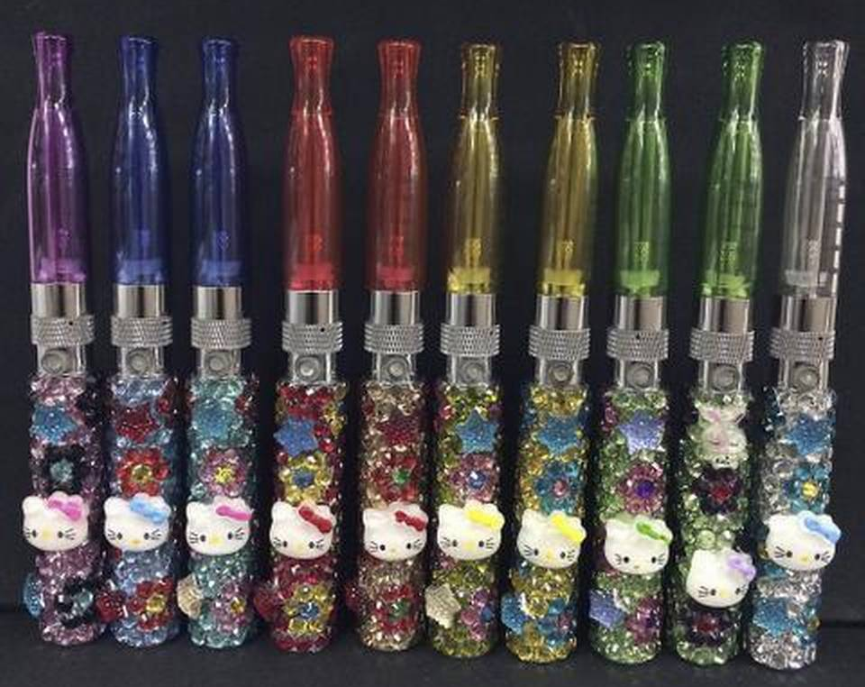
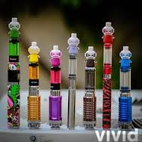
2018: Over 2 MILLION middle school and high school students admit they vape

Slide 22
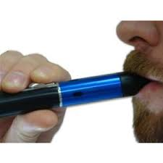
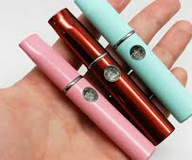
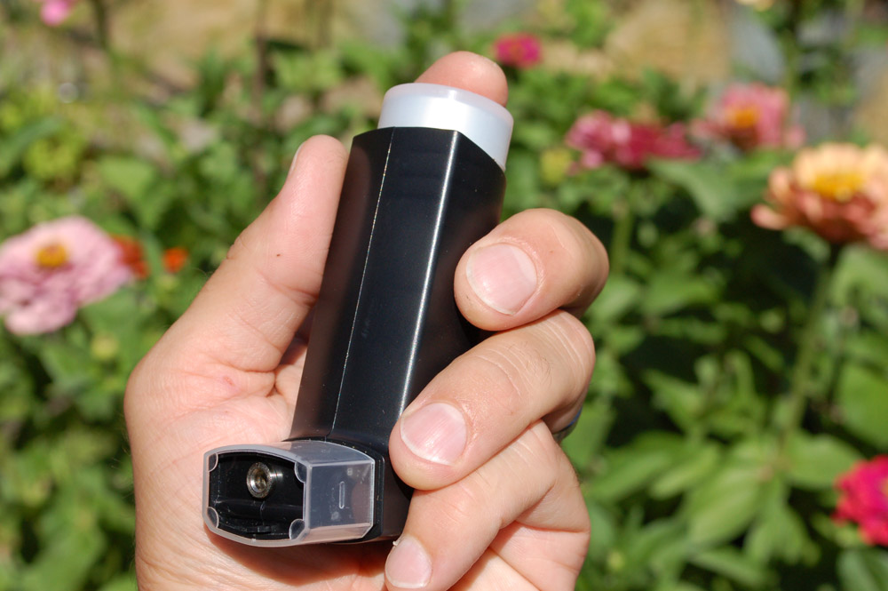
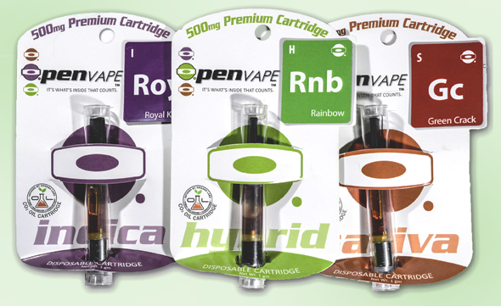


Slide 23
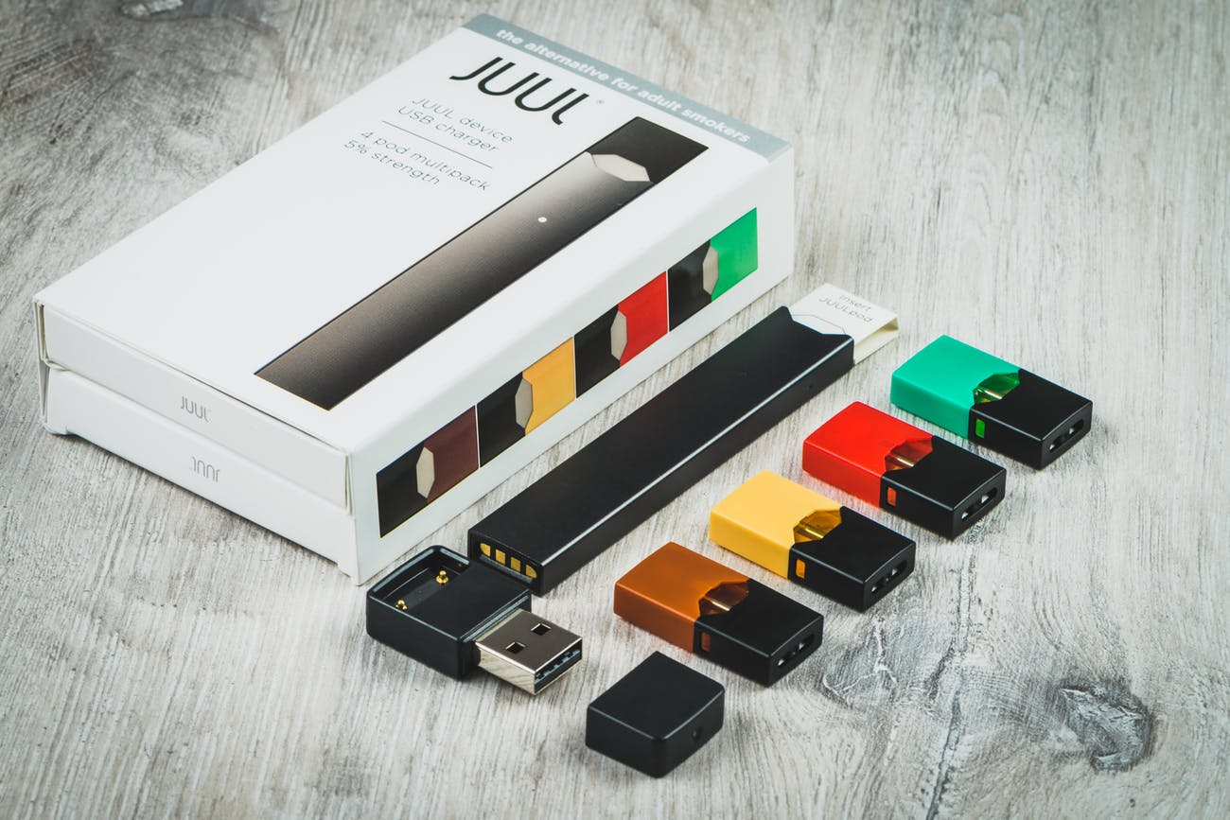

Slide 24

Risks
Tobacco vaping and onset of/increased use of marijuana are directly correlated
Findings were significant for adolescents, aged 12-17
Heavy use more prevalent in younger adolescents
Electronic Cigarettes and Future Marijuana Use: A Longitudinal Study
Hongying Dai, Delwyn Catley, Kimber P. Richter, Kathy Goggin, Edward F. Ellerbeck
Pediatrics May 2018, 141 (5) e20173787; DOI: 10.1542/peds.2017-3787

Slide 25
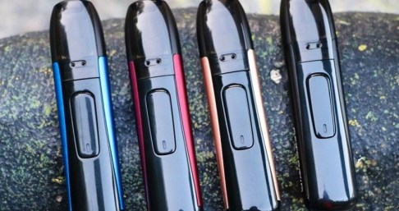
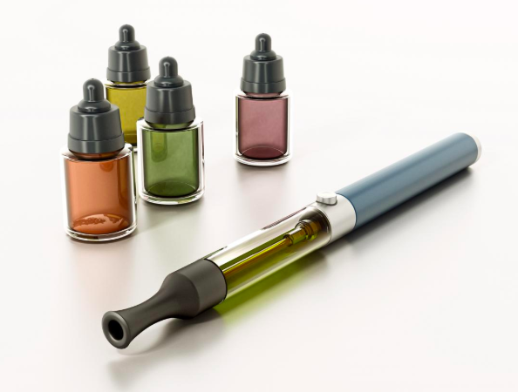
Risks
Teens who vape are 6x more likely to progress on to smoke tobacco products
High temps made with lead and other HEAVY METALS
NOT approved by the FDA as a “quit smoking” device

Slide 26
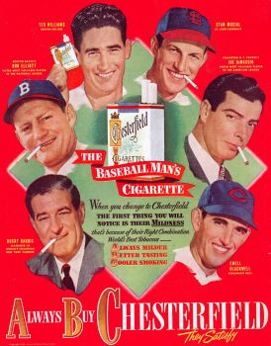
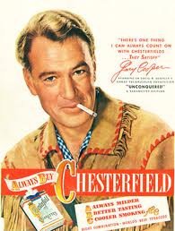


Popularized Similar to Tobacco

Slide 27


Slide 28
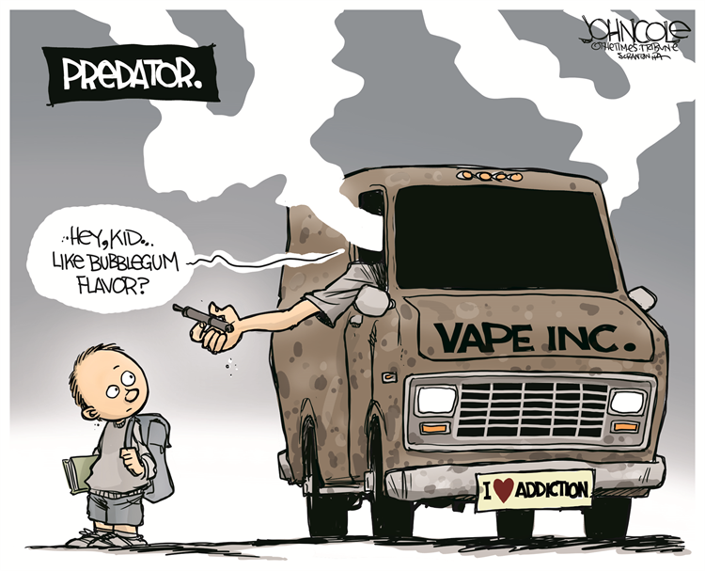
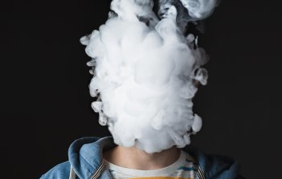
Risks
Addiction: Compulsive use even though it causes problems or interferes with normal routines and/or healthy activities Fixation on frequency or “need” to use

Slide 29
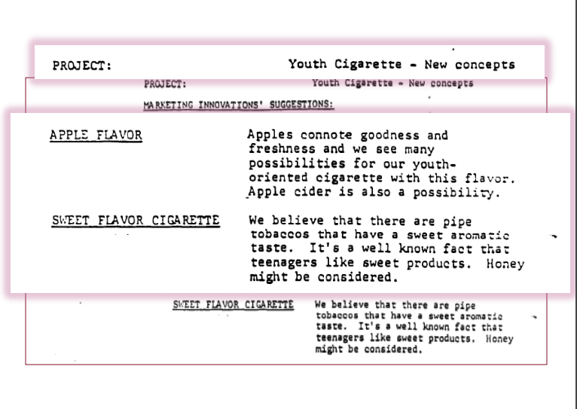
Big Tobacco Playbook

Slide 30
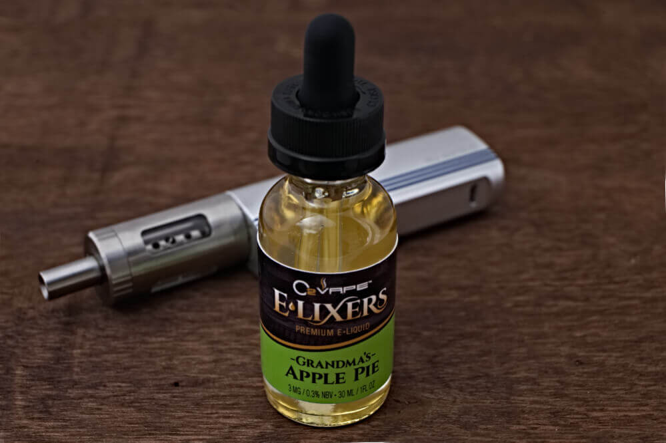
Direct Marketing to Youth

Slide 31
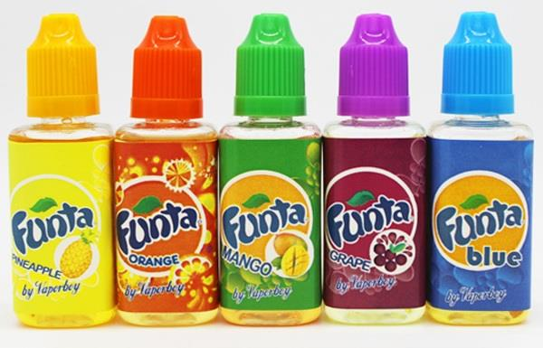
Direct Marketing to Youth

Slide 32
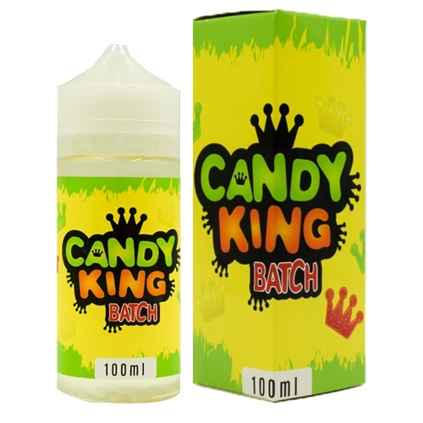
Direct Marketing to Youth

Slide 33
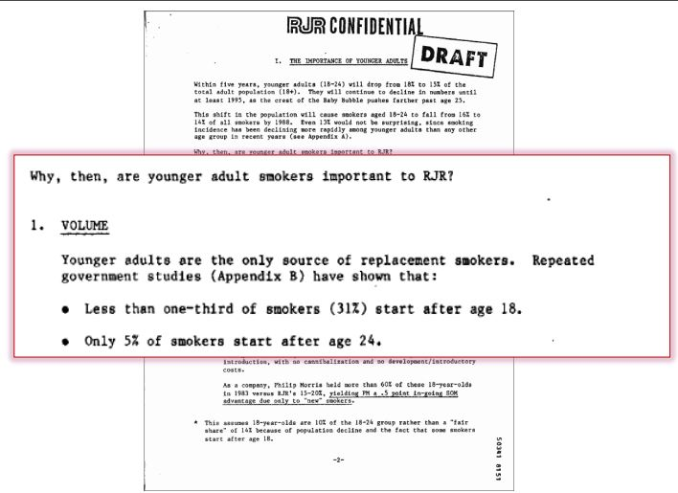

Slide 34
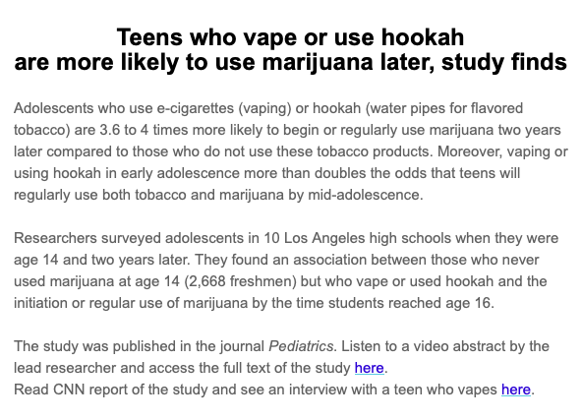
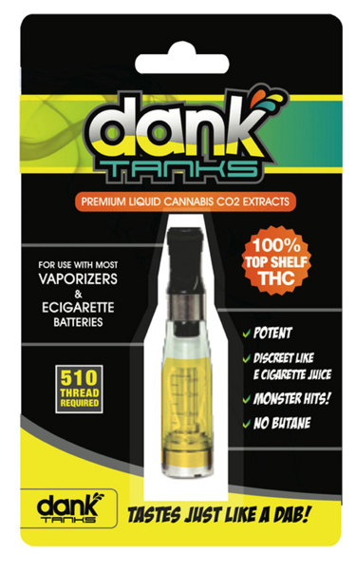

Slide 35

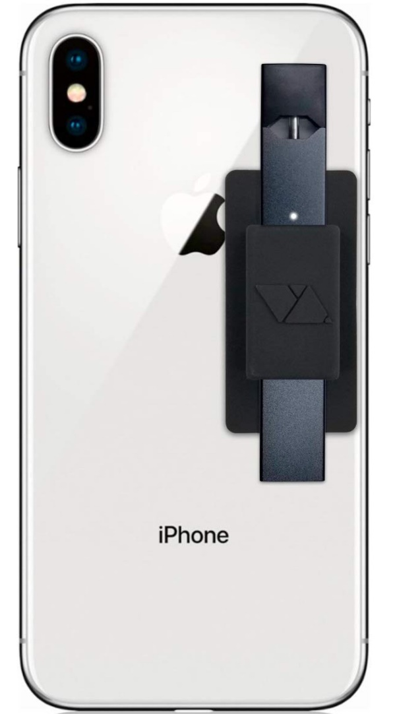

Consumer Conversion

Slide 36
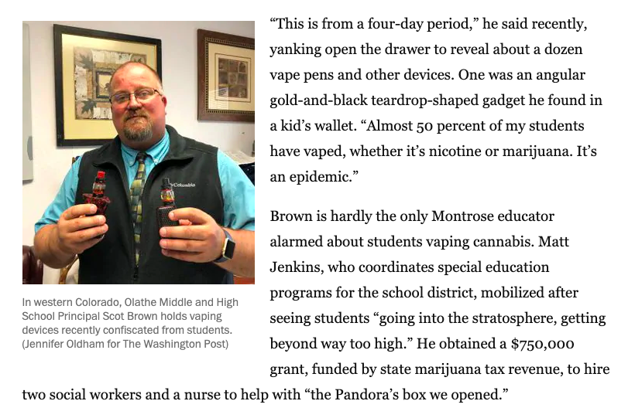
“Potent pot, vulnerable teens trigger concerns in first states to legalize marijuana”
https://www.washingtonpost.com/national/potent-pot-vulnerable-teens-trigger-concerns-in-first-states-to-legalize-marijuana/2019/06/15/52df638a-8c9a-11e9-8f69-a2795fca3343_story.html?noredirect=on&utm_term=.fd410fe35f4f

Slide 37
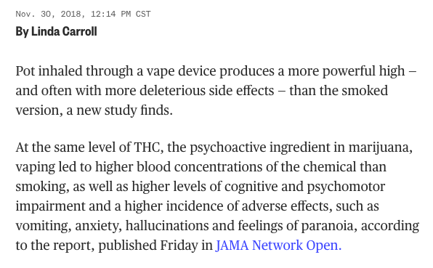


Slide 38


Slide 39

Risks
Heavy metals, lead poisoning
Toxins in emissions cause 2nd hand exposure
Anything brought into the body in a combustible manner is harmful (American Lung Assoc)
Teens who vape have more cancer-causing agents in their bodies than those who do not

Slide 40


Slide 41


Slide 42


Slide 43

Suggestions
EDUCATE, EDUCATE, EDUCATE
We need a best-practice model for youth education
This needs to be all-encompassing, as a societal message
Schools, workplaces should ban vaping due to public health & safety concerns. Consider other possible controls.
We must have a “Listen First” approach with young people
When they engage in the conversation, they learn more
Youth focus groups/effective messaging
Be cautious about overly humorous messages – could lead to more of a “commercialization effect”

Slide 44
Suggestions
LIMIT RETAIL SATURATION of VAPE shops
Increase buffer zones around schools, daycares, youth facilities, residential neighborhoods, etc.
Tobacco-free community parks
Reduce access to flavored products
Consider that vape shops are pseudo-head shops and should also be limited in scope.
Youth access should be restricted and enforced

Slide 45
Black Market

Slide 47


$50 cash reimbursement covers vehicle fuel for a marijuana “donation” delivered to your home

Slide 48


Slide 49
Societal Impacts

Slide 51


Slide 52

Mental Health Considerations
https://www.mentalhealthamerica.net/conditions/risky-business-marijuana-use

Slide 53


Slide 54


Slide 55



THC Extractions = Butane Hash Oil Explosions

Slide 56



Home Grow Operations
No inspections for molds, pesticides, contaminants, etc.
No established safety standards
Undercuts the tax scheme
“Free gift” loopholes

Slide 57




Slide 58


Slide 59

Pregnancy & Breastfeeding
Smoking tobacco or marijuana, taking
prescription painkillers, or using illegal
drugs during pregnancy is associated
with double or even triple the risk of stillbirth.
Cannabis use early in pregnancy results in reduced fetal growth.
Cannabis, the pregnant woman, and her child: weeding out the myths. Jaques S et al. J. of Perinatology 2014; 1‐8
Day NL, Richardson GA, Goldschmidt L, et al. Neurotoxicol. Teratol. 1994;16(2):169‐175

Slide 60


Slide 61

2017 We refer to the massive amounts of homeless as “Marijuana Refugees”

Slide 62




Slide 63
Suggestions
EDUCATE, EDUCATE, EDUCATE
Support Public Health education campaigns & funding
Specific outreach to parents
Lock-box campaign
Harms to children/youth
Be tough on those who put cannabis over kids
Support treatment providers
Zero tolerance for home hash-oil/dab labs

Slide 64

Workplace Impacts
Of 600 employees surveyed, 48% said they have gone to work high in the past 30 days
Westword, Jan 2018

Slide 65
Quest Diagnostics Drug Test Index™
http://www.questdiagnostics.com/home/physicians/health-trends/drug-testing
Notes:
Quest Diagnostics’ Drug Testing Index showed that in 2013, positive results for marijuana increased 6.2%. Marijuana positivity rates were dramatically higher in the two states with legal recreational marijuana: marijuana positivity rates increased 20% in Colorado and increased 23% in Washington. Quest Diagnostics Drug Testing Index. (2014, September 11). Workforce drug test positivity rate increases for the first time in 10 years, driven by marijuana and amphetamines, finds Quest Diagnostics Drug Testing IndexTM analysis of employment drug tests. Madison, NJ: Quest Diagnostics. Available: http://www.questdiagnostics.com/home/physicians/health-trends/drug-testing

Slide 66


Job Applicants at Local Electric Company
February 2015
12 applicants in the pre-employment process
Mobile drug test collector arrives
9 applicants walk-out
3 complete pre-employment drug screen
2 pass the drug screen
1 fails (THC positive)
vs

Slide 67

Looking Outside the State for Qualified Employees
“
Jim Johnson said his company has encountered so many job candidates who have failed pre-employment drug tests because of their THC use … it is actively recruiting construction workers from other states.
”
GE Johnson
http://gazette.com/drug-use-a-problem-for-employers/article/1548427

Slide 68

Employer Challenges
Pate Construction
For every 75 people we interview, we can find about 15 who can pass the drug test
Canon City Workforce Center
It took 2 months to find 3 CDL drivers that could pass the drug test. Salaries offered were competitive

Slide 69
Suggestions
EDUCATE, EDUCATE, EDUCATE
Employers have a federal right to safe & drug free workplace
Support Safety First
Must have clear policies, consistently enforced
Drug testing programs WORK

Slide 72
What are the COSTS? Some Preliminary Findings
For every dollar gained in tax revenue, CO spent approx. $4.50 to mitigate the effects
Costs related to healthcare and high school drop-outs are the largest contributors
The estimated costs of DUI’s for people who tested positive for marijuana n 2016 is nearly $25 million
In 2016, the MJ Industry used enough electricity to power 32,355 homes
http://www.ccu.edu/centennial/policy-briefs/marijuana-costs/

Slide 73
How Will Recreational Marijuana & Vaping Look in Your Community?

