Slide 1

Marijuana & Legalization… What To Expect
Impacts to Public Safety and Law Enforcement
A “predictive tool” for potential impacts to public health and public safety
Wheaton, IL
November 22, 2019

Slide 2
Common issues and concerns
Impacts being seen after marijuana is legalized in the areas of:
Public Health Issues
Potency
Usage Rates
Treatment
Public Safety Issues
Impaired Driving
Black Market
Crime
Hospitalizations
Diversion
Extraction Labs
Other Topics
Taxation Issues
Product Awareness 101
National Marijuana Initiative July 2019

Slide 3
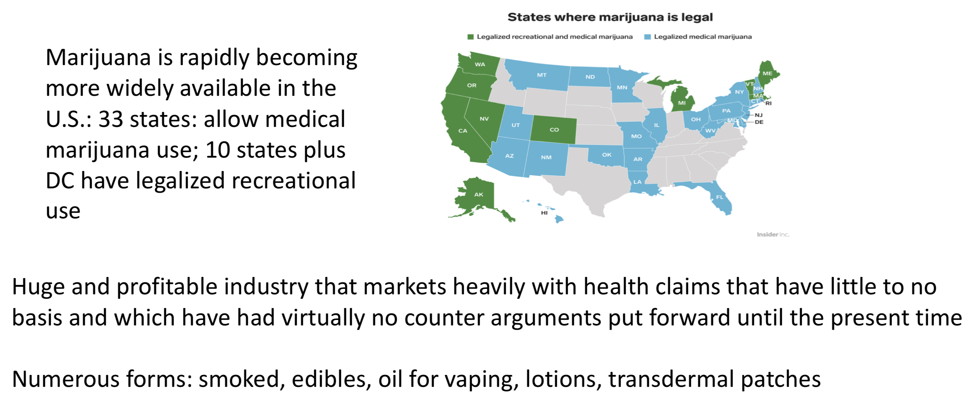

Slide 4
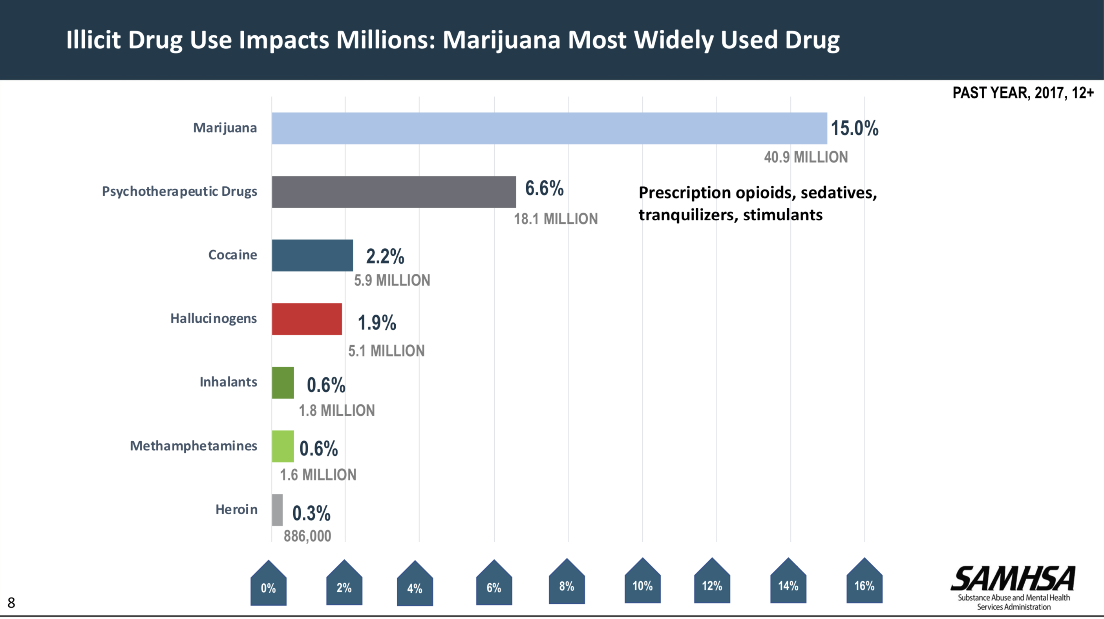

Slide 5
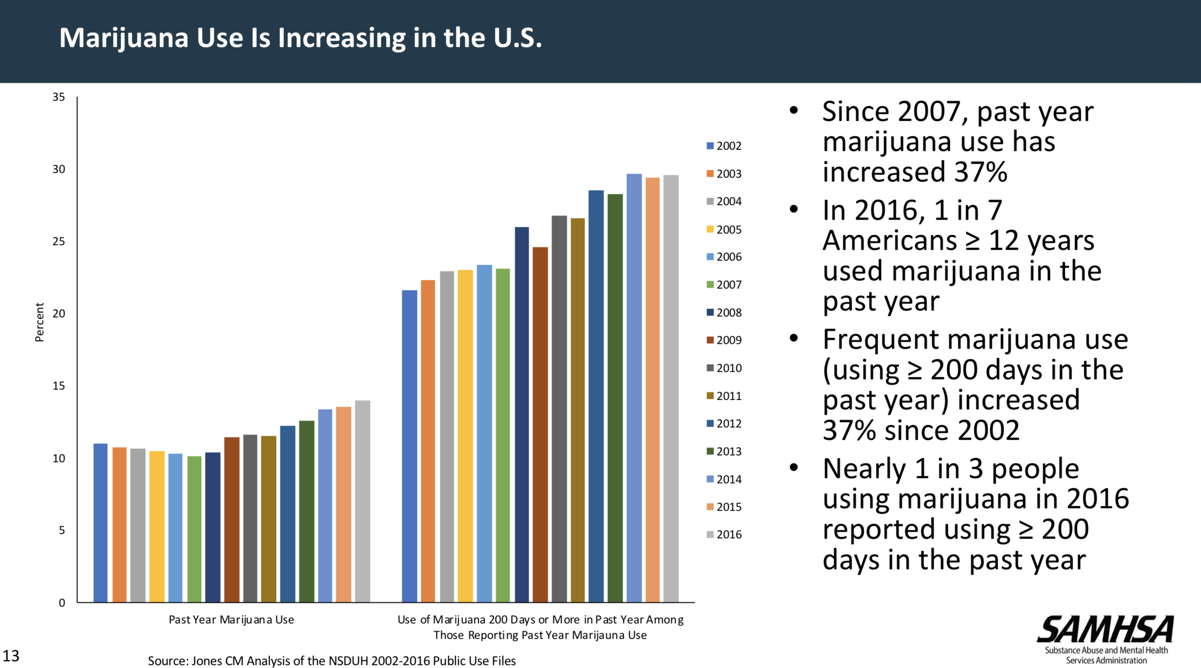

Slide 6
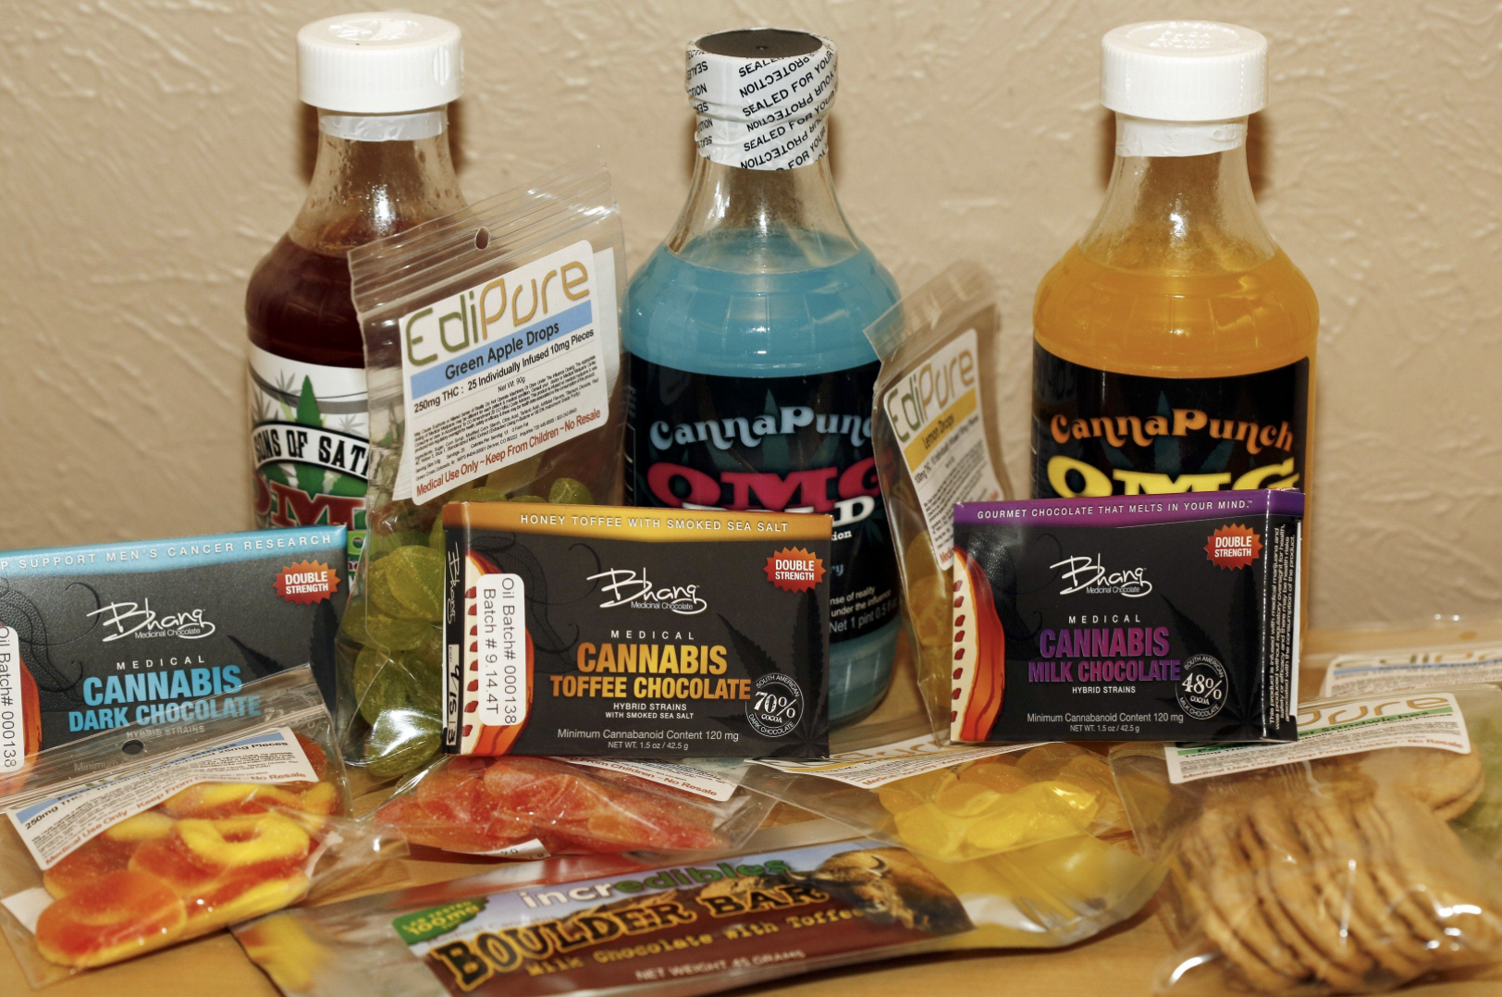
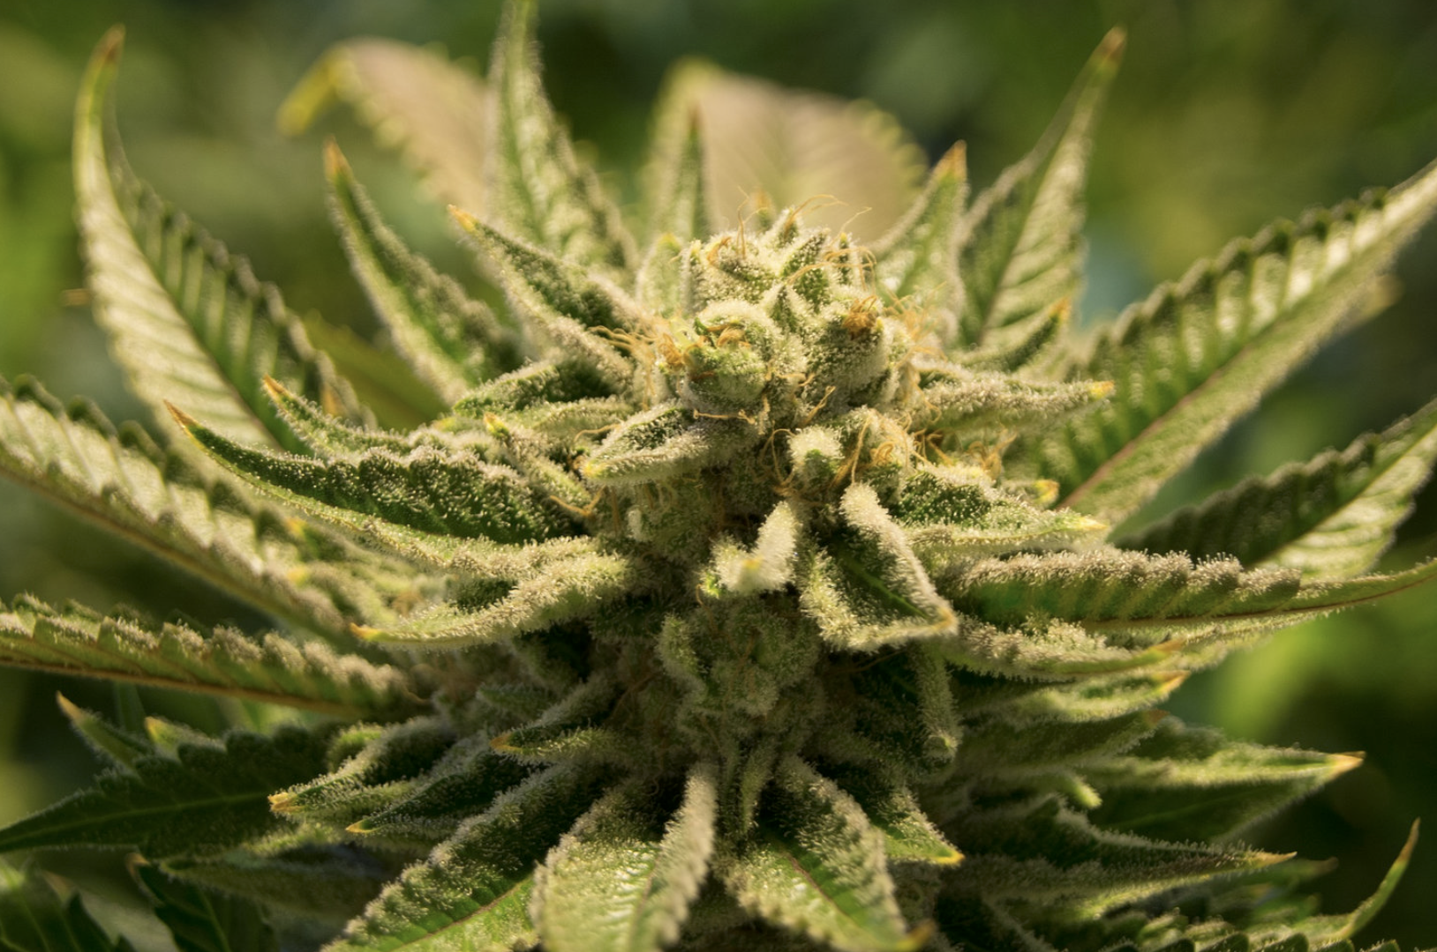
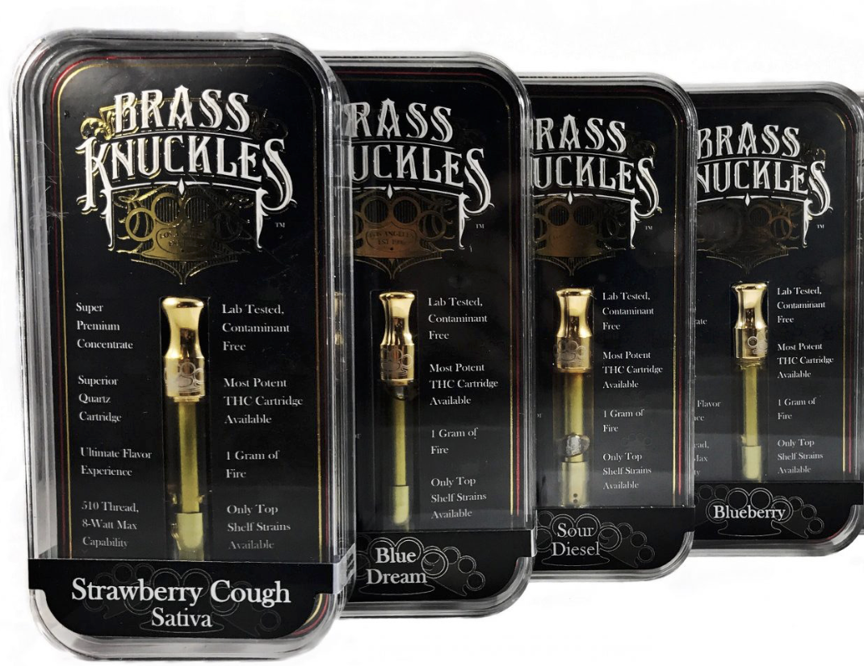
Public Health Issues - Potency
Source: Open Source Media
National Marijuana Initiative July 2019

Slide 7
Public Health Issues - Potency
Key Talking Points:
The potency of THC in raw marijuana are at historic highs
High potency THC products are being made in response to market demand
Higher potency THC products place users at a greater risk of addiction and cognitive impairment
THC Potency examples:
  1995: 4 percent
  2014: 12 percent
  2017: 23 – 34 percent
  2018: THC-A reported at 99 percent
Source: M. ElSohly (2016), J. Pierre (et.al) (2017)
National Marijuana Initiative July 2019

Slide 8
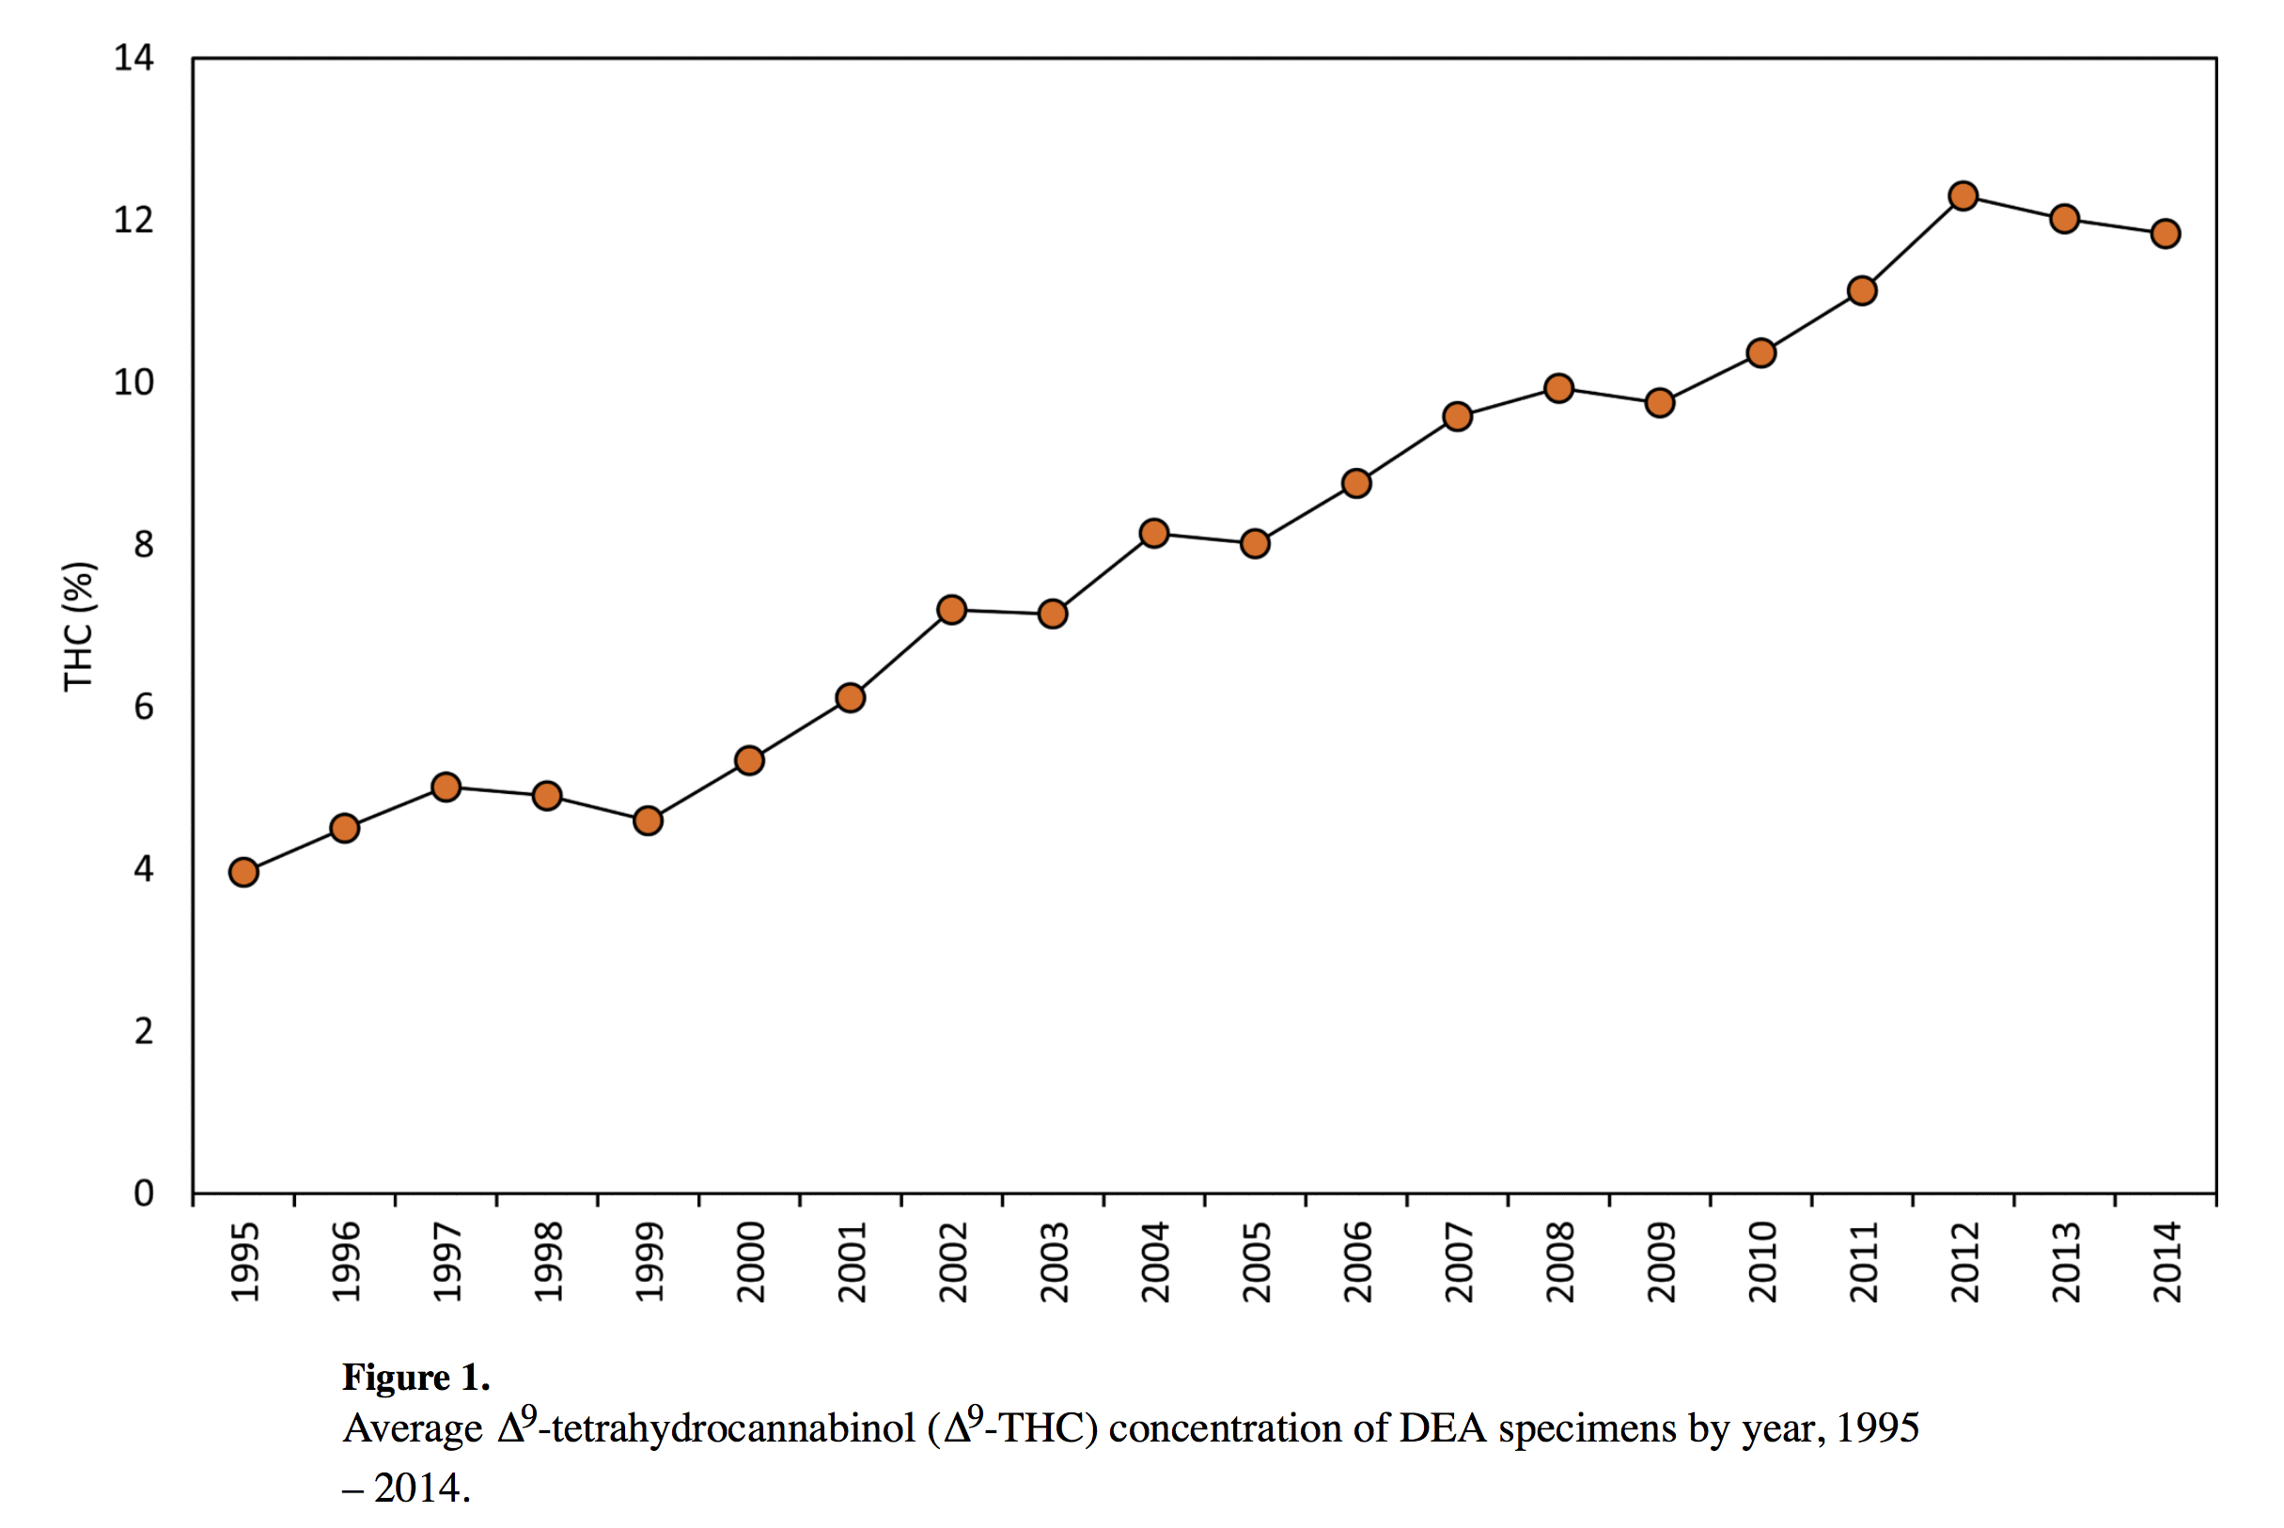
Public Health Issues - Potency
THC levels have been trending upward to meet greater demand for high potency THC products.
Higher THC levels are a byproduct of science and genetic engineering by the marijuana industry to meet market demand.
It’s no longer the same plant God placed upon this Earth
Source: ElSohly MA et al., Biol Psychiatry 2016
National Marijuana Initiative July 2019

Slide 9
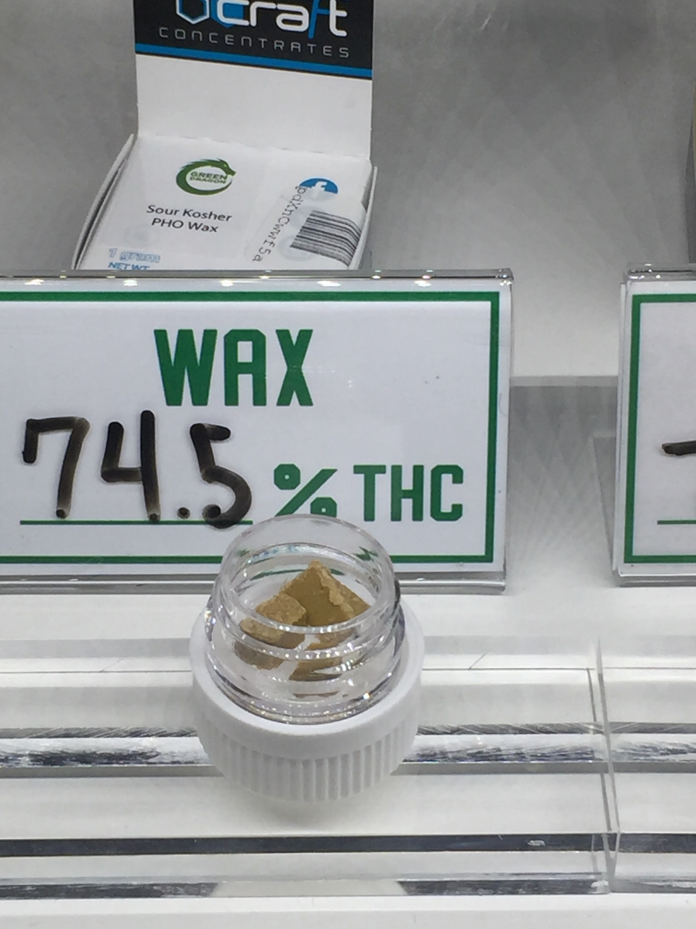
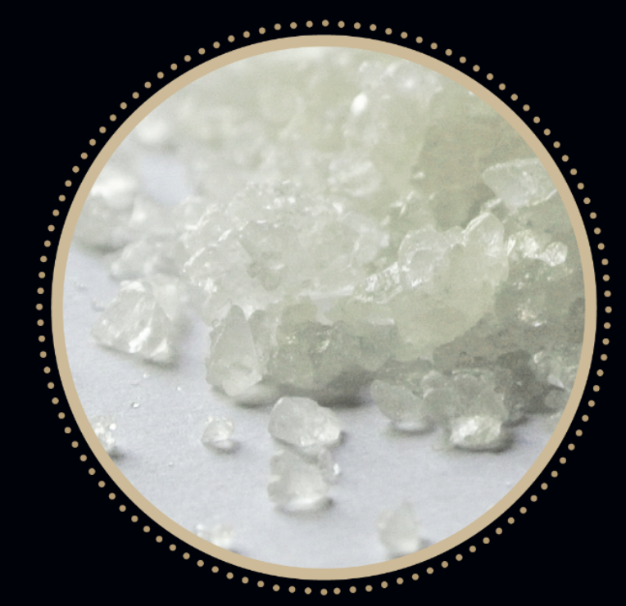
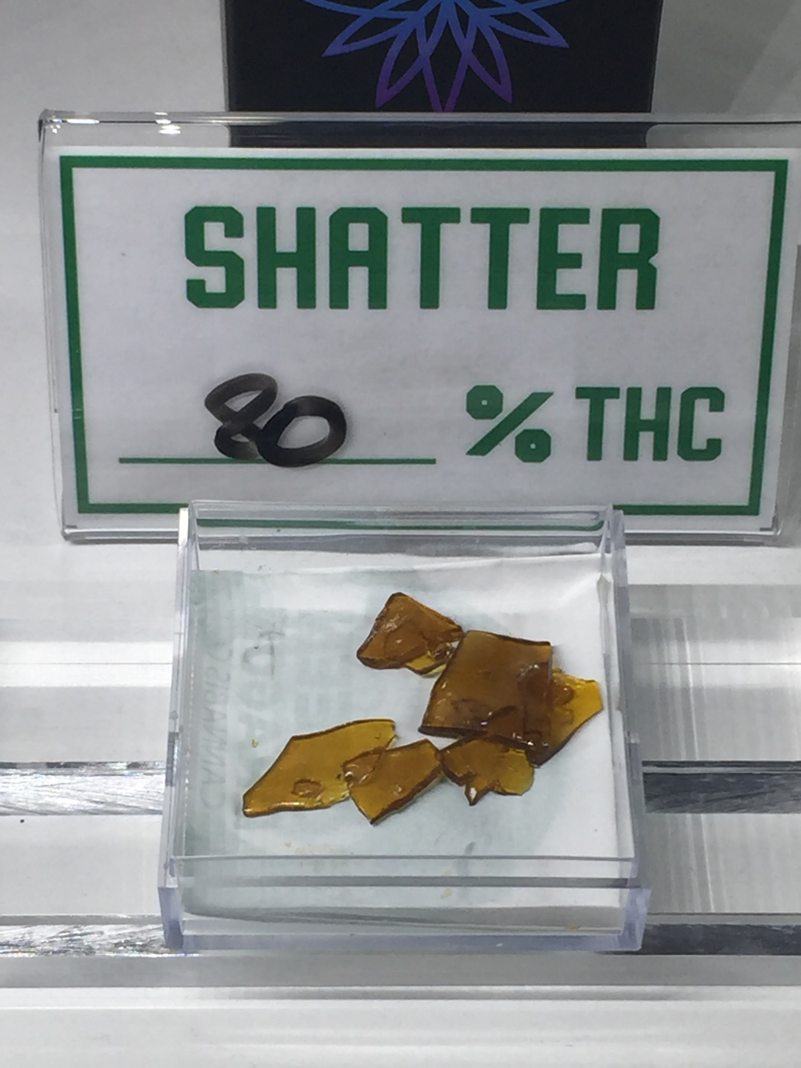
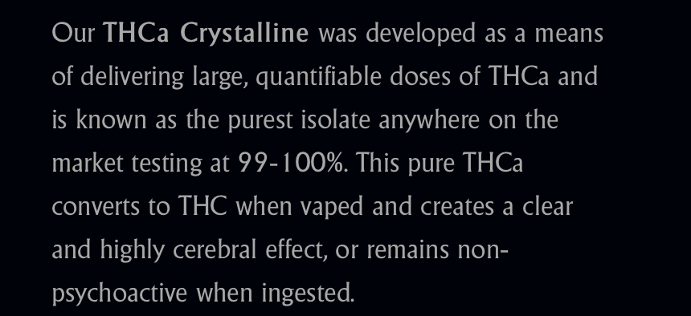
Public Health Issues - Potency
Source: Guild Extracts Website for THCA
National Marijuana Initiative July 2019

Slide 10
Public Health Issues - Potency
Concentrates : “710” …. is the new 420
  Butane-extracted hash oil (BHO)
A chunk of the stuff the size of a Tic Tac can be the equivalent of hoovering up an entire joint in one massive toke.
Even for hardcore smokers, the experience – which fans call dabbing – can be like getting high for the very first time.
Your head spins, your eyes get fluttery, a few beads of sweat surface on your forehead and, suddenly, you're cosmically baked. (Rolling Stone Magazine, 6/20/2013)
Question :
Where’s the dialog
about patient care or being sick??
Source: Rolling Stone Magazine, 6/20/2013

Slide 11
Public Health Issues - Potency
Key Talking Points: …. and counter-points
The potency of THC in raw marijuana are at historic highs
  We have no long-term research into effects of high potency THC
  Policy and Laws are being created absent of valid data.
High potency THC products are being made in response to market demand
  Demand is based on desired effect / “high”
  Like alcohol … some people think stronger is better
Higher potency THC products place user at greater risk of addiction and cognitive impairment
  Does the reward justify the risk …. ????
            Data and research is lacking.
National Marijuana Initiative July 2019

Slide 12
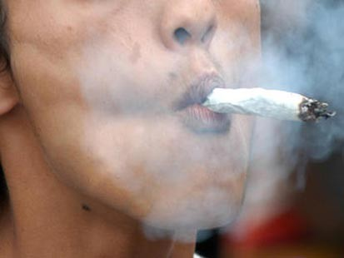

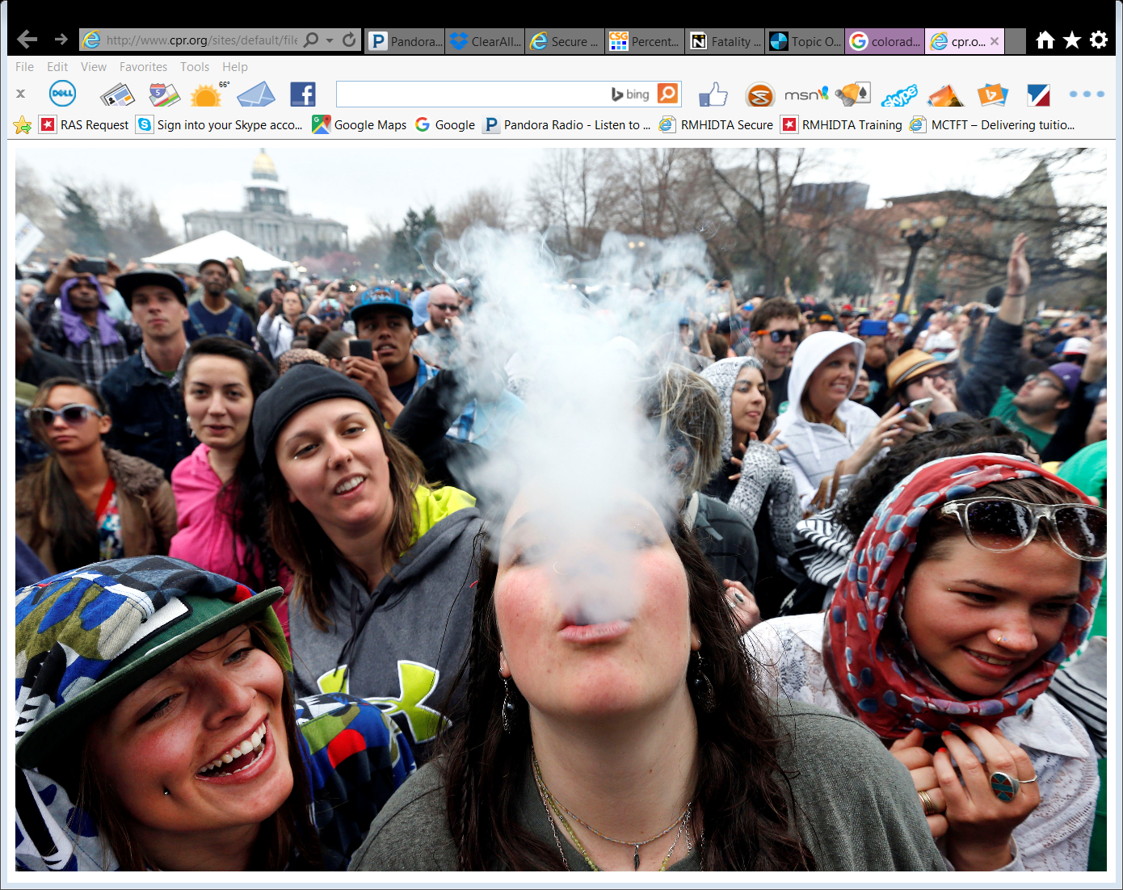
Marijuana Use in Youth and Adults

Slide 13
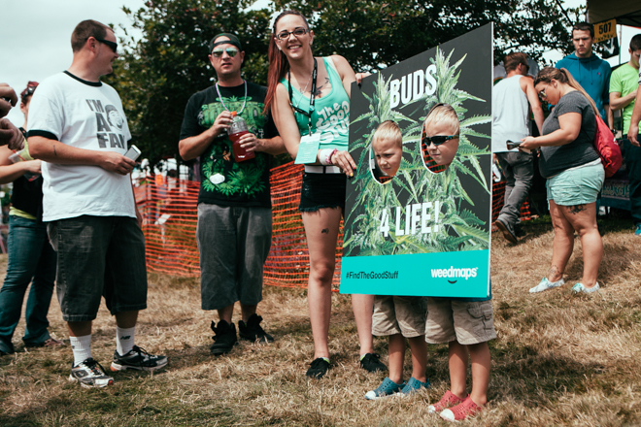

Slide 14

Public Health Issues – Current Use Rates
Current Use Rate Defined:
Having used marijuana,
At least once,
In the last 30 days
By age group
Most broadly accepted data point to date.
Daily use rate would be best,
But ….not a broad bases of data in this area.
National Marijuana Initiative March 2019

Slide 15
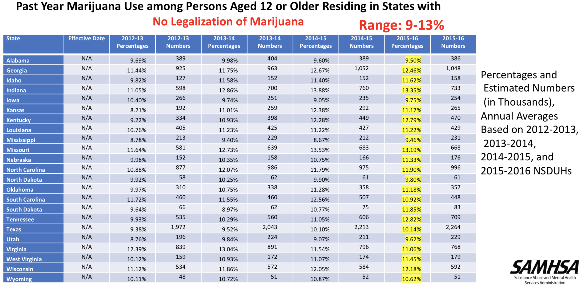

Slide 16
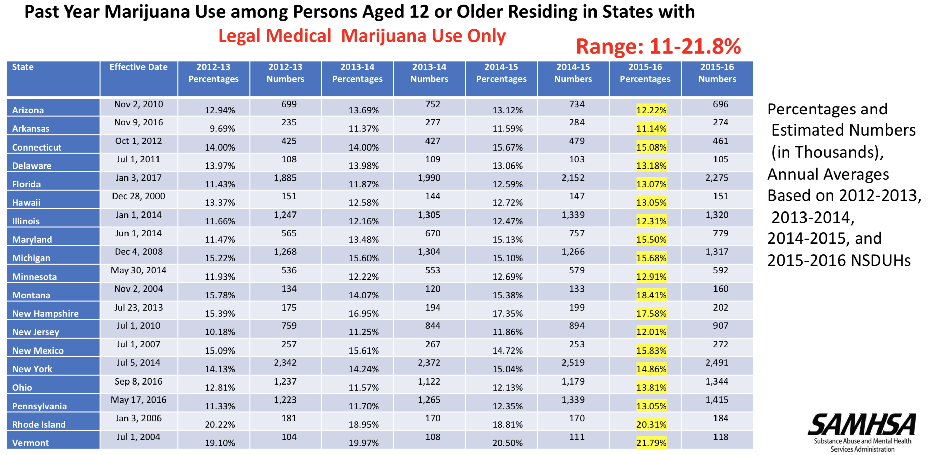

Slide 17
Past Month Usage by 12 to 17 Year-Olds
Youth (12 – 17 years) Current Marijuana Use in 2017
  National average for youth = 6.75 percent (Down from 2014)
  Colorado average for youth = 9.02 percent (Down from 2014)
  Colorado youths are ranked 7th nationally in 2017
    Ranked 5th in 2011
    Ranked 4th in 2012
    Ranked 3rd in 2013
    Ranked 1st in 2014 and 2015
  34.5 percent higher than national average
Source: National Survey on Drug Use and Health & DASIS 2017

Slide 18
Past Month Usage – State Comparisons
Source: National Survey on Drug Use and Health 2011 – 2017
Source: National Survey on Drug Use and Health 2011 – 2016

Slide 19
Past Month Usage by 18 to 25 Year-Olds
Adult Marijuana Use – College Age (18-25) in 2017
  National average = 20.3 percent (Up from 2014)
  Colorado average = 32.2 percent (Up from 2014 )
  Colorado young adults are ranked 3rd nationally
    Ranked 4th in 2011
    Ranked 3rd in 2012
    Ranked 2nd in 2013
    Ranked 1st in 2014
    Ranked 2nd in 2015
  58.6 percent higher than national average
Source: National Survey on Drug Use and Health & DASIS 2017

Slide 20
Past Month Usage – State Comparisons
Source: National Survey on Drug Use and Health 2011 - 2017

