Slide 1
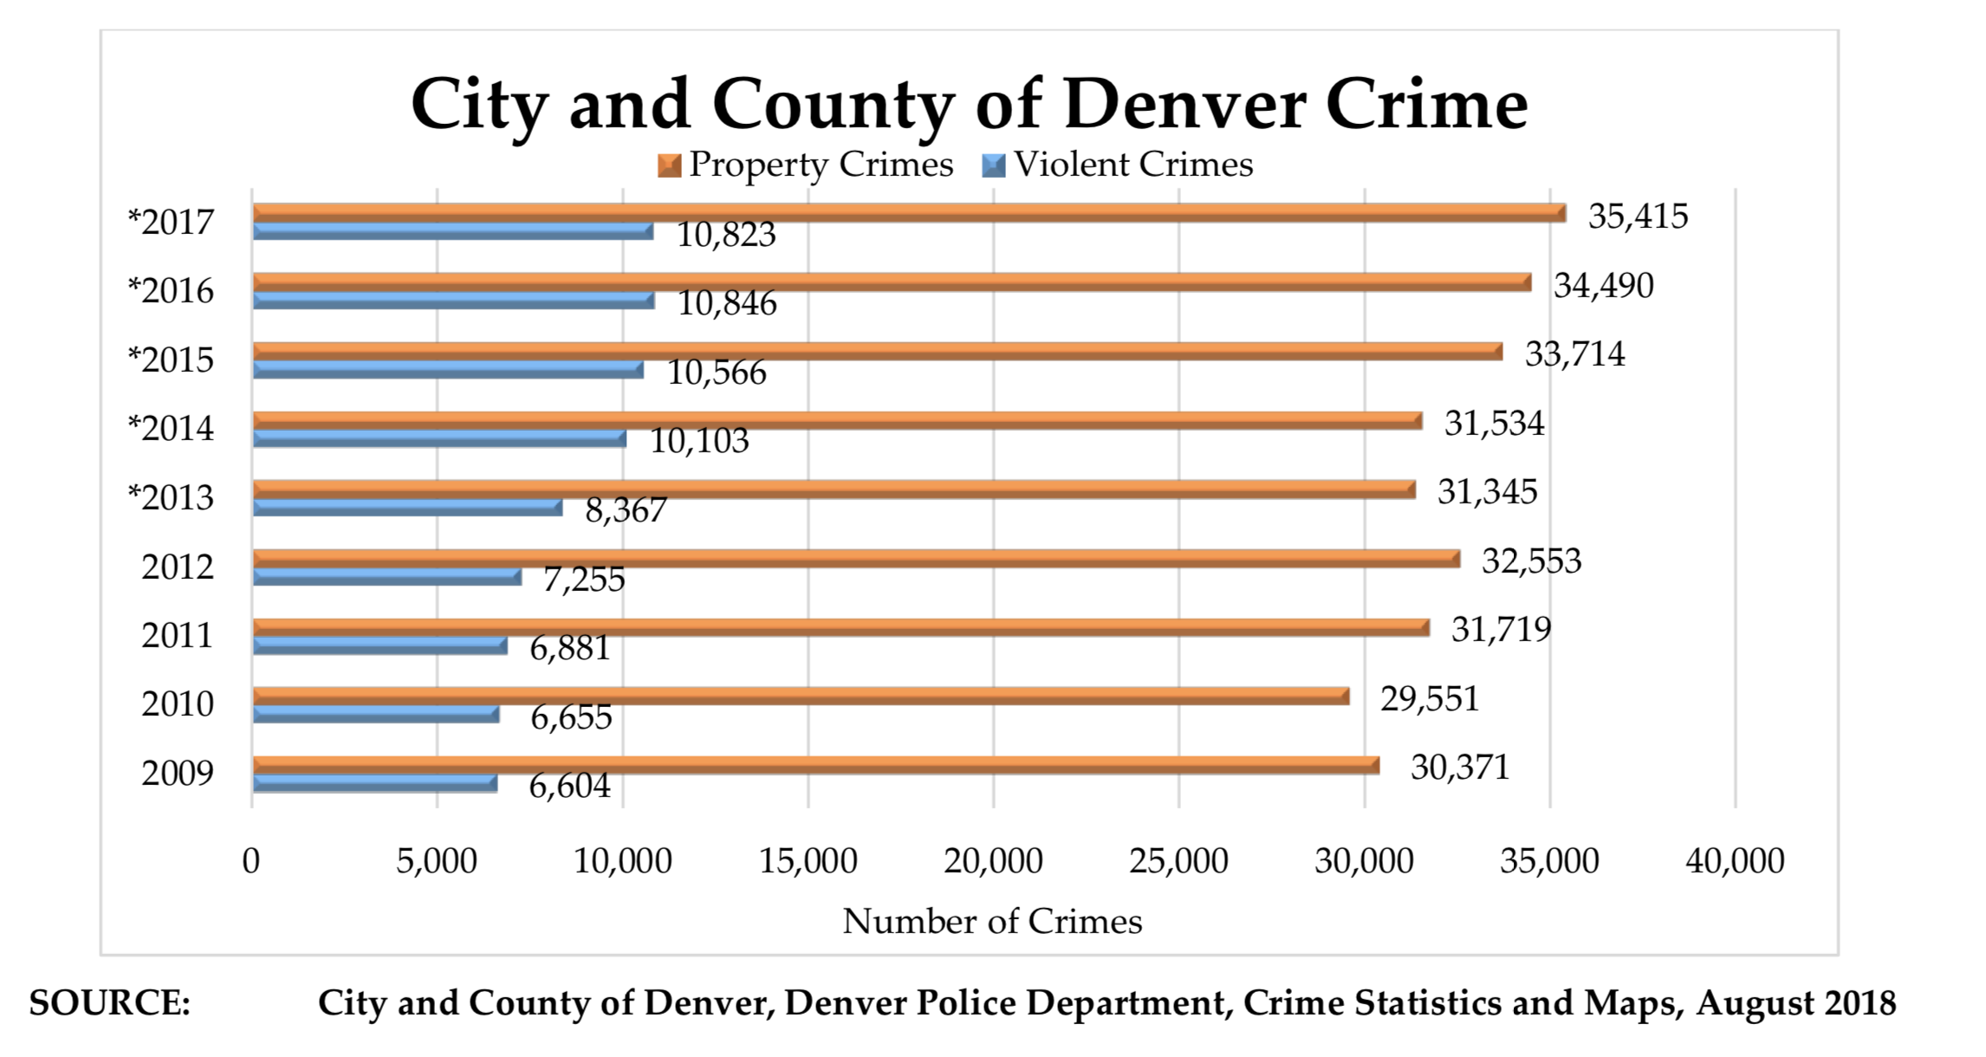

National Marijuana Initiative July 2019

Slide 2
Five year snapshot in Colorado
Homelessness growth rate that ranks among the highest in the country during the past five years.
Doubling the number of drivers involved in fatal crashes who tested positive for marijuana based on research by the pro-legalization Denver Post.
Five years of commercial marijuana have been five consecutive years of more marijuana in schools than teachers and administrators feared, according to the Denver Post.
Unfortunately the worst effects of widespread pot use will culminate over decades.

Slide 3

Drug Dog
Programs

Slide 4
Marijuana Diversion K-9 Case Law
Colorado Supreme Court – Recent Cases
No. 16SA92, People v. Zuniga
Probable Cause to Search
Totality of the Circumstances—Marijuana Odor (06-27-16)
No. 16SA187, People v. Cox
Fourth Amendment—Probable Cause—
Totality of the Circumstances—Canine Alerts (02-06-17)
No. 14SC109, People v. Crouse
Medical Marijuana—Preemption of Controlled Substances Act. (01-23-17)
Can law enforcement be forced to return marijuana for acquittal of a state violation?

Slide 5
Marijuana Diversion K-9 Case Law
No. 16SA92,People v. Zuniga—Probable Cause to Search—Totality of the Circumstances—Marijuana Odor (06-27-16)
The odor of marijuana is relevant to the totality of the circumstances test and can contribute to a probable cause determination.
Summary of facts
Good grounds for the stop
“Heavy” odor of raw marijuana from vehicle
Conflicting stories between driver and passenger
Both displayed “extreme” nervousness
Sweat
Stutter
Hands shaking
Canine alert on rear of vehicle – Free Air Alert
1 pound raw marijuana
12.6 ounces marijuana concentrate
No. 16SA187
People v. Cox—Fourth Amendment
Probable Cause
Totality of the Circumstances
Canine Alerts (02-06-17)

Slide 6
Marijuana Diversion K-9 Case Law
No. 14SC109,People v. Crouse—Medical Marijuana—Preemption—Controlled Substances. (01-23-17)
Can law enforcement officers lawfully return medical marijuana seized from an individual later acquitted of a state drug charge.
Conflict between state and federal law requirements
Is it “lawful”?
The federal Controlled Substances Act prohibits the distribution of marijuana, with limited exceptions
This court has held that an act is “lawful” only if it complies with both state and federal law
The state return provision is preempted and rendered void under federal law

Slide 7
Marijuana Diversion K-9 Case Law
Reasonable Detention – Time Lines for Interdiction
Detention versus Arrest
Short term or deprived of movement / exit
Reasonable Suspicion versus Probable Cause
Reasonable suspicion = Detention
Probable cause = Arrest
Probabilities defined
Probabilities are not technical; they are the factual and practical considerations of everyday life on which reasonable and prudent men, not legal technicians, act.
Brinegar v. United States, 338 U.S. 160 (1949)
15 - 20 minutes operating window
Documentation of times and receipt of information is key

Slide 8
And now Hemp
The New Strategy – HEMP
Round 1 - The 2014 Farm Bill
The 2014 Farm Bill:
Sign into law in February 2014
Slated to expire in 2018
Buried in Section 7606 – “Legitimacy of Industrial Hemp Research”
Allowed for “industrial” hemp research by:
Institutions of higher education
State department of agriculture
For agriculture pilot program or academic research
Pilot program focus on growth, cultivation and marketing
SOURCE: H.R. 2642, “2014 Farm Bill”, govinfo.gov

Slide 9
Historical Overview
The New Strategy – HEMP
Round 1 - The 2014 Farm Bill
The 2014 Farm Bill:
Industrial Hemp defined:
7606 (b)(2) - INDUSTRIAL HEMP – The term “industrial hemp” means the plant Cannabis sativa L. and any part of such plant, whether growing or not, with a delta-9 tetrahydrocannabinol concentration of not more that 0.3 percent on a dry weight basis. (emphasis added)
SOURCE: H.R. 2642, “2014 Farm Bill”, govinfo.gov

Slide 10
Historical Overview
The New Strategy – HEMP
Round 2 -The 2018 Farm Bill and Hemp
The Farm Bill allows for:
Hemp to be viewed separate from marijuana
The broad cultivation of “commercial” Hemp
Transportation across interstate lines
The sale/possession/transportation of “hemp-derived” products
Shared state and federal regulatory involvement
Removal of “hemp derived products” from Sch. I status
Now under USDA guidance
SOURCE: Brookings.edu, The Farm Bill, Hudak, J. December 14,2018 c

Slide 11
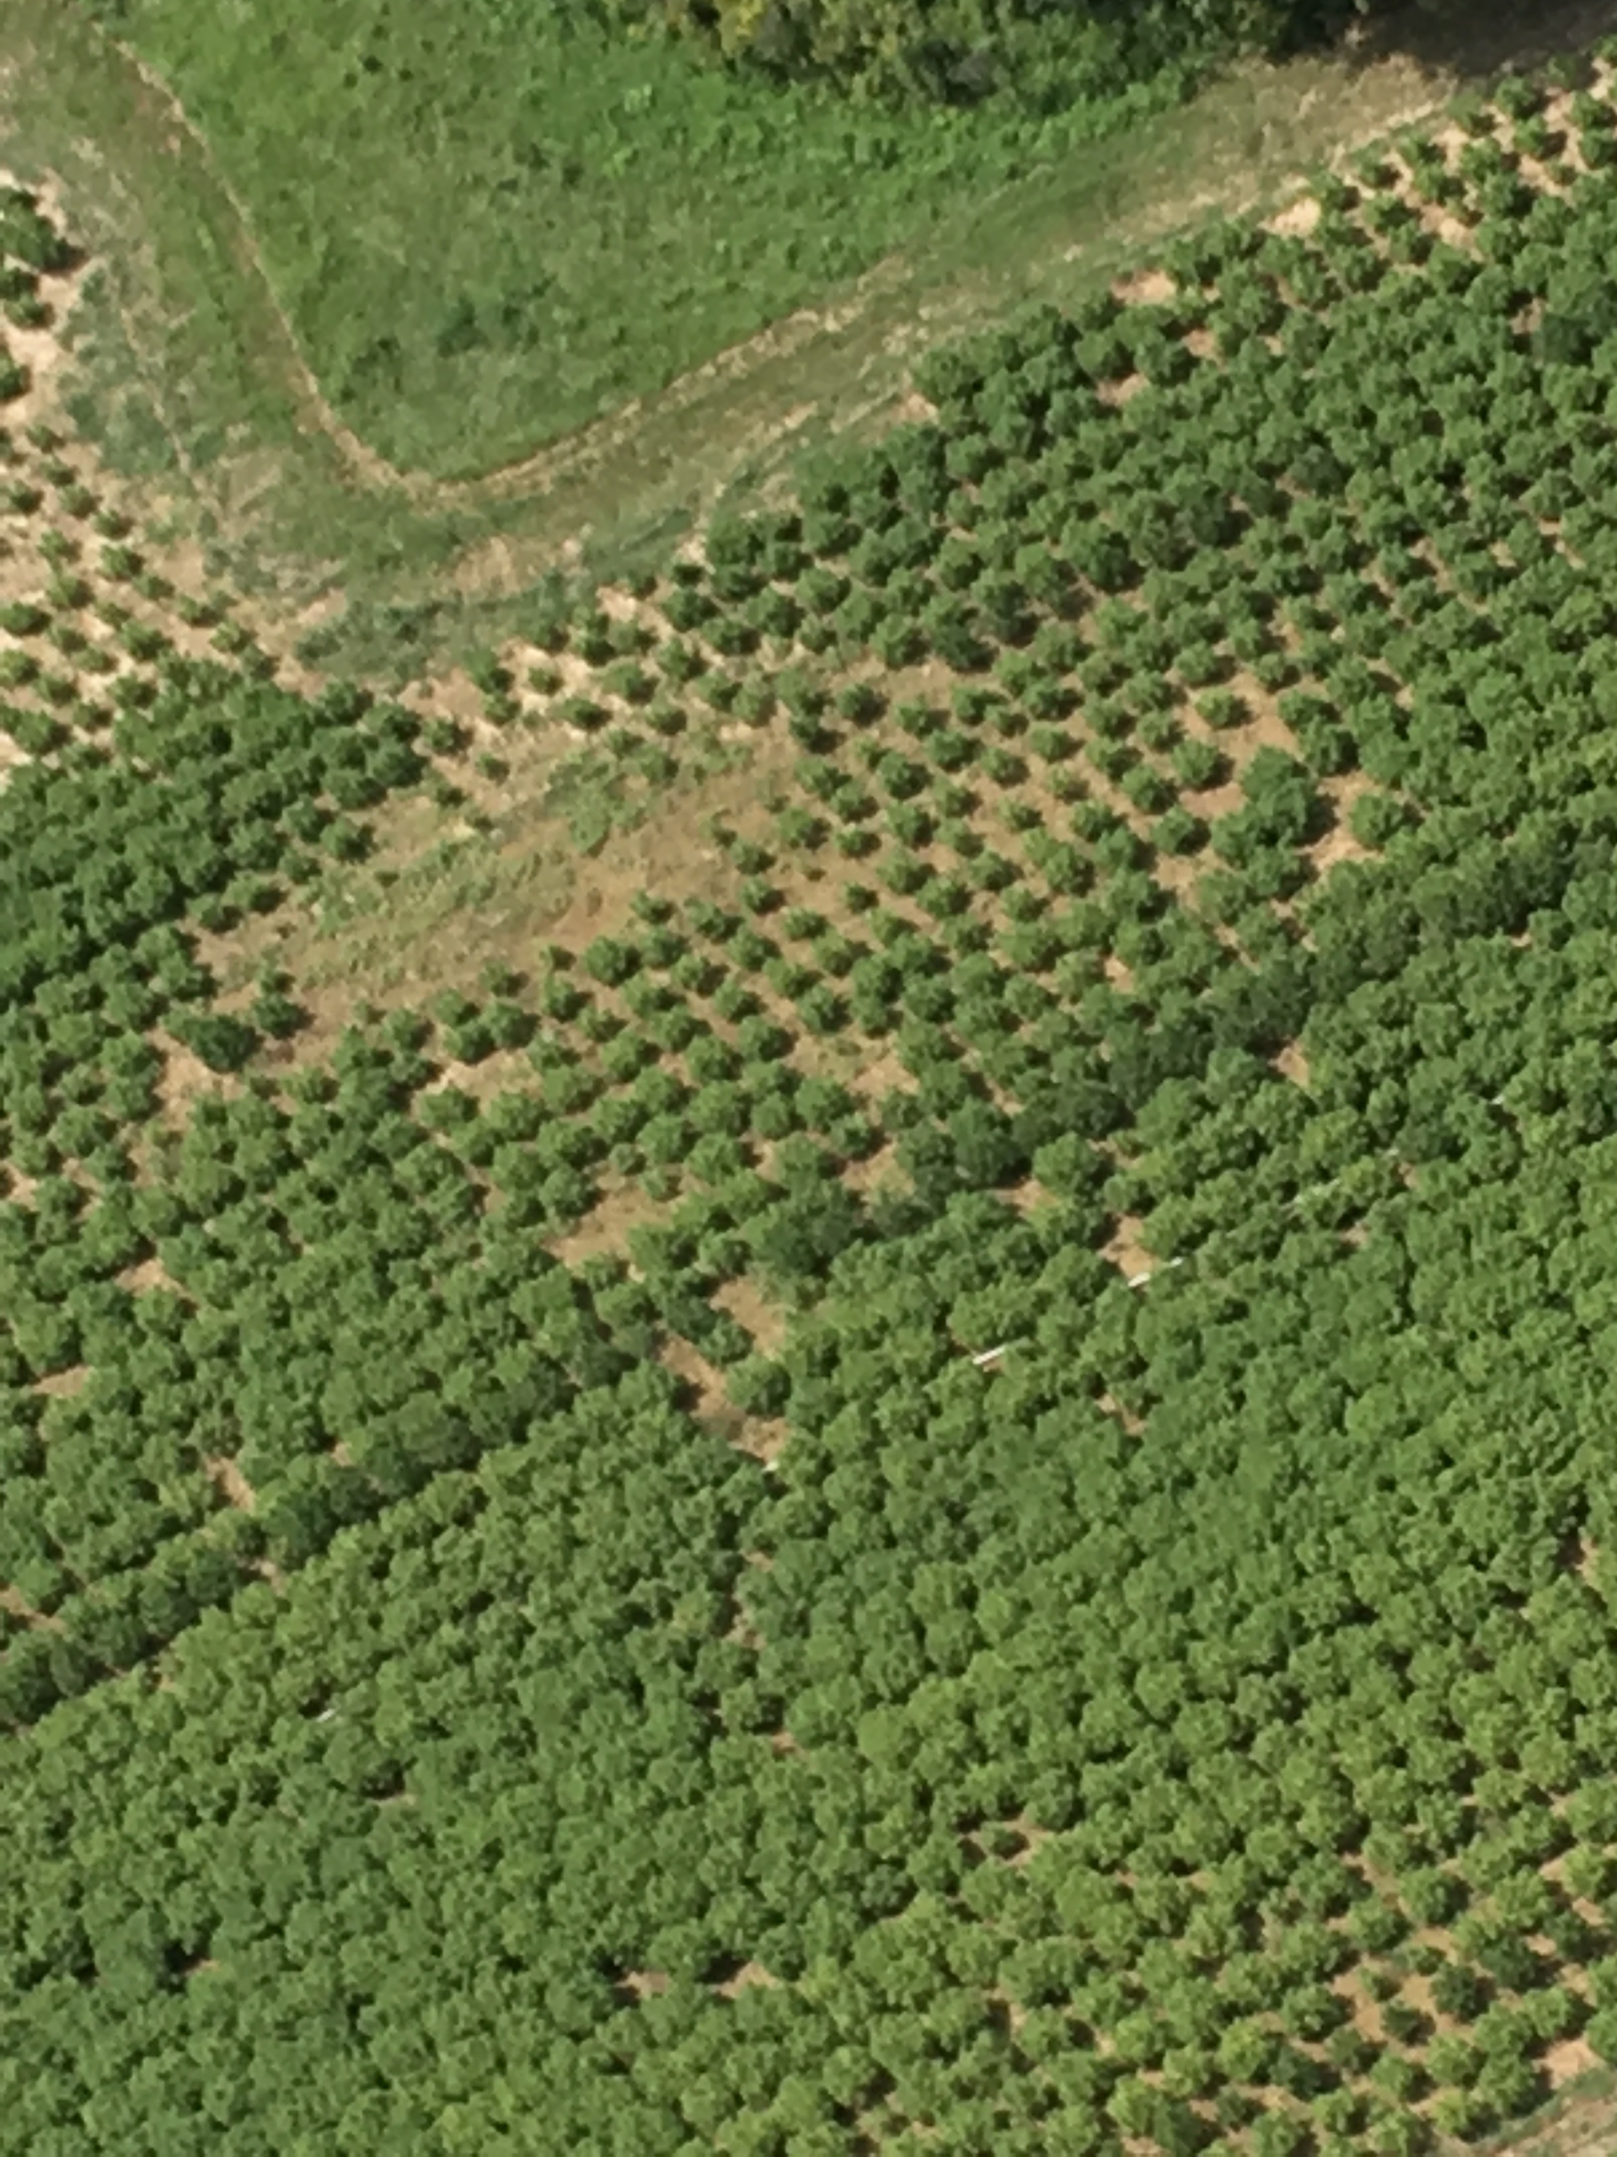
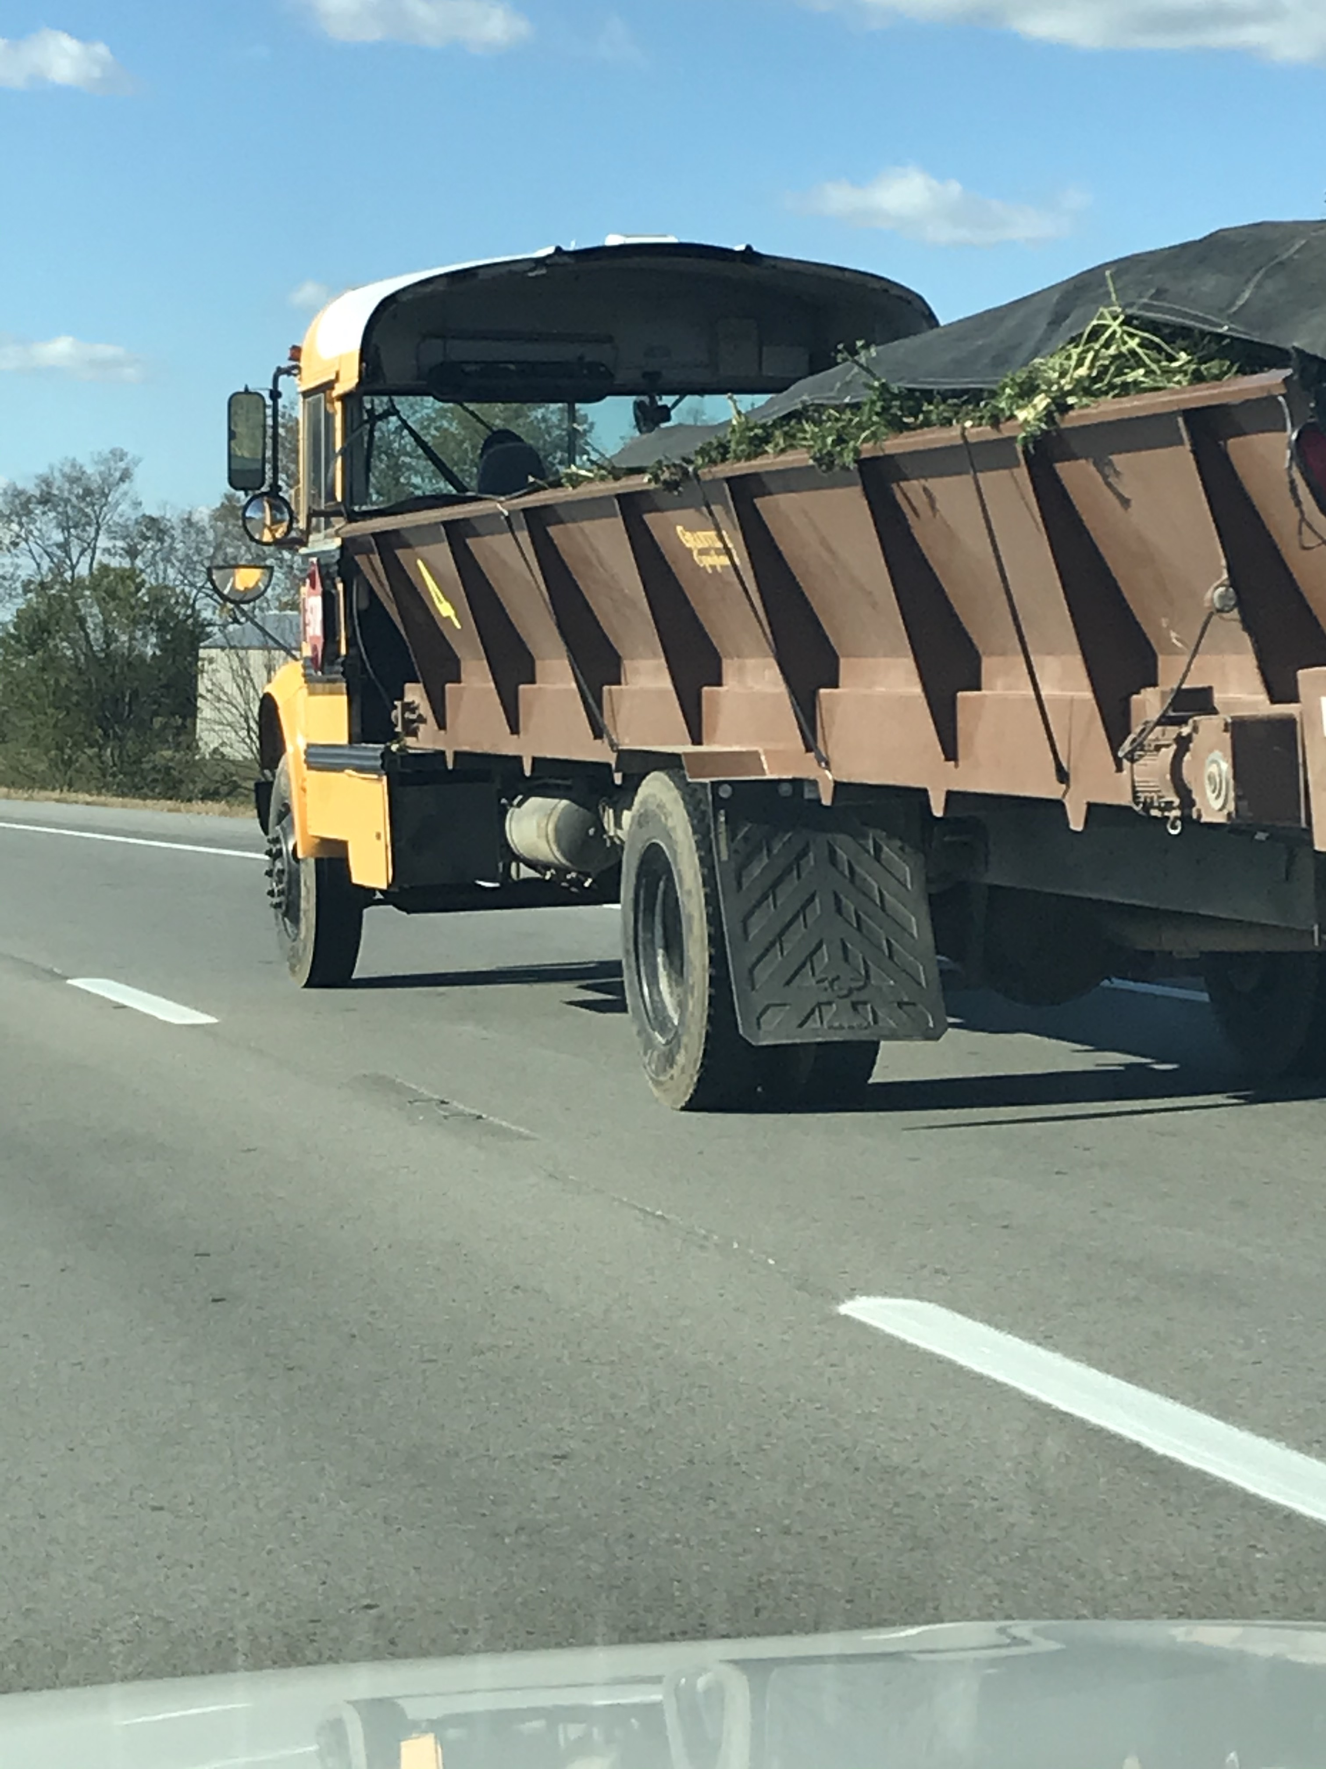
And here we are!

Slide 13
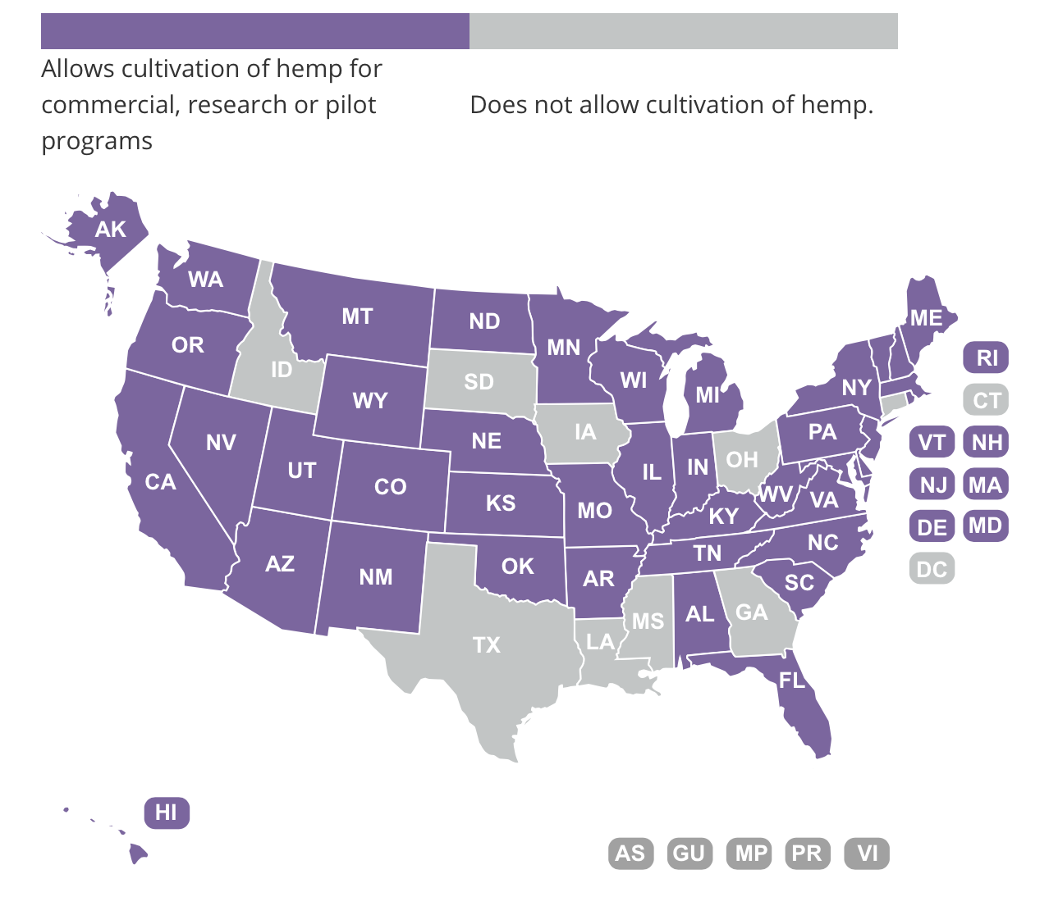

Slide 14
Best Quote I’ve heard so far!
Dr. Mahmoud A. Elsohly-University of Mississippi “Potency Monitoring Project”
“When I was in Kentucky looking at their Hemp fields, I could not tell the difference from the marijuana that I grow in my fields.” “How are you going to tell the difference?” “This is not an agriculture commodity, it is marijuana.” “Where is the market? All the research that I have read says that they is only a small niche market.”
(March 2019 in a meeting with NMI and his staff)

Slide 15
So what is it all about?
In my state it is all about CBD!
So what is CBD?
They grow to produce CBD products.
Oil is the principle product but we see claims of CBD in just about any product that you can imagine.
It is really about legalization!

Slide 16

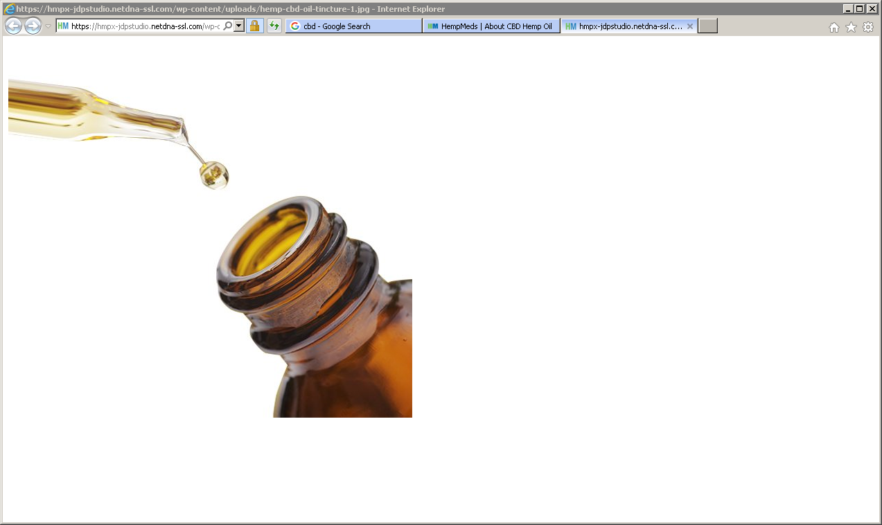
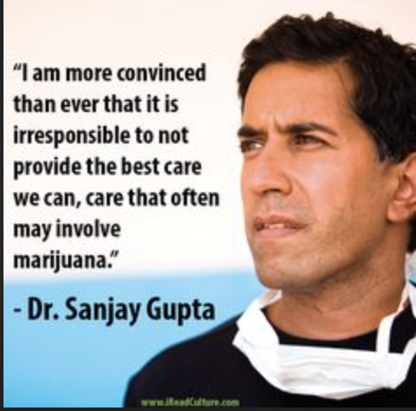

Slide 17
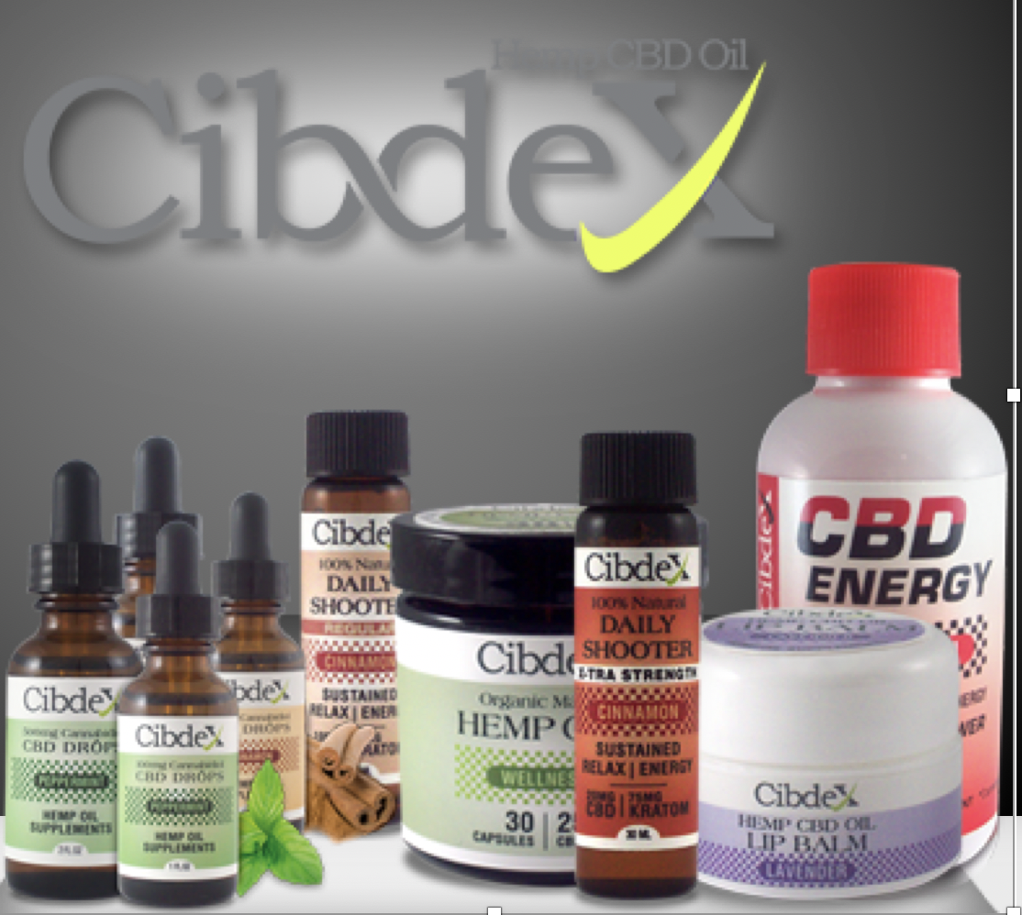

Slide 18
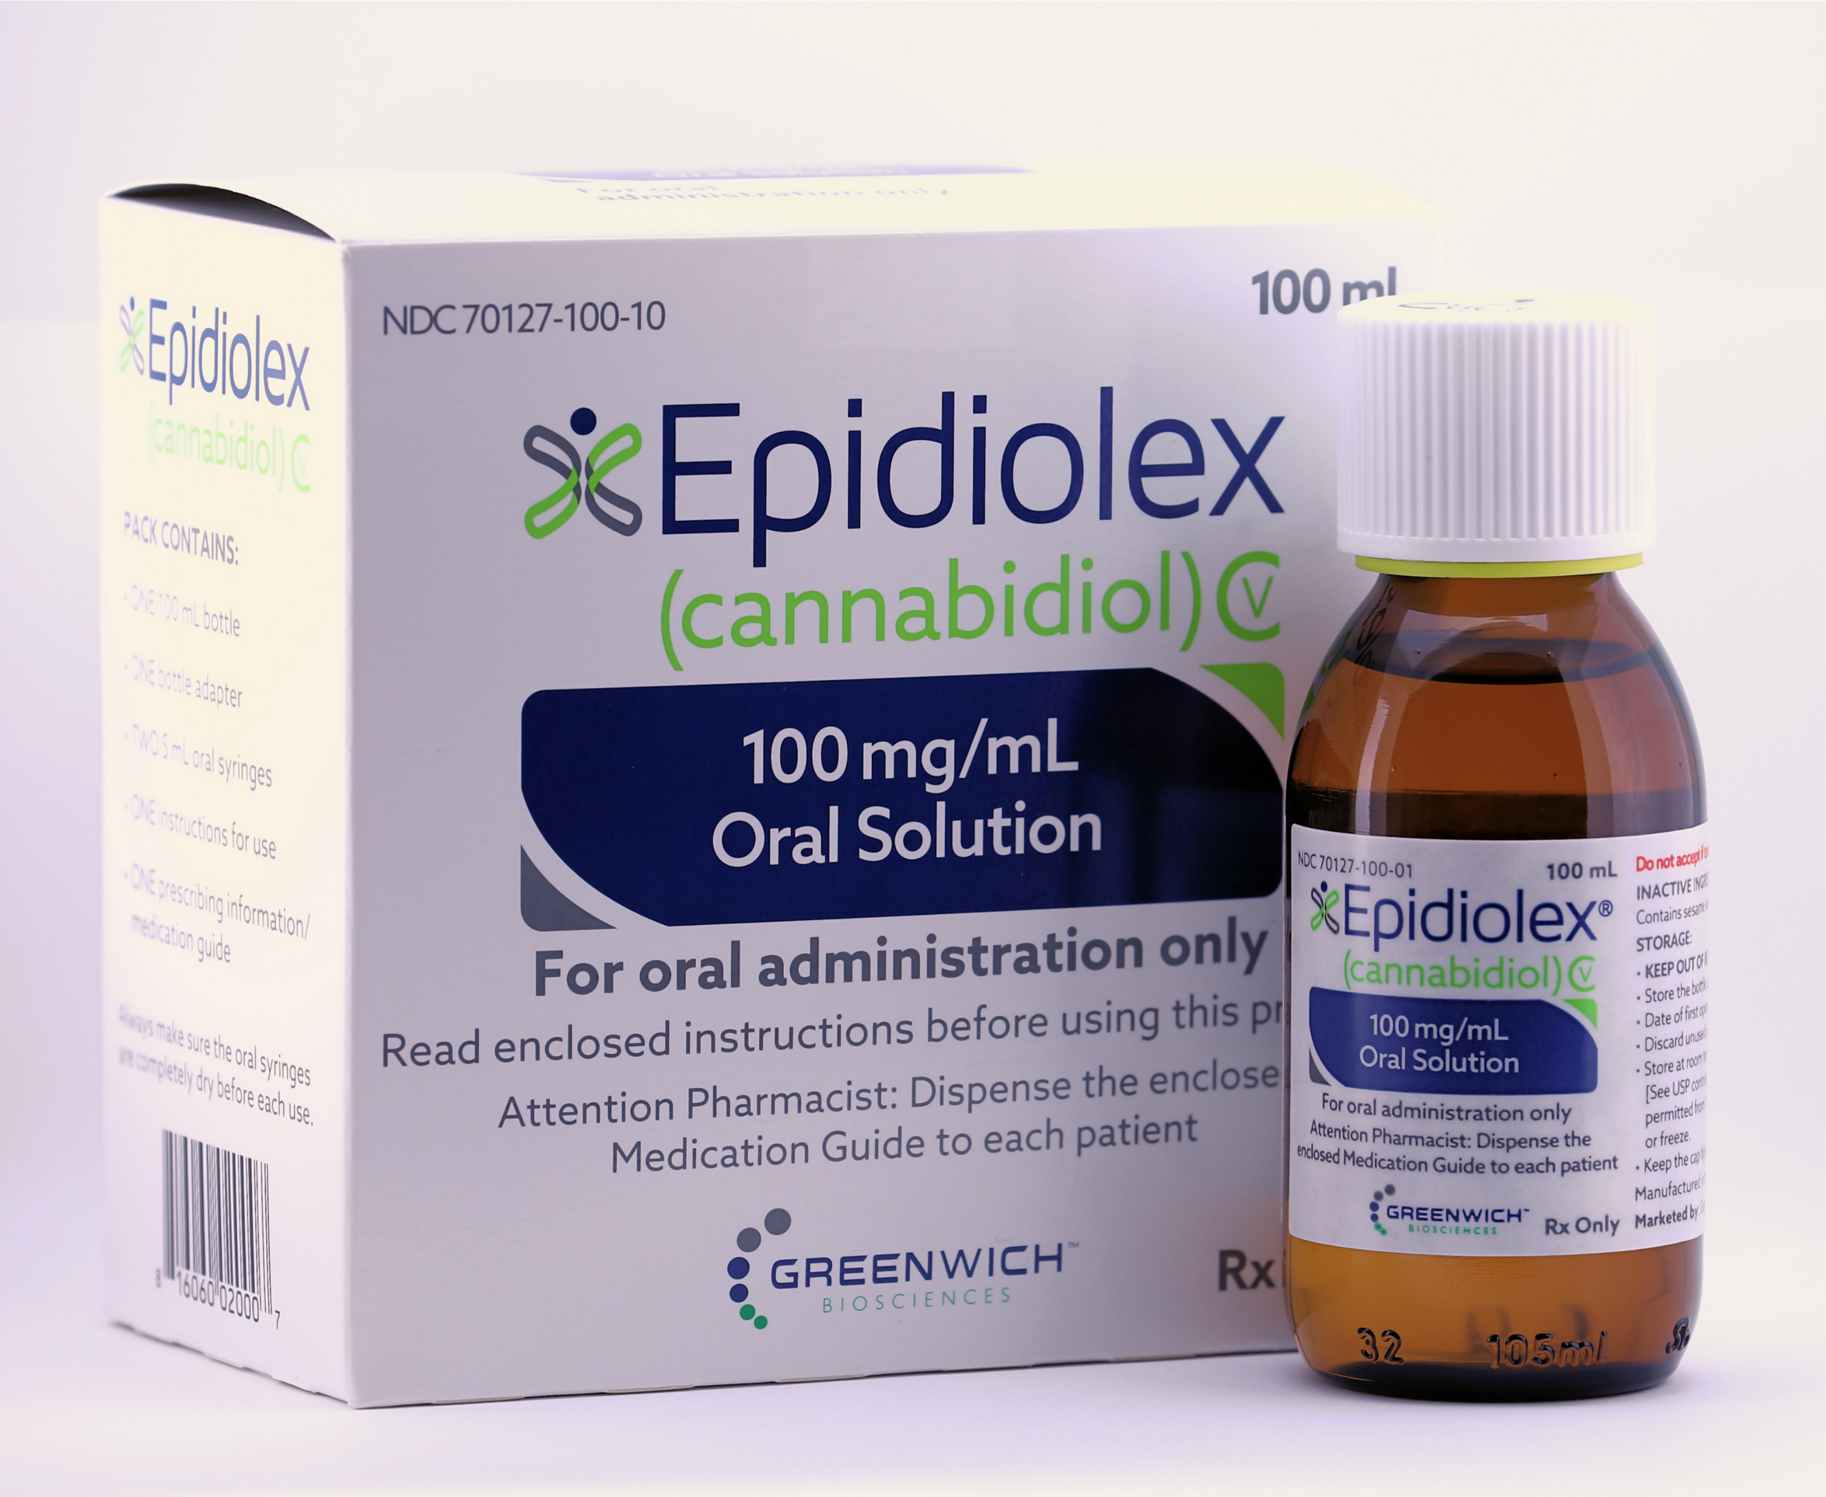
This is the only FDA/DEA Approved CBD product.

Slide 19
summary …
Hemp and marijuana are only distinguished by the THC content. It is Cannabis Sativa L.
THC for Hemp is 0.3% or less by dry weight. It is all over the board and most contain little CBD.
No way to distinguish unless you are doing quantitative analysis.
Most state statutes limit law enforcement involvement and make enforcement difficult.
Hemp is just another method that is use to normalize marijuana in the publics eye. After all it is an agricultural commodity!

Slide 20
Summary
Hemp will be the ideal vessel for comingling of other illicit drugs. We already have seen tractor trailer loads of the stuff interdicted and officers have no idea what to do.
Hemp sales in Canada have not been the cash cow that the farmers were promised.
Yet to be determined here.
Hemp currently can not be regulated and is an enforcement nightmare.

