Slide 1

Past Month Usage by 26+ Year-Olds
Adult Marijuana Use – Ages 26+ in 2017
National average = 6.88 percent (Up from 2014)
Colorado average = 14.00 percent (Up from 2014)
Colorado adults are ranked 3rd nationally
Ranked 6th in 2011
Ranked 7rd in 2012
Ranked 5th in 2013
Ranked 1st in 2014
Ranked 1st in 2015
103.4 percent higher than national average
Source: National Survey on Drug Use and Health & DASIS 2017

Slide 2
Past Month Usage – State Comparisons
Source: National Survey on Drug Use and Health 2011 - 2017

Slide 3
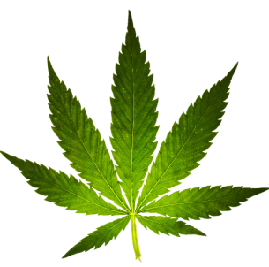
The Legalization of Marijuana in Colorado: The Impact
Contributing factors to drug abuse
Harm
Use goes up
Risk
Easy to get
Social Acceptance
Social Apathy
Availability

Slide 4
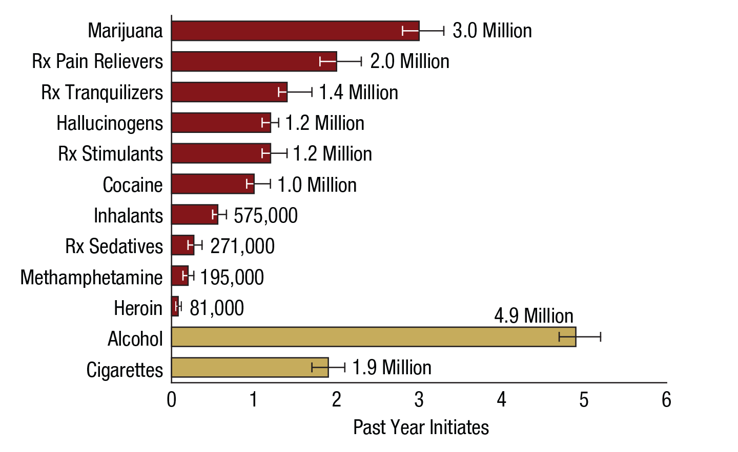
Numbers of Past Year Initiates of Substances among People Aged 12 or Older: 2017
Drug Use In America
FFR1.27
Persons
Source: SAMHSA NSDUH Report Sept. 2017

Slide 5
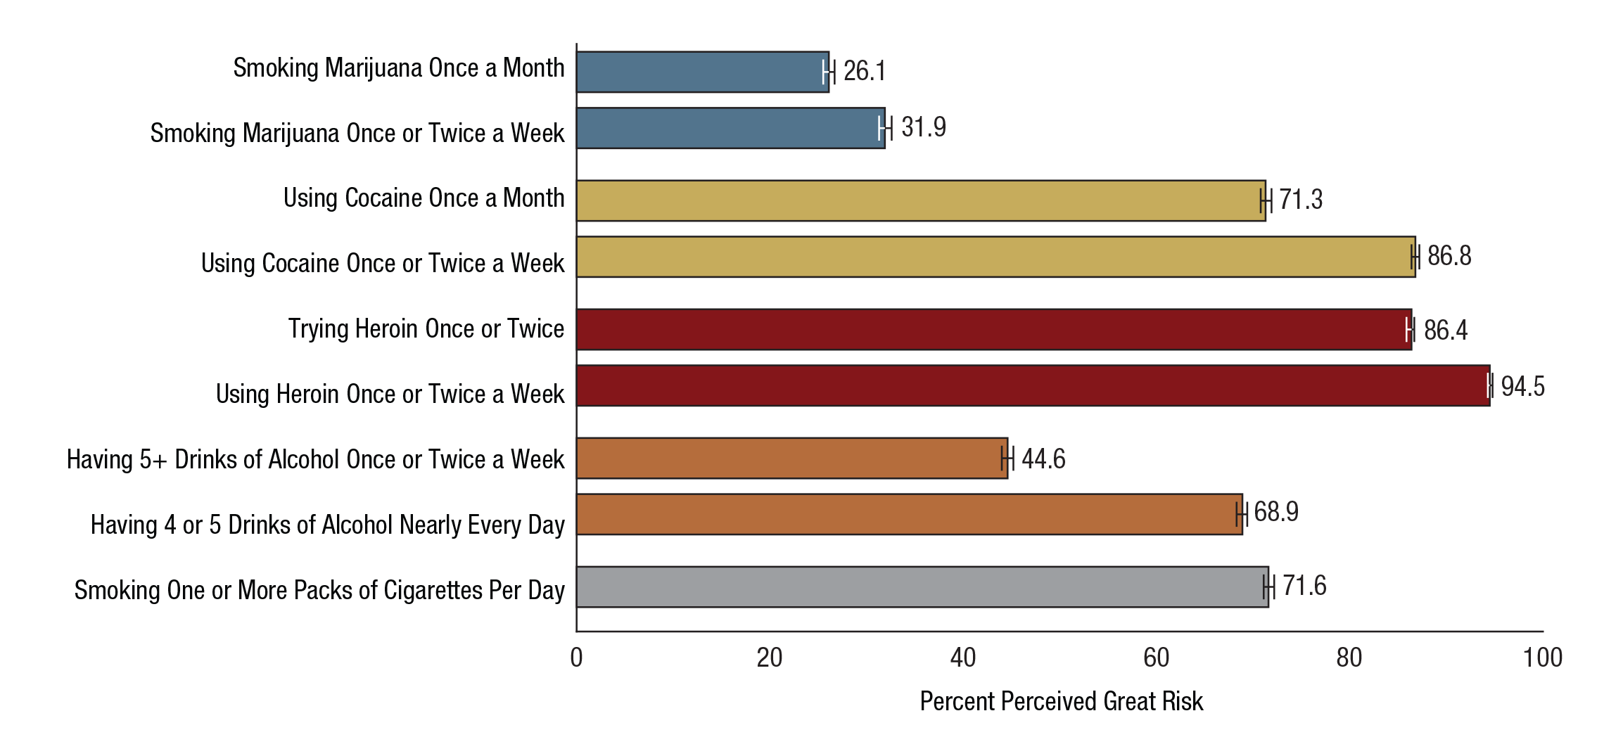
Perceived Great Risk from Substance Use among People Aged 12 or Older: Percentages, 2017
Drug Use In America
FFR1.31
Marijuana
Cocaine
Heroin
Alcohol
Cigarettes
Source: SAMHSA NSDUH Report Sept. 2017

Slide 6
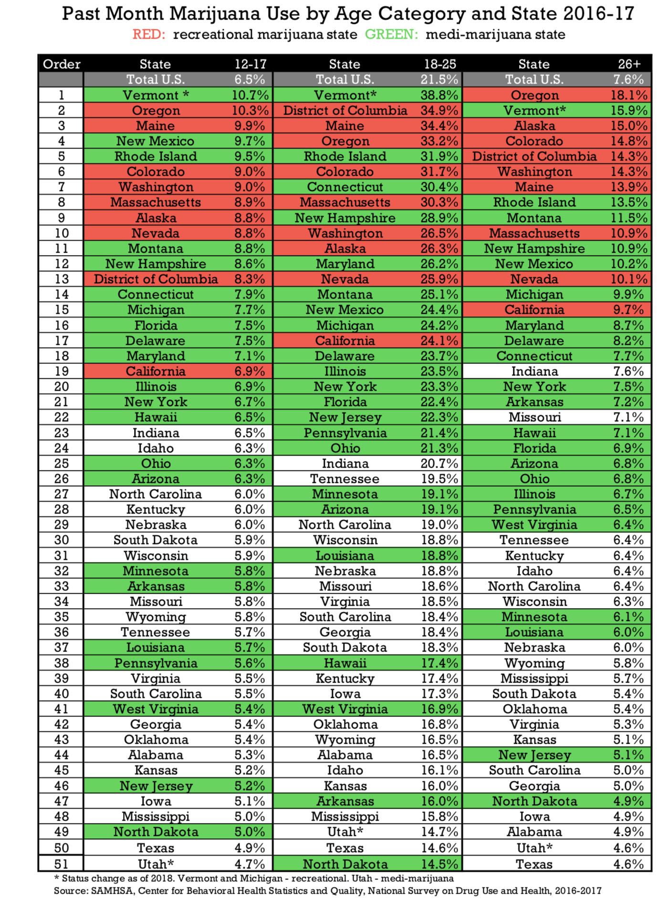
Public Health Issues – Current Use Rates
SOURCE: NSDUN 2016 – 2017 data
National Marijuana Initiative March 2019

Slide 7
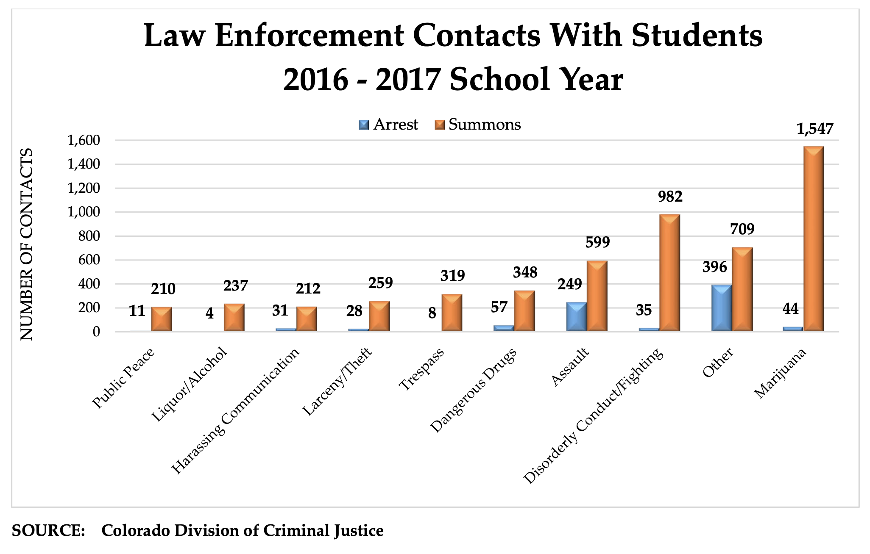

Slide 8
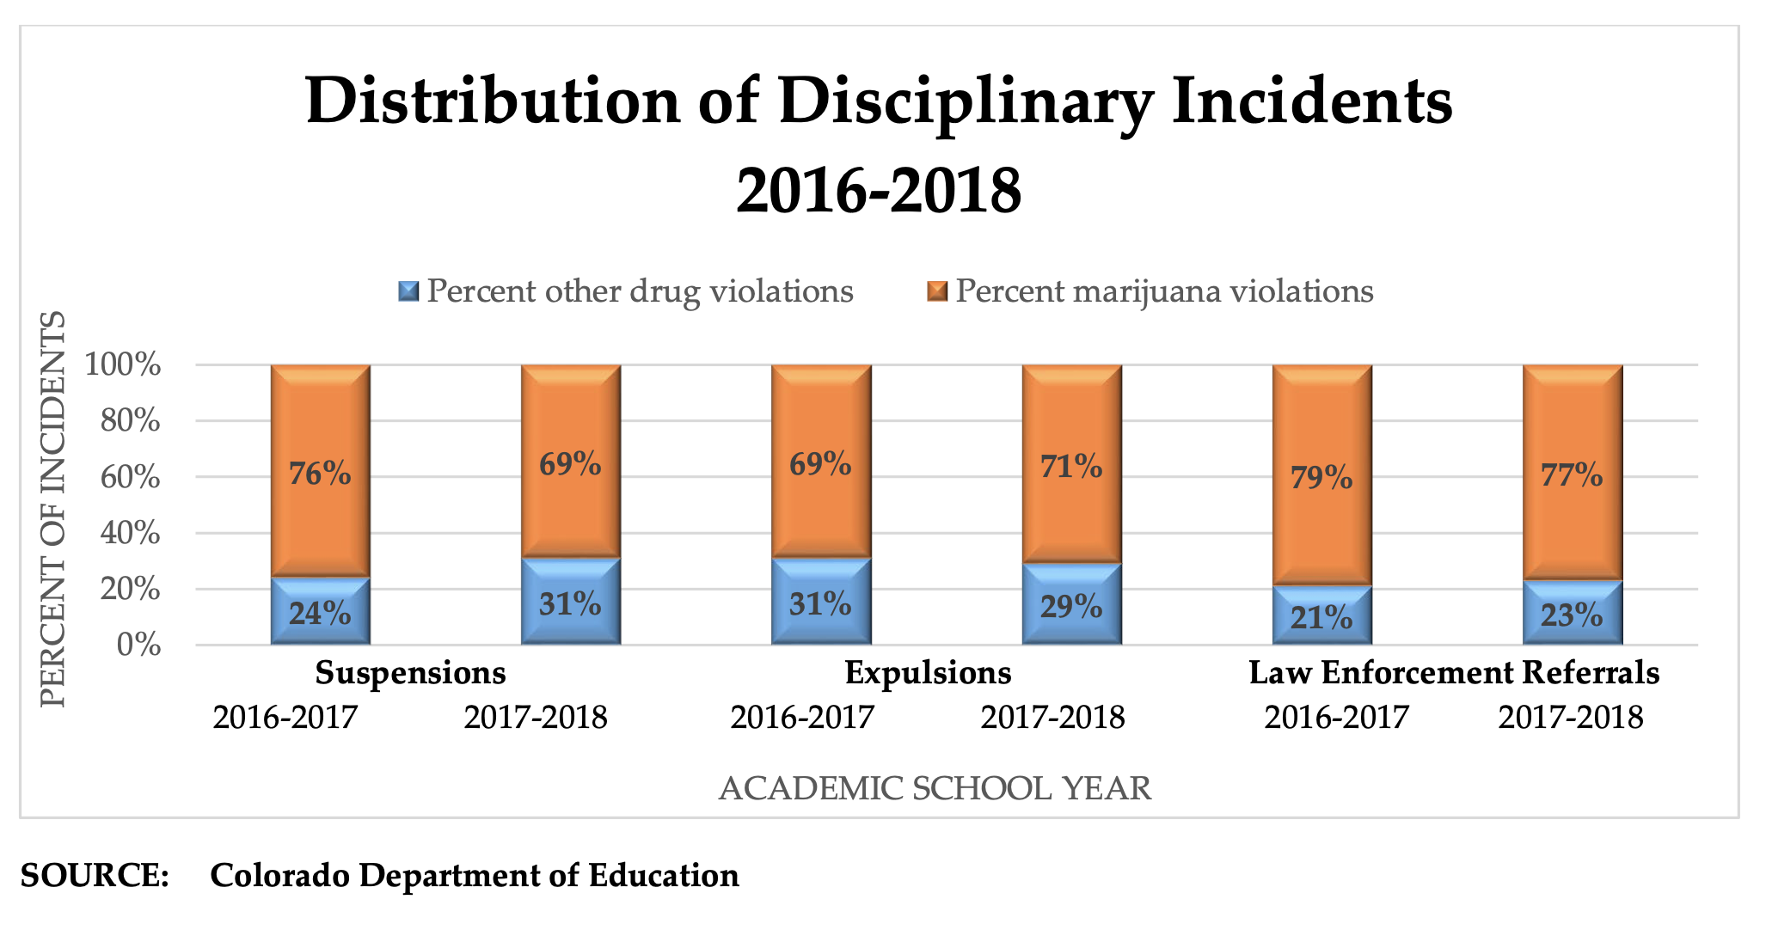

Slide 9
Public Health Issues – Treatment Data
Key Talking Points:
In states where marijuana is legalized there are less referrals to treatment from the courts
Initial referral may be missed due to lack of enforcement
Nationally, treatment admission data reveals:
From 2014 – 2016
Ranking of treatment admissions:
Heroin – 26 – 30 yr olds
Alcohol – 46 - 55 yr olds
Marijuana – 12- 17 yr olds
Marijuana is the only drug where minors, 12 – 17 year olds, are the most effected age group
SOURCE: SAMHSA / DASIS Data, March 25, 2016
National Marijuana Initiative March 2019

Slide 10
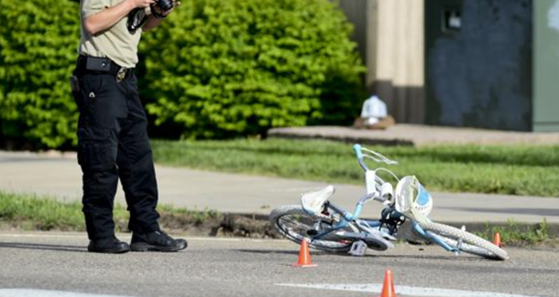
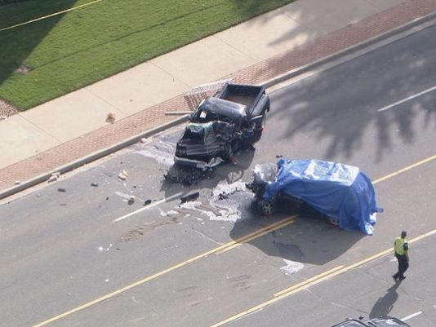
Marijuana and Traffic Safety Issues

Slide 11
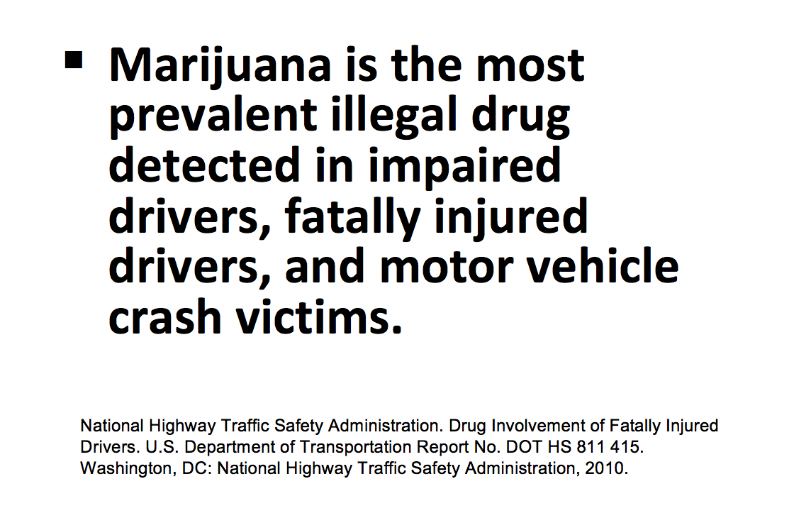
Public Safety Issues – Impaired Driving
National Marijuana Initiative March 2019

Slide 12
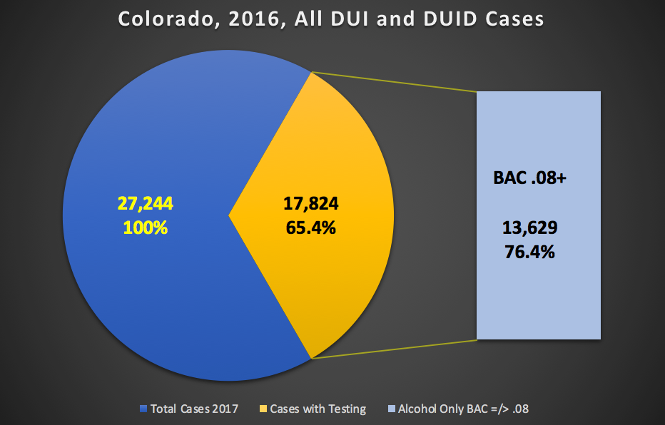
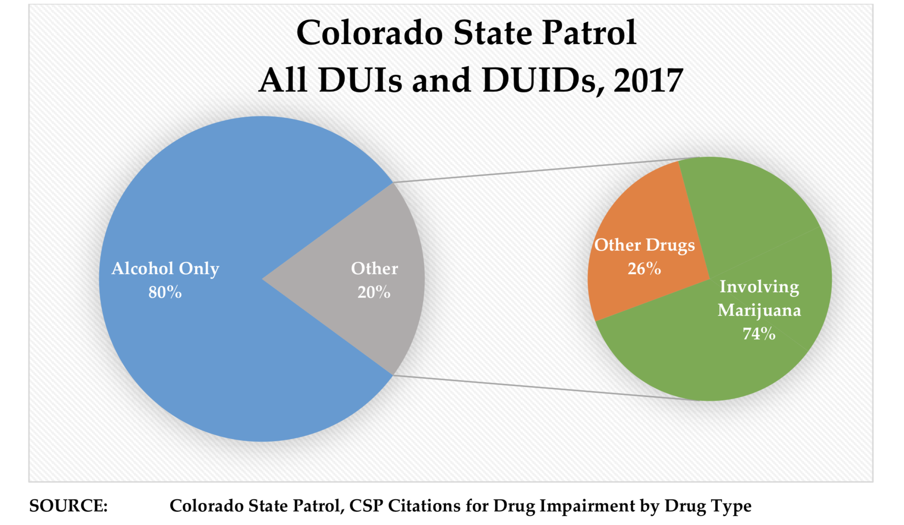
Marijuana and Highway Safety
Why Is This Important To Understand?
National Marijuana Initiative (NMI) 01/2019
Source:
Colorado Department of Public Safety Division of Criminal Justice - July 2018

Slide 13
Marijuana and Highway Safety
18.3%
Increase
Rev. 03-01-19
Source: Colorado Dept. Transportation – Total Crashes Report

Slide 14
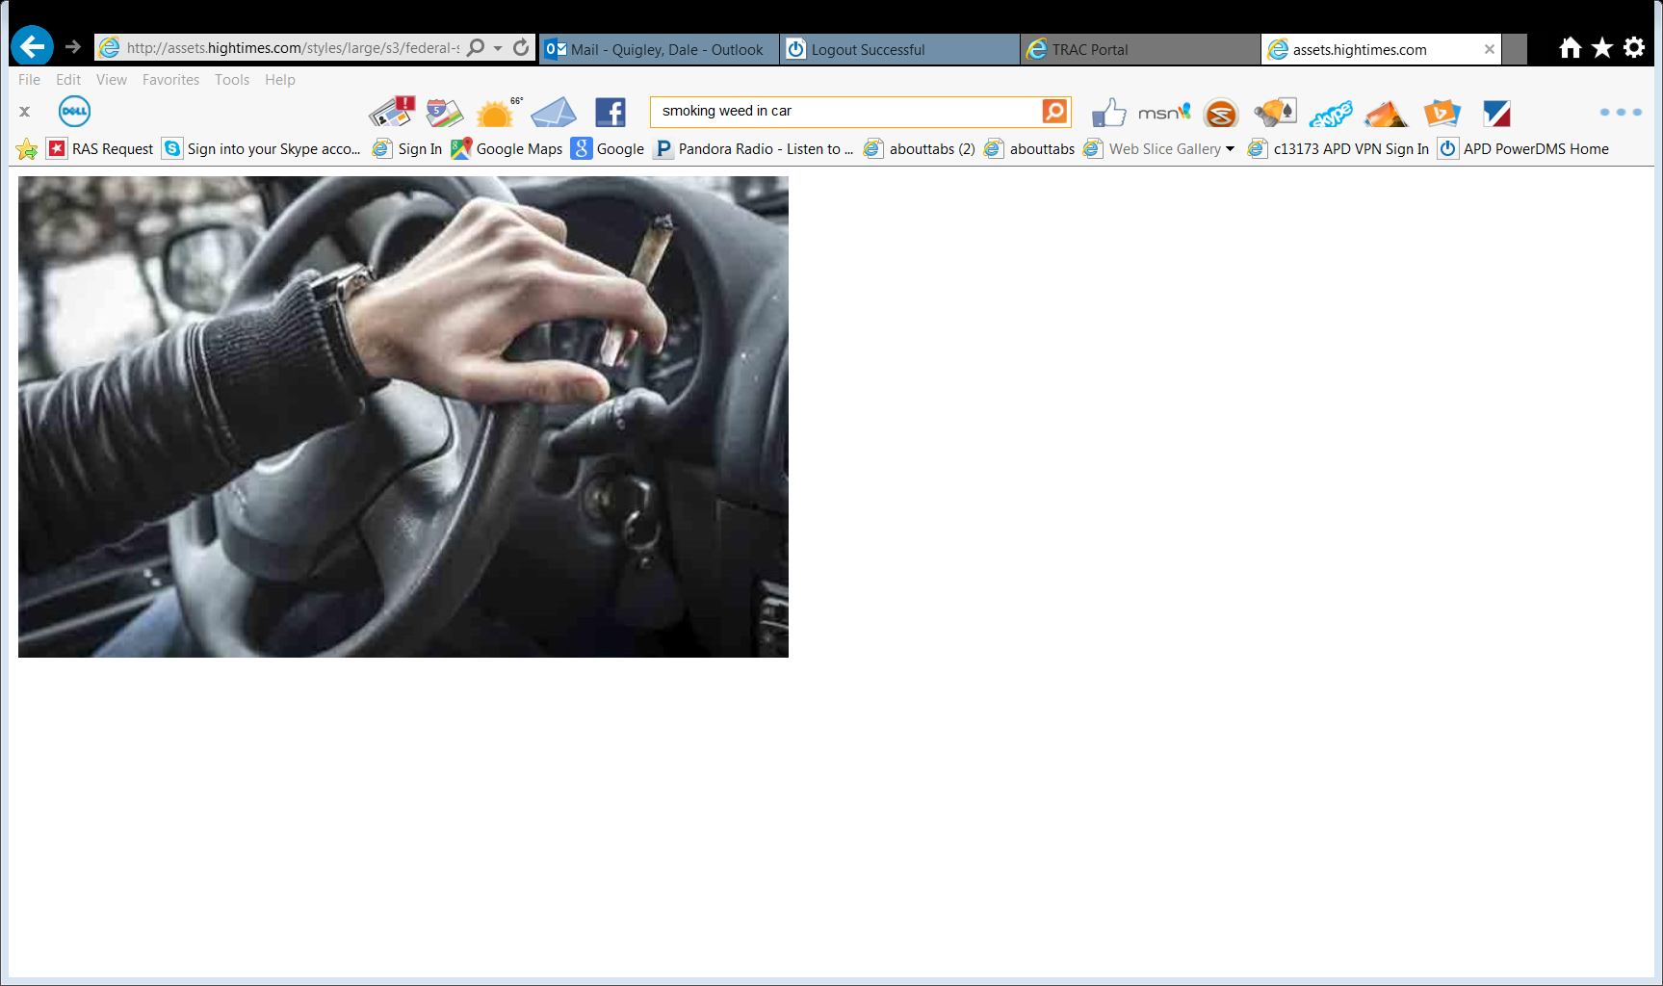
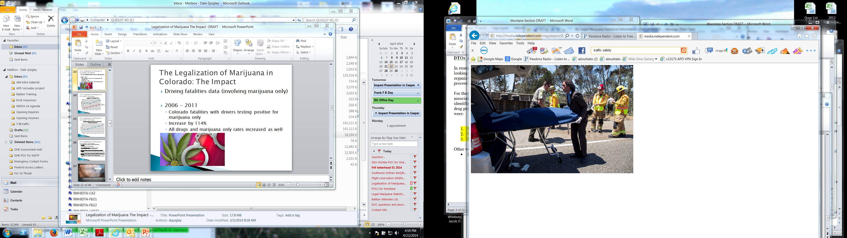
Marijuana and Highway Safety
Driving fatalities data – Recent changes
2011 - 2017
Overall Colorado fatalities increased by 44.9%
Fatalities with operators testing positive for marijuana up by 157 %
National Marijuana Initiative (NMI) 01/2019
Source: Colorado Department of Transportation - 2018

Slide 15
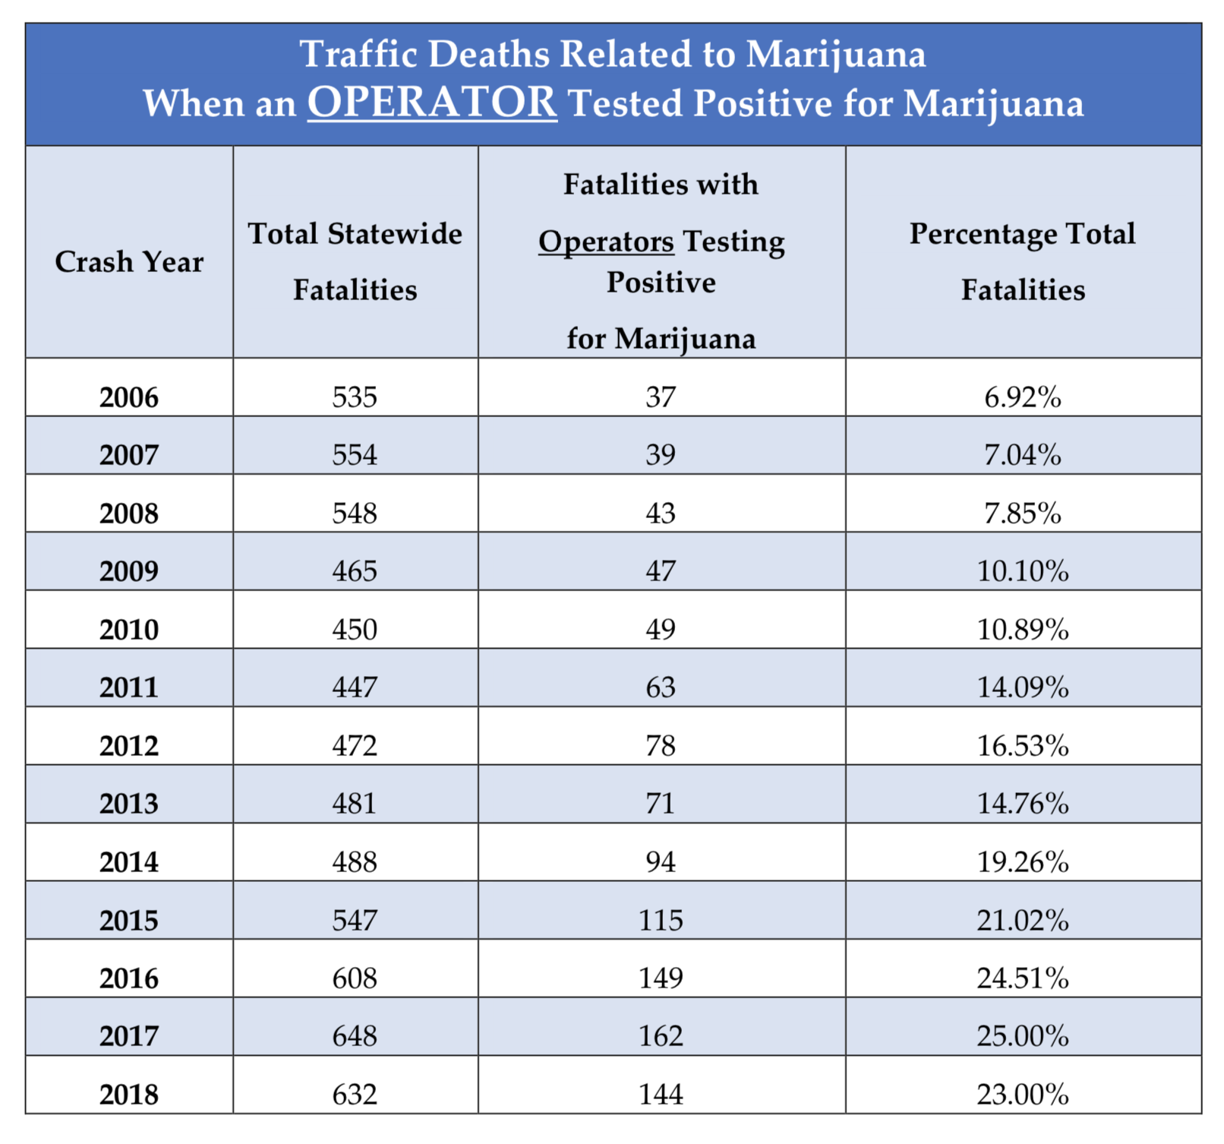

Slide 16
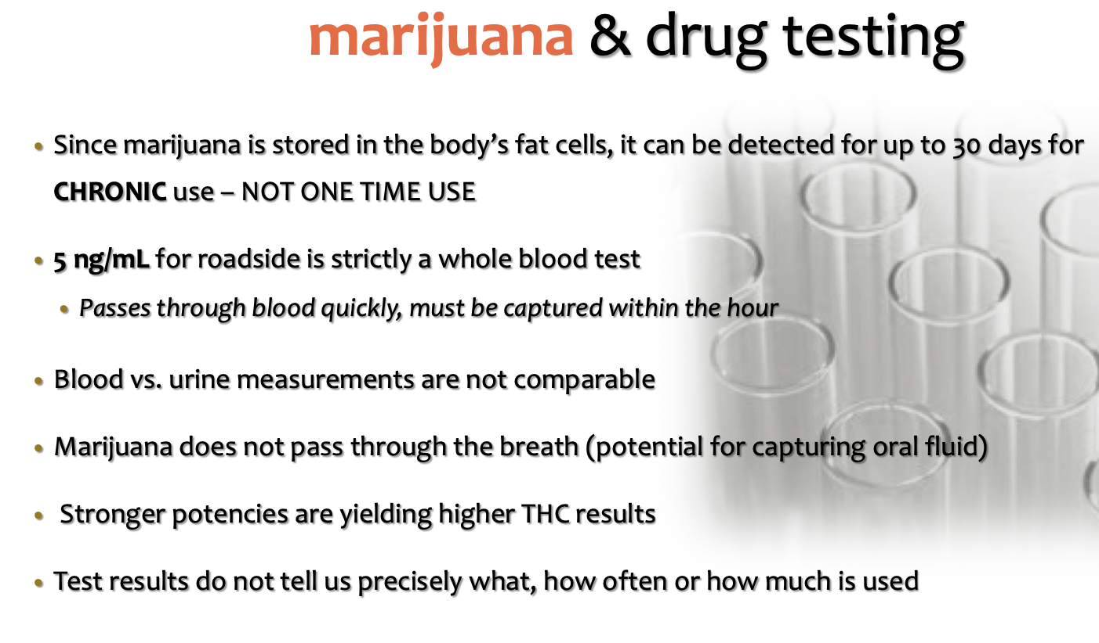

Slide 17
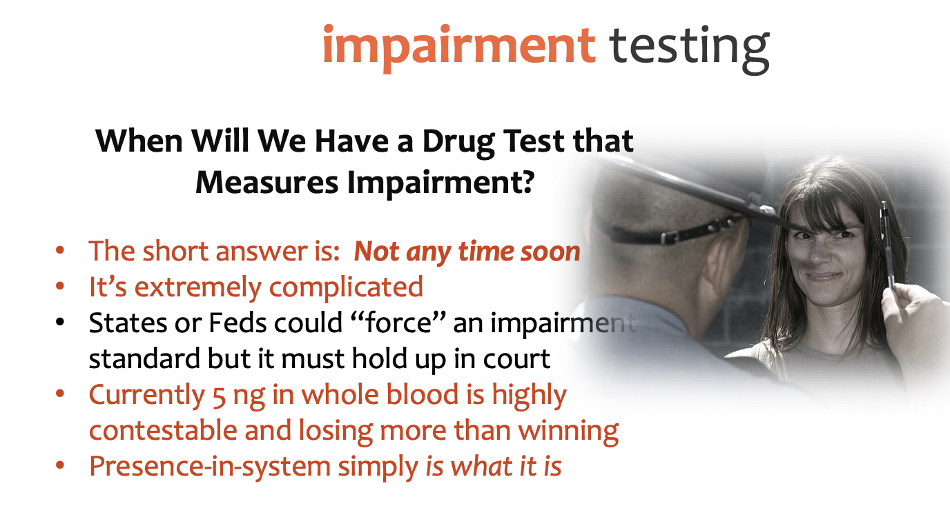

Slide 18
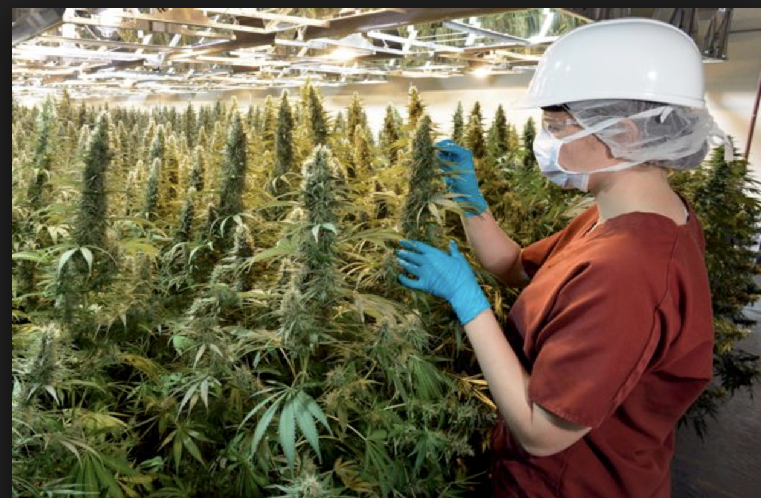
Marijuana – Black, Grey or What Operations ??

Slide 19
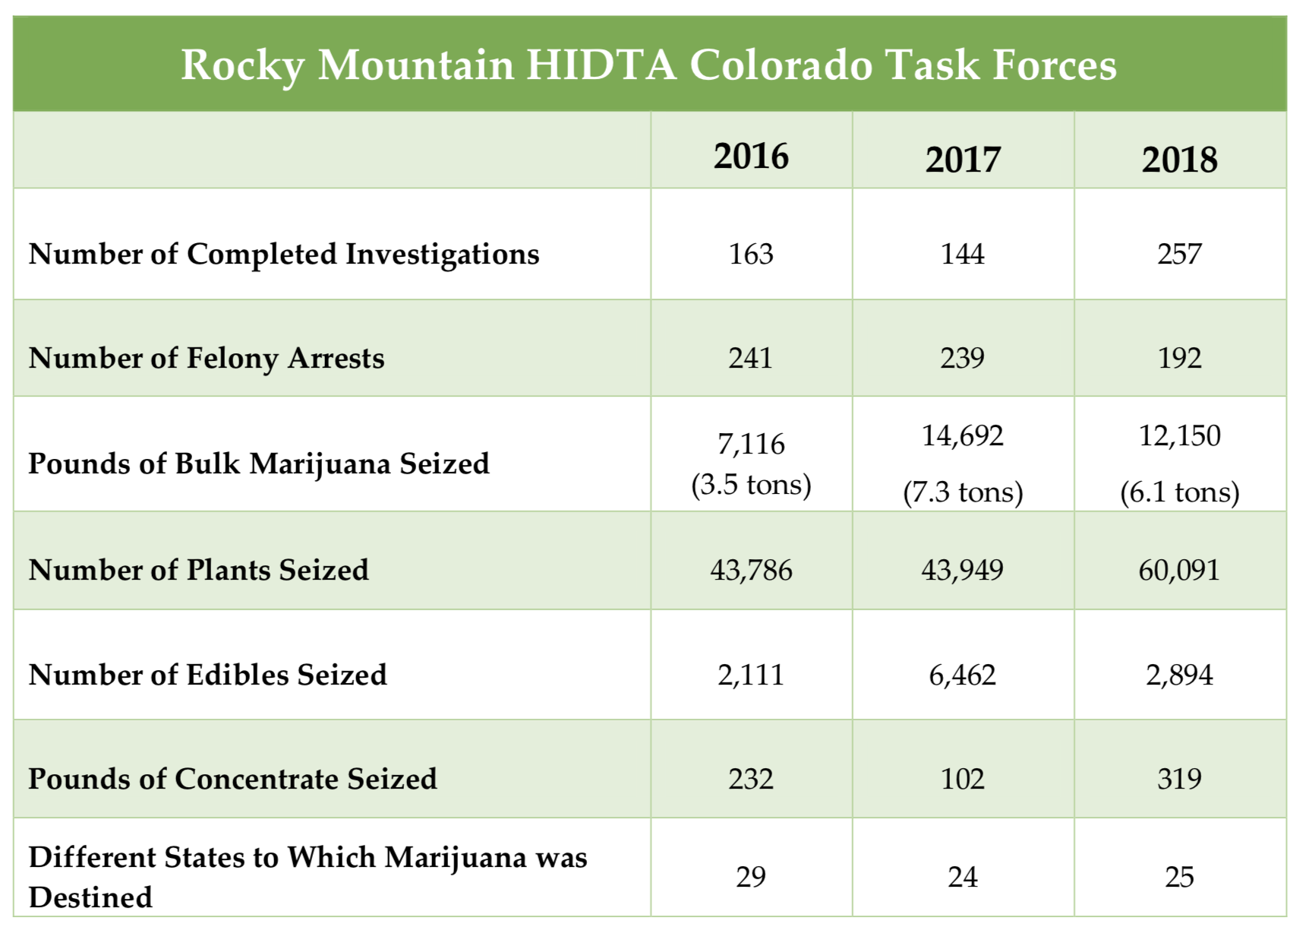
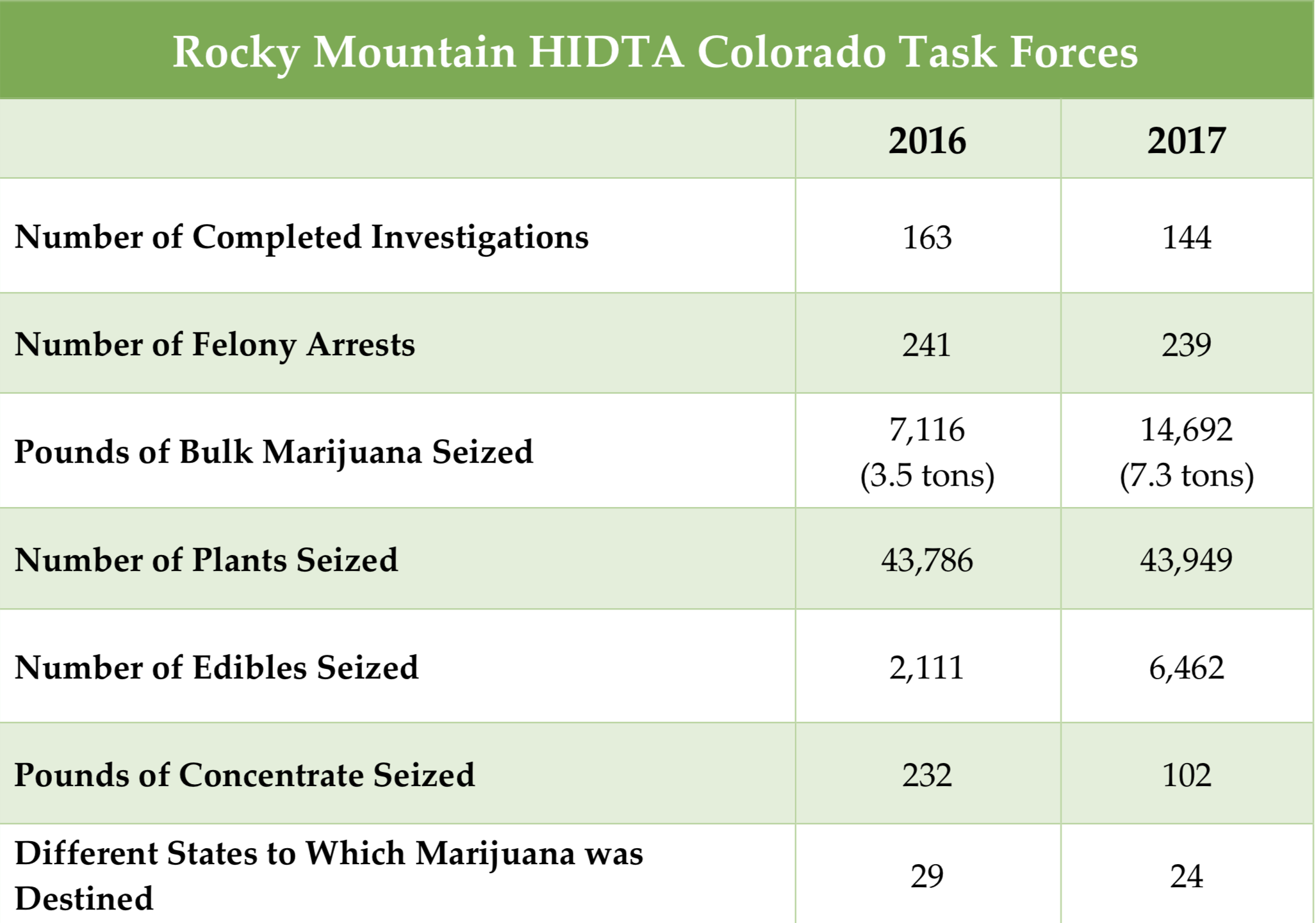
Public Safety Issues – “Black Market” Ops
Black Market – Outside the legal regulations of operations.
Looking at just Rocky Mountain HIDTA Task Force Enforcement Initiatives
2016 – 2018 for
Investigations, Seizures and Arrests
SOURCE: Rocky Mountain HIDTA, PMP data , 2016 - 2018
National Marijuana Initiative Oct. 2019

Slide 20
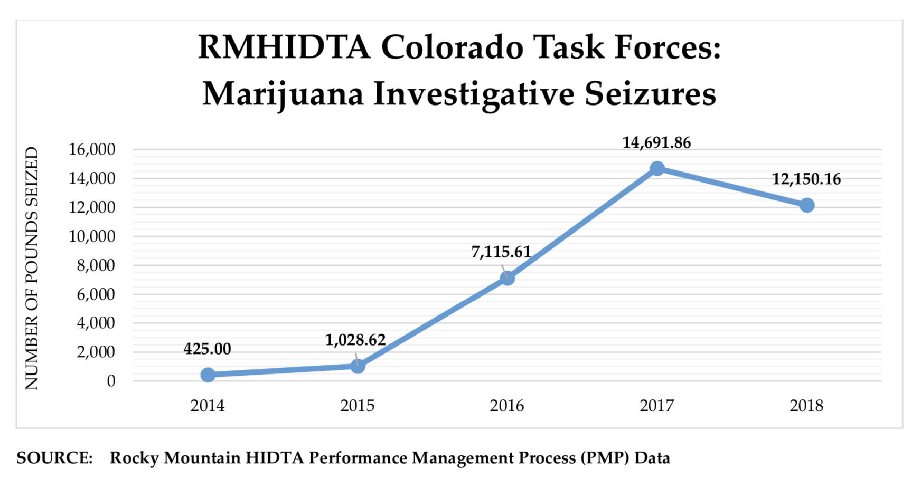
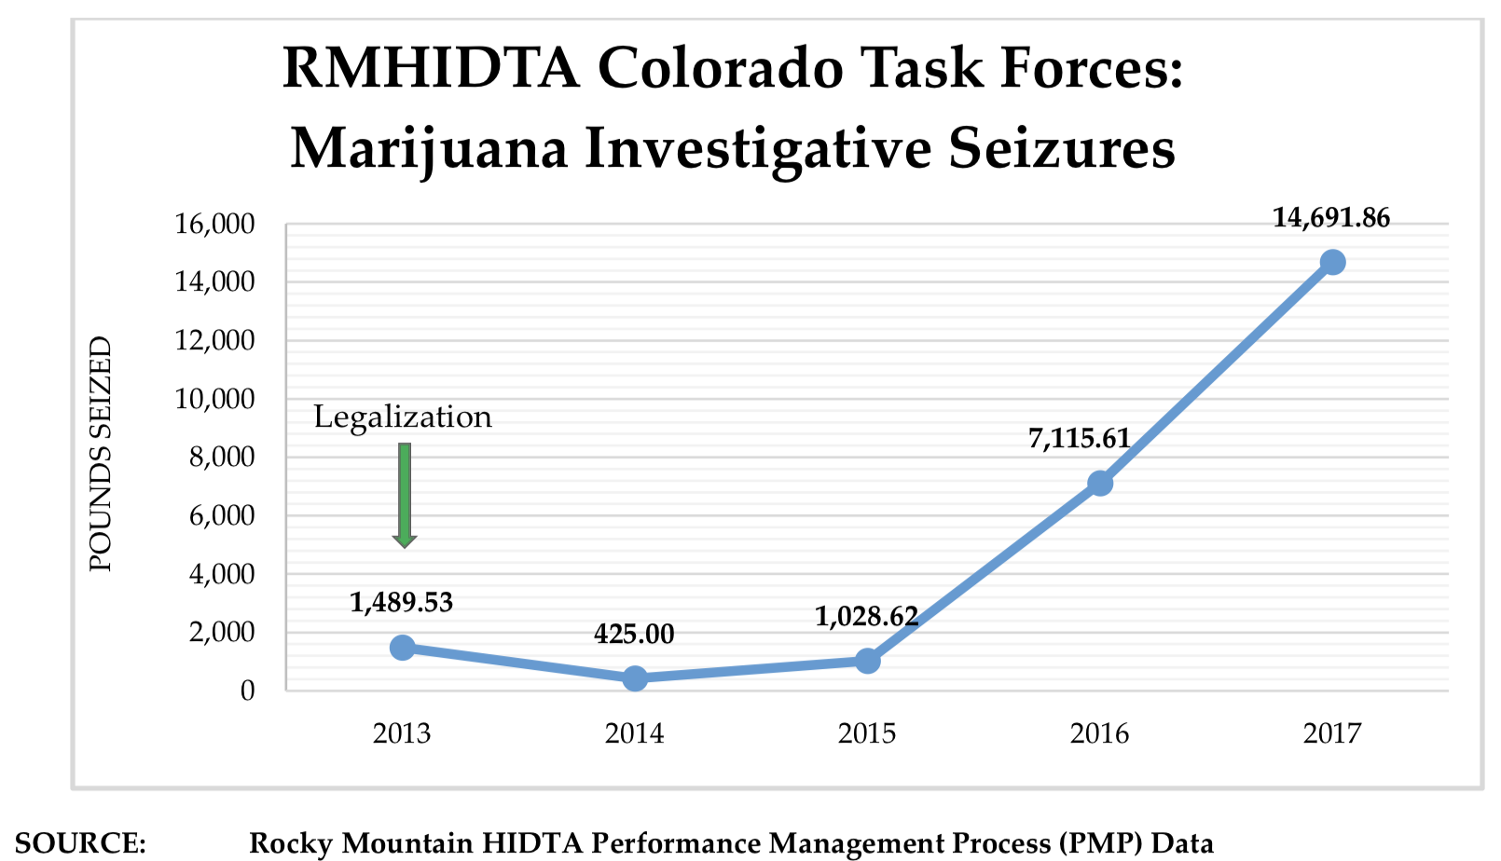
Public Safety Issues – “Black Market” Ops
National Marijuana Initiative Oct 2019

Slide 21
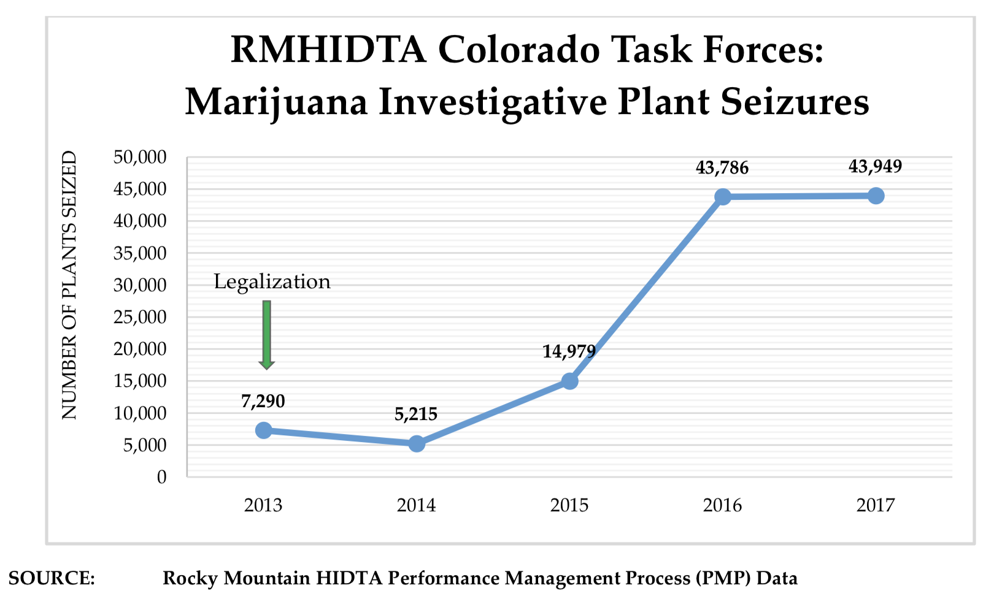
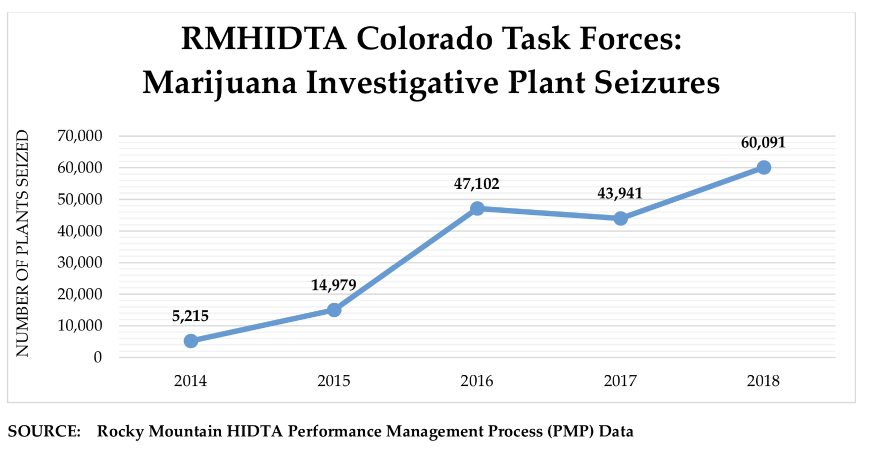
Public Safety Issues – “Black Market” Ops
National Marijuana Initiative Oct 2019

Slide 22
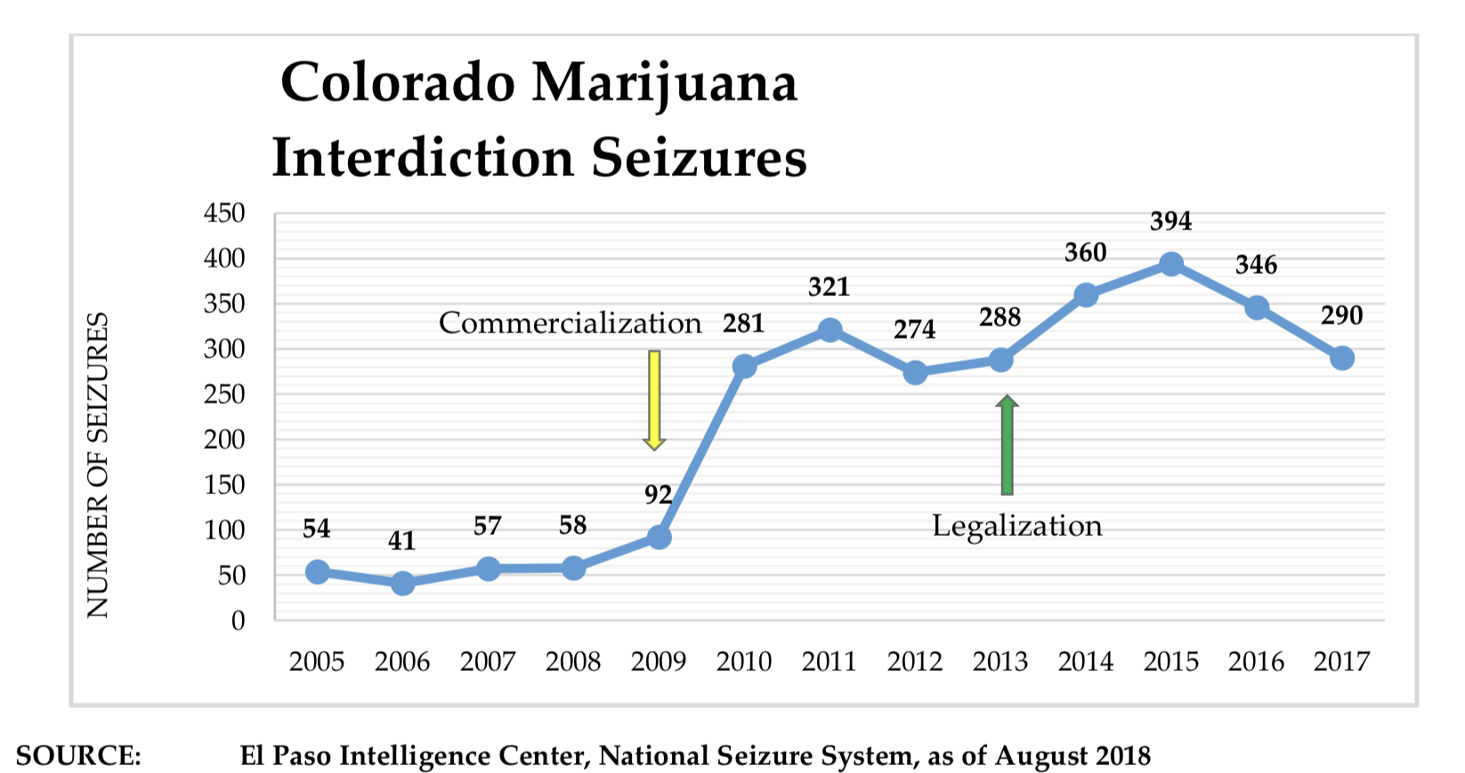
Public Safety Issues – “Black Market” Ops
National Marijuana Initiative July 2019

Slide 23
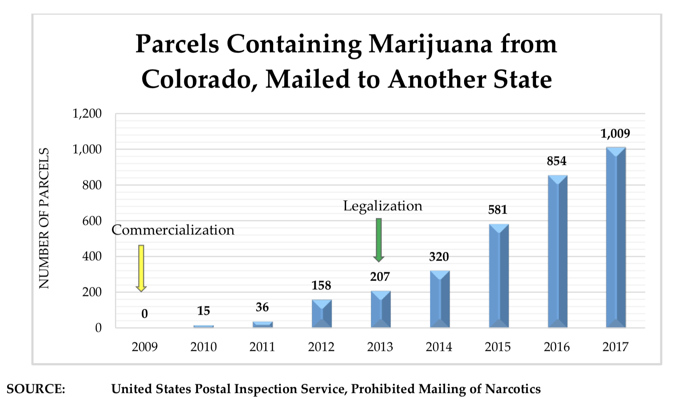
Public Safety Issues – “Black Market” Ops
National Marijuana Initiative July 2019

Slide 24
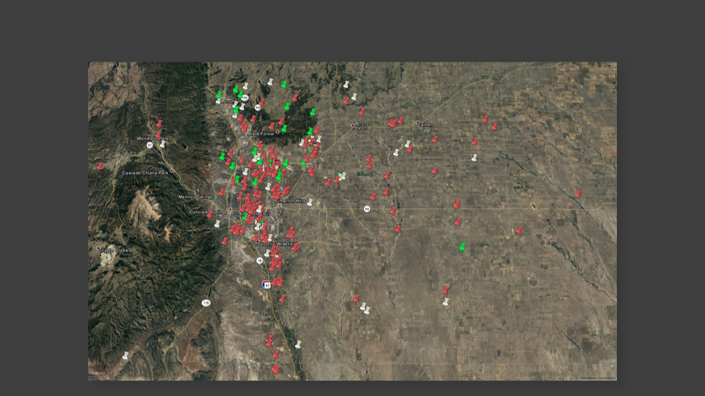
El Paso County Colorado
Over 650 Cuban Grow houses identified in DEA Colorado Springs cases

Slide 25
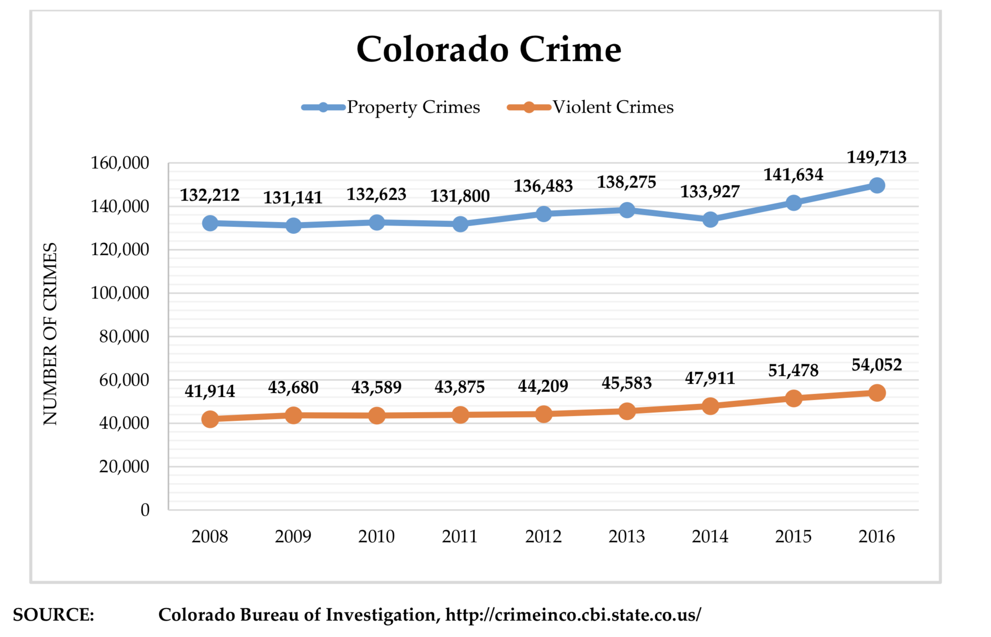
Public Safety Issues- Crime in general
National Marijuana Initiative July 2019

