Slide 1


Slide 2

About IYS
Illinois Youth Survey (IYS) is FREE to schools and takes just one class period to survey students. ​
The IYS is administered every other year to 8th, 10th, and 12th grade students.
Use IYS data to:​
Better understand your students’ health and wellness needs.
Educate and raise awareness among faculty and staff​.
Provide information for parents and guardians​.
Utilize data collected from IYS to make data driven decisions to benefit the school and community​.
Registration reopens in September 2025.
Therefore, the next opportunity to survey will be 2026.

Slide 3
Information Collected
Student Characteristics: demographic data​
Drug Prevalence and Behaviors: type, freq., consequences of drug use​
Drug Use Contributing Factors: access to drugs, parental communication about expectations to not use drugs​
Interpersonal Conflict, Violence, Delinquency: bullying, high-risk behaviors​
Academic and School Experience: youth opinions of academic experiences, school environment, engagement in school​
Mental, Social, and Physical Health: thoughts about depression/suicide, nutrition, and physical activity.

Slide 4
Be Part of the Bigger Picture!
Data strengthens countywide initiatives/prevention efforts
    Grant funding (DFC, STOP grant, Safe Schools)
Data helps policymakers at all levels listen
Data is used to create countywide mass media campaigns
    Previous DuPage PLT campaigns include social hosting, impacts of teen marijuana use, vaping, mental health, etc.
Data is used by student groups when advocating to village boards
    Reality Illinois has used this data to locally pass Tobacco 21, Smoke Free Parks, etc.

Slide 5
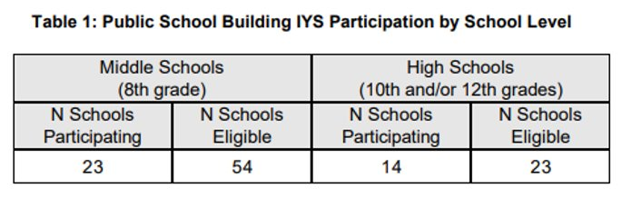
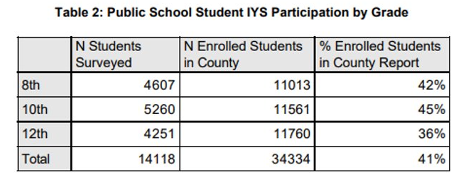
2024 Participation

Slide 6
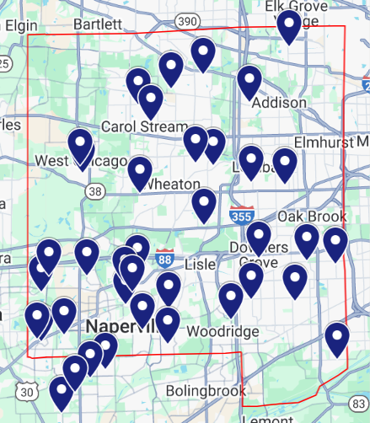
GIS Map

Slide 7
Utilizing the Data
Utilize data to create a Social Norming Marketing Campaign for students and the surrounding community
  Correct false perceptions about peer substance use
  Recognize and validate those making healthy choices
Communicate the data to…
  Parents - provide data & resources on how to talk with their children about the importance of being alcohol, tobacco, and drug-free, as well as the important role that parents play in regards to youth substance use
  Teachers & Coaches - make available for teachers so they may better understand what is going on in their students’/athletes’ lives and include teachers and faculty to help address substance use in their school
    Provide them with resources to give to students, ex. Health Department Health Education presentations, pamphlets, information on substance use
  Other stakeholders in the community
    Many other individuals in the community work with youth that could benefit from IYS information
    Law enforcement, Mayors and Managers, Social Services Agencies, after school programs

Slide 8
Your Local Prevention Partner and Resource
Visit Us!
Follow Us!
Join Us!
www.dupageplt.org
Facebook
@DuPagePLT
Twitter
@PLTDuPage
Instagram
@leaveyourmarkdupage
Monthly Coalition
Meetings
Notes:
There are always seats open at our table and all our welcome to get involved in our mission.
We encourage you to follow us on social media and join our monthly coalition meetings, which you can find on our website.
Alone we can all only do so little, but together we can do so much!

Slide 9

Your Local Prevention Partner & Resource

